Slide 1

Climate Change Vision in Syria
Essam Shahoud
Global & Regional Climate Change

Slide 2
Climate Change Scenarios
Precipitations
Hadley Model A2-CM3 for 2010-2039, 2040-2069 and 2070-2099,
Model Principle :
Simulate changes in temperature and precipitations for 2010-2100, with reference to baseline record values of the 1961-1990
time span
Years | Winter | Spring | Summer | Autumn | Annual
2010-2039 | 3.0 : -12.0 | 3.0 : -8.0 | 4.0 : -4.0 | -4.0 : -16.0 | -2.0 : -40.0
2040-2069 | -6.0 : -22.0 | -3.0 : -22.0 | 4.0 : -6.0 | -4.0 : -28.0 | -20.0 : -60.0
2070-2099 | -16.0 : -34.0 | -6.0 : -38.0 | 14.0 : -12.0 | -6.0 : -40.0 | -6.0 -34.0
Seasonal and Annual Precipitation Variability (in mm) for the Years 2010-2039, 2040-2069 and 2070-2099, compared to Normal Average (1961-1990).

Slide 3
Precipitations
Scenario B2-CM3
Years | Winter | Spring | Summer | Autumn | Annual
2010-2039 | 4.0 : -6.0 | 4.0 : -10.0 | 8.0 : -8.0 | -4.0 : -20.0 | -8.0 : -44.0
2040-2069 | -11.0 : -18.0 | 7.0 : -7.0 | 9.0 : -5.0 | -3.0 : -17.0 | -8.0 : -49.0
2070-2099 | -12.0 : -18.0 | -6.0 : -28.0 | 10.0 : -12.0 | -2.0 : -28.0 | -25.0 : -75.0

Slide 4
Temperature
A2 Scenario
Years | Winter | Spring | Summer | Autumn | Annual
2010-2039 | 0.8-1.0 | 0.7-1.1 | 1.2-1.9 | 1.1-1.7 | 0.9-1.4
2040-2069 | 1.8-2.2 | 1.8-2.6 | 2.6-4.4 | 2.2-3.0 | 2.1-3.0
2070-2099 | 3.3-4.1 | 3.3-4.7 | 4.4-7.0 | 3.9-5.0 | 2.1-3.0

Slide 5
Temperature
B2 Scenario
Years | Winter | Spring | Summer | Autumn | Annual
2010-2039 | 1.0-1.3 | 0.8-1.2 | 1.1-2.5 | 1.2-1.8 | 1.1-1.7
2040-2069 | 1.5-1.9 | 1.1-1.8 | 2.1-3.6 | 1.7-2.1 | 1.6-2.4
2070-2099 | 2.5-2.8 | 2.4-3.2 | 3.4-5.1 | 1.7-2.1 | 2.8-3.8

Slide 6
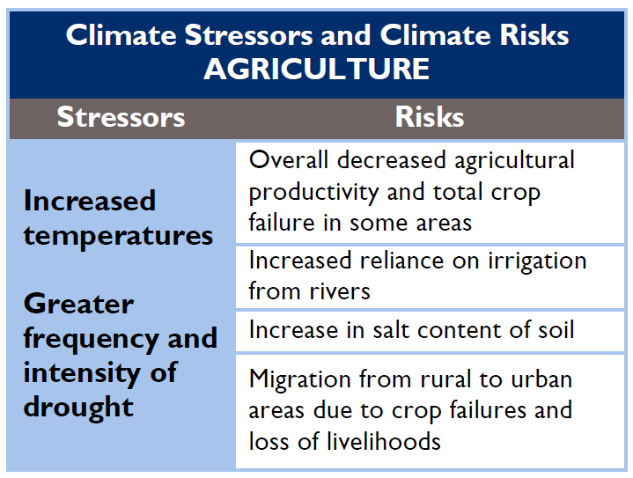
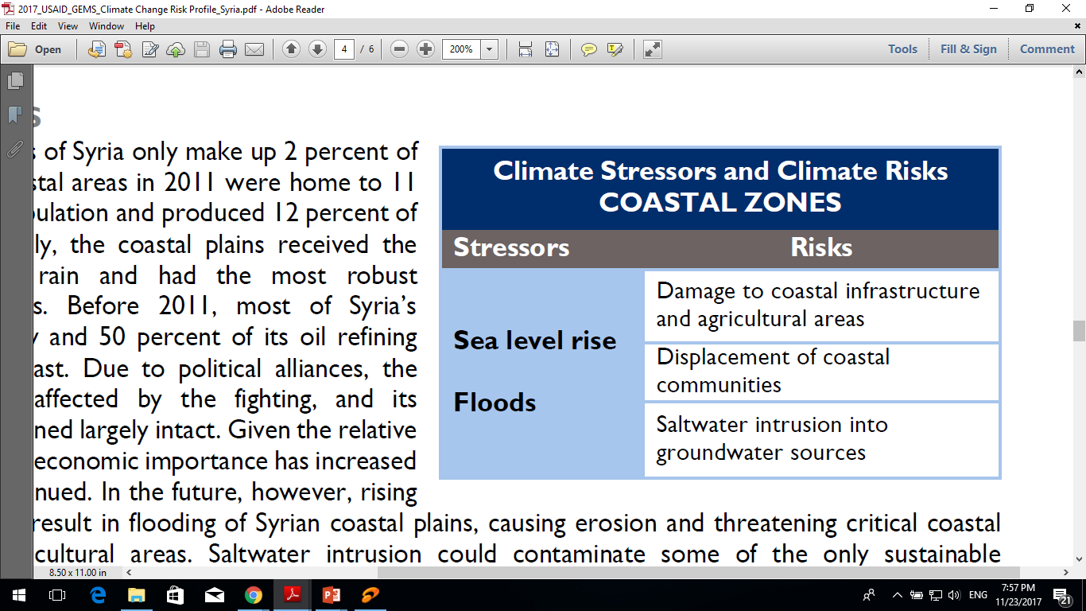
IMPACTS OF CLIMATE CHANGE
IN SYRIA

Slide 7
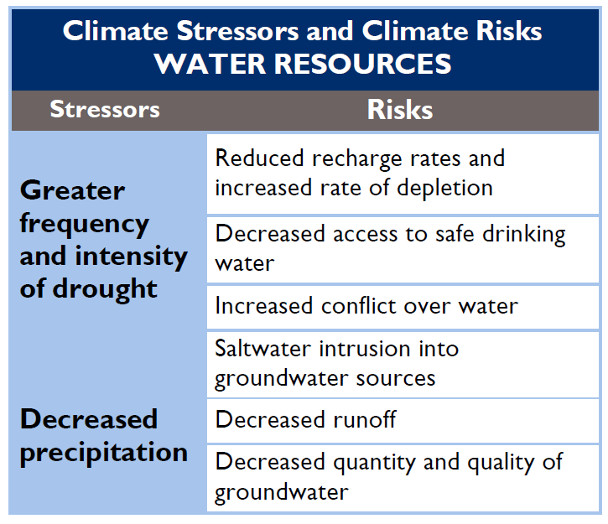
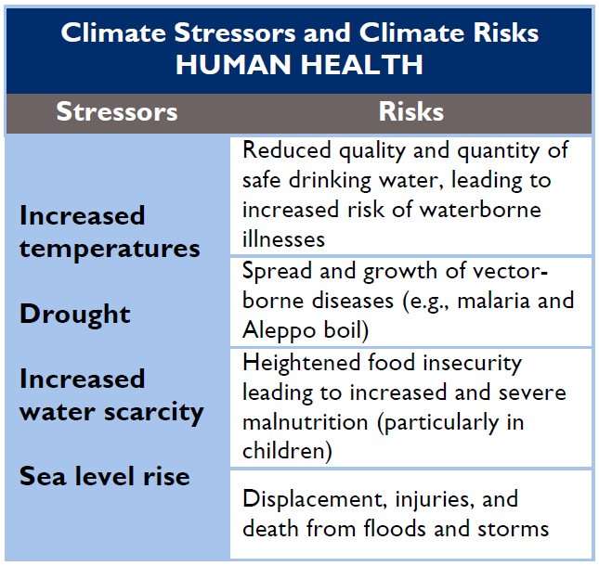
IMPACTS OF CLIMATE CHANGE IN SYRIA

Slide 8
HISTORICAL CLIMATE | FUTURE CLIMATE
Increased mean annual temperature at a rate of 0.8°C per century since the 1950s. | Increase in mean annual temperatures by 2°C by 2050.
Decreased mean rainfall of 18.23 mm per month per century. | Decrease in precipitation by 11 percent by 2050. Decrease in runoff by 25-27 percent.
Increased autumn average monthly precipitation in the northern and central areas. | Increase in the number of consecutive dry days by 5, and decrease in annual frost days by 13.
Increased frequency, length, and intensity of droughts. Frequent heat waves during the spring and summer, resulting in temperature increases of 8-10°C above average. | Increase in frequency of dust storms and coastal flooding.

Slide 9
References
Ministry of State for Environment Affairs. 2010. Initial National Communication of the Syrian Arab Republic. http://unfccc.int/resource/docs/natc/syrnc1.pdf
AQUASTAT. 2008. “Syrian Arab Republic.” Irrigation in the Middle East Region in Figures. http://www.fao.org/nr/water/aquastat/countries_regions/syr/SYR-CP_eng.pdf
Kelley, Colin P. 2015. “Climate Change in the Fertile Crescent and Implications of the Recent Syrian Drought.” PNAS. http://www.pnas.org/content/112/11/3241.full.pdf?with-ds=yes
National Report of the Syrian Arab Republic to the United Nations Conference on Sustainable Development (2012)
2017_USAID_GEMS_Climate Change Risk Profile Syria

Slide 10
Thank you

