Slide 1
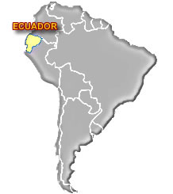
Climate Change in Ecuador
Global an regional climate change (aa2n1150e)
Cristina Silva Cisneros

Slide 2
Change in the statistical distribution of weather patterns when that change lasts for an extended period of time
Ecuador (equatorial line)
3 Different regions
Ecuador is a highly vulnerable country to impacts of climate change
High vulnerability of sector such as: health, agriculture, energy, water resources, species, etc.
RCM (Regional Climate Model)

Slide 3
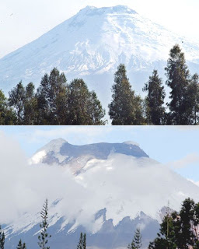
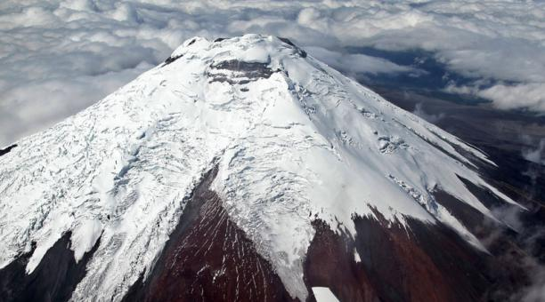
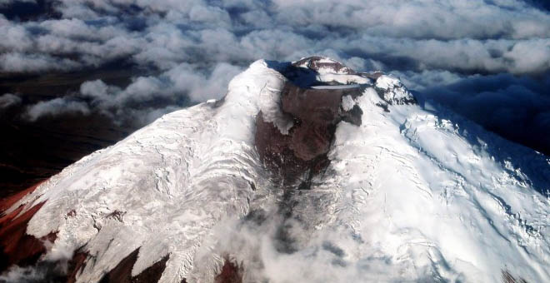
WATER RESOURSE
Principal source of water are paramo (a high treeless plateau in tropical South America) and glacier mountain.
Antisana Lost 23%
Cotopaxi Lost 44%

Slide 4
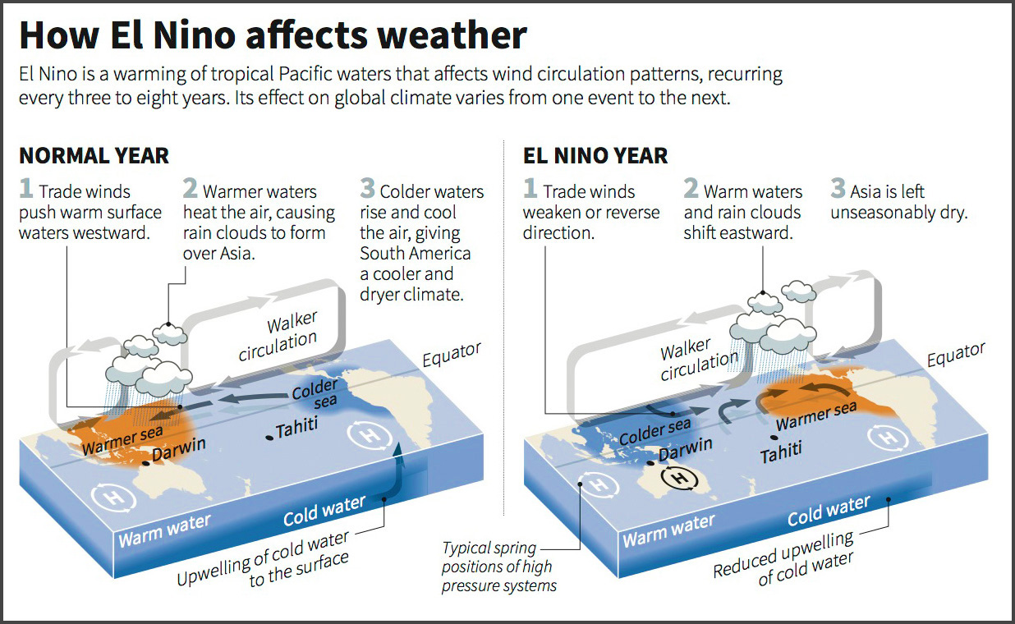
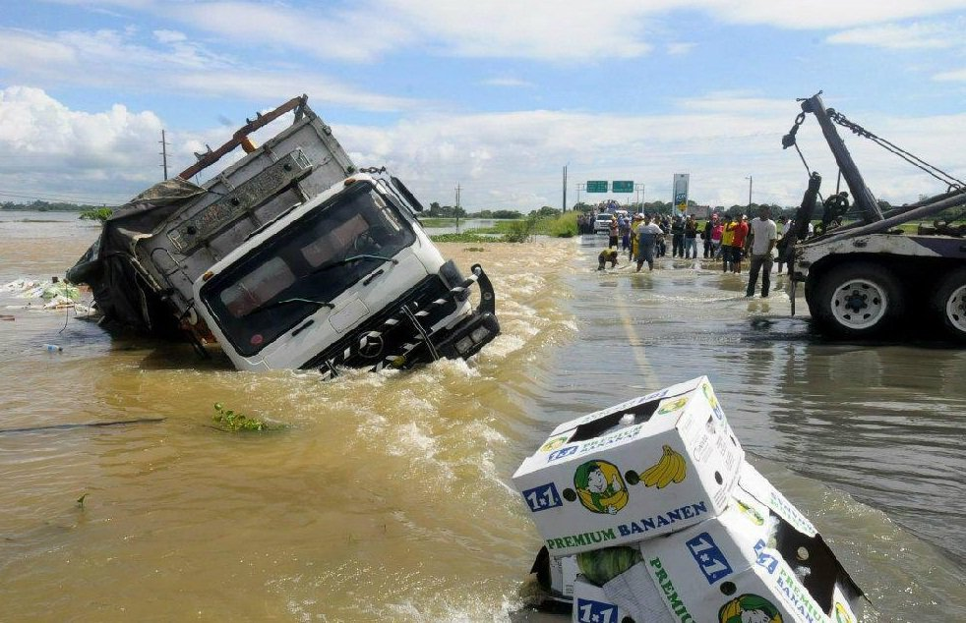
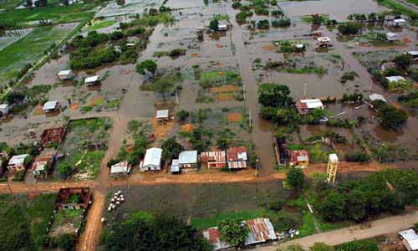
Precipitation patterns are highly variable over 3000mm on the outer Amazonian slopes to less than 500mm in the interandean valley and the south-west Paciﬁc slopes. El Niño events 1982-83 and 1997-98 effects of climate variability in the country. Pacific water that affects wind circulation patterns, 3-8 years, variable

Slide 5
Higher temperatures are likely to increase evapotranspiration and therefore the atmospheric water vapour content.
Changes in large-scale precipitation patterns and the frequency of extreme events
Affect various types of water resources, streamﬂow, and groundwater storage

Slide 6
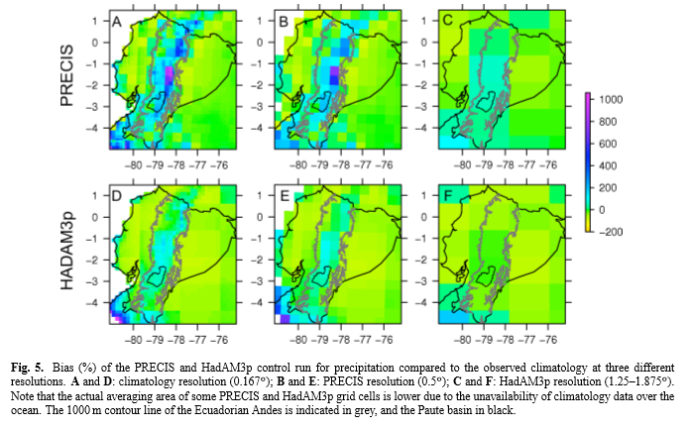
PRECIS is able to simulate total precipitation better over the Amazon basin
A,C explained correct observation of precipitation (1978 to 1991)
2070– 2099. Using the average of the entire IPCC ensemble, an increase in precipitation of around 7.5–10%
Temperature increase 3°C

Slide 7
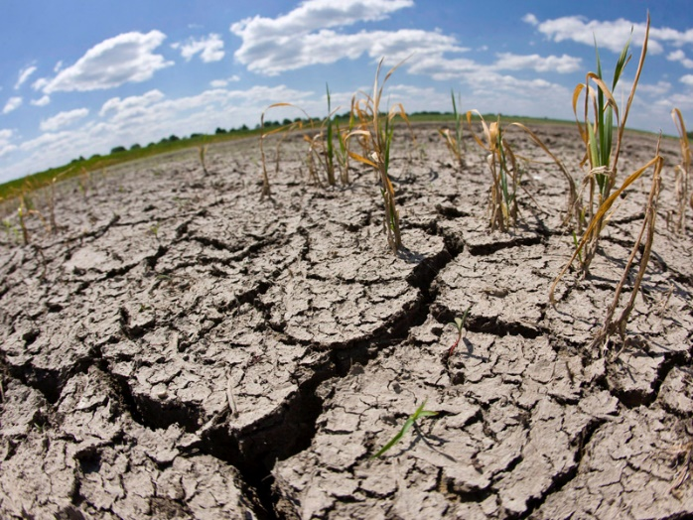
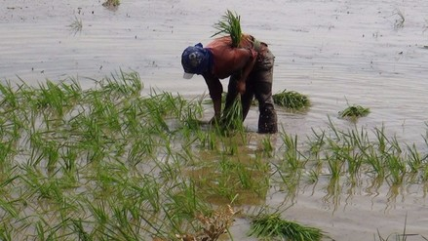
AGRICULTURE
Agriculture is highly vulnerable to weather variability.
Prolonged droughts, floods and the increase of pests are the result of extreme climates
Precipitation that diminishes in some areas and increases in others/ Erosion.
The effects by climate change is the reduction of the nutritional properties of some foods (rice)
Land use change and forestry are the largest contributors to GHG emissions in the country.

Slide 8
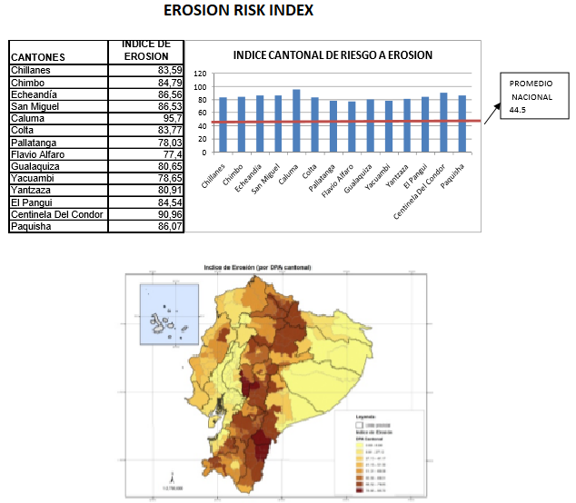
A2: Lower economic dynamism, less globalization and high and sustained population growth
B2: Level of mitigation of emissions through the efficient use of energy and technological improvements
2020 to 2030
PRECIS-ECHAM ("Poverty levels by NBI", “I. ethnic", “I. erosion", “ I. ΔTemp", “ I. Δrainfall“)

Slide 9
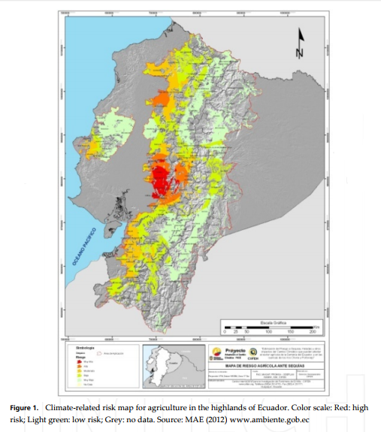
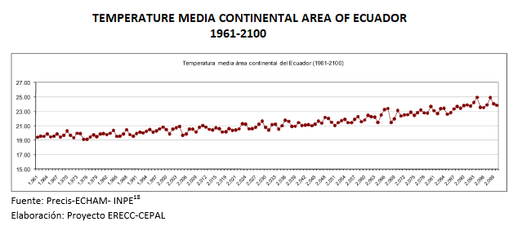
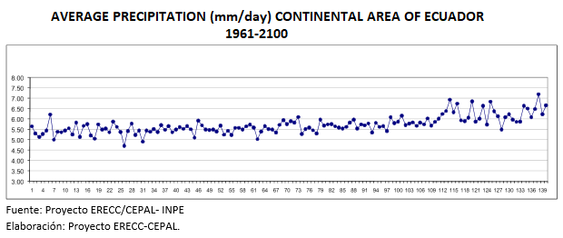

Slide 10
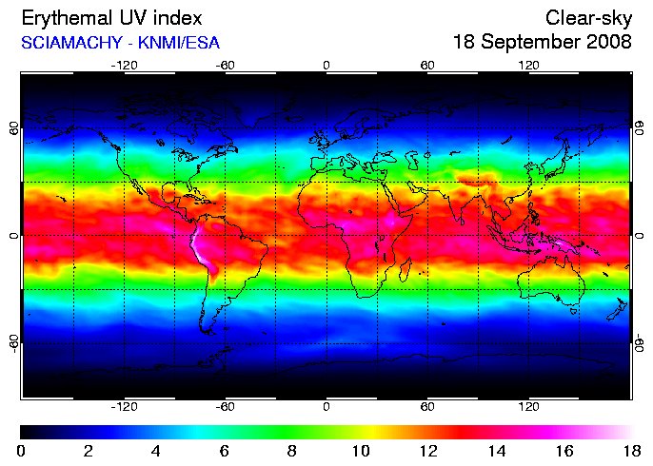
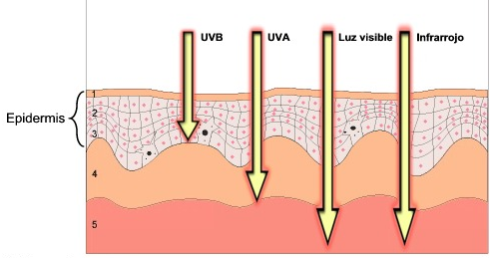
PUBLIC HEALTH
Climate change may increase UV radiation levels at ground by affecting the expected recovery of the stratospheric ozone depletion.
Quito and the interandean region (2800-3000 meters), are exposed to UV levels about 40% higher than those in low-land regions.
October 2017, UV 11-14 at 10 am to 4 pm.

Slide 11
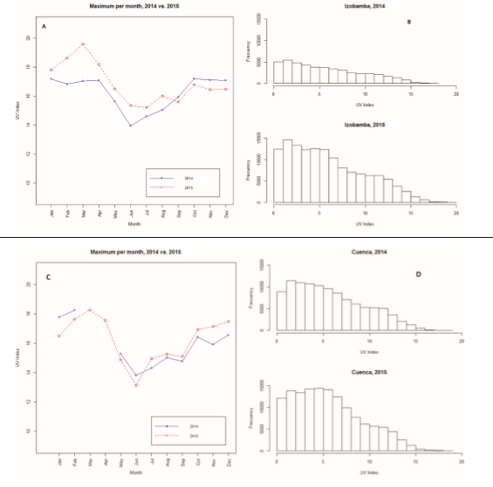
INAMHI (2014 and 2015). Meteorological station recording UV and ozone data.
Izobamba (Jan.-Aug.= 0.5 to 2.5), Cuenca (Jul.-Nov.=18,25).
Considering the present and predicted increases in global air pollution and temperature, climate change might aggravate the exposure to hot weather and UV radiation in the coming years.
Agricultural workers in Ecuador and worldwide exposed to UV radiation and hot temperatures are at higher risk for morbidity and mortality.

Slide 12
Strategy National of Climate Change in Ecuador – ENCC (2012-2025)
SECTORS | SUBSECTORS
Energy | Fuel burning activities
 | Fuel emissions
 | Transport and storage of CO2
Industrial processes and use of products | Mining industry
 | Metallurgical industry
 | Electronic industry
 | Manufacture
Agriculture, Silviculture and other use of the land | Animal breeding
 | Soil
Waste | Management of solid waste
 | Biological treatment of solid waste
 | Incineration and burning of waste
 | Treatment and discharge of wastewater
Others | Indirect emissions of NO2, NOx and NH3
Source: Priority sectors for mitigation, IPCC, 2006

Slide 13
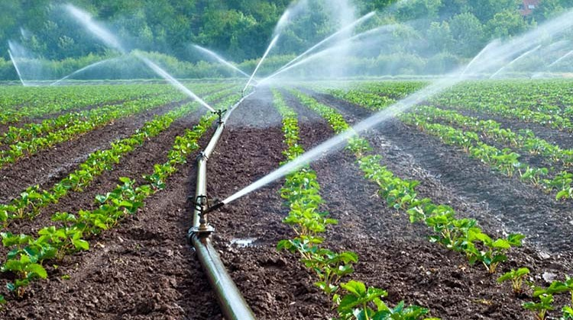
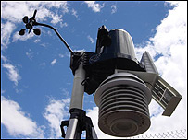
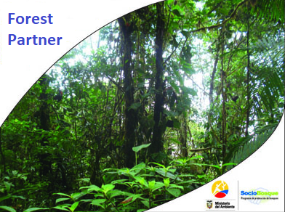
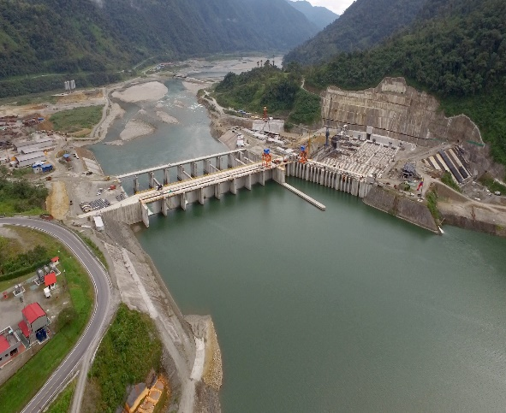
Strategic line: Adaptation to climate change
Create the capacity of social, economic and environmental systems to face the impacts of climate change.
Implement measures that guarantee food safety against the impacts of climate change.
Implement prevention measures to protect human health from the impacts of climate change.
Manage the water heritage with a comprehensive approach and integrated by the Hydrographic Unit, to ensure the availability, sustainable use and quality of the water resource for different human and natural uses, against the impacts of climate change.

Slide 14
Conclusions
Ecuador is a region very vulnerable to climate change, mainly due to its geographical location.
It is necessary to promote the research and development of mathematical models that allow understanding the flow of climatic factors in Ecuador, for adaptation to climate change
The implementation of environmental public policies help reduce greenhouse gas emissions.

Slide 15
Bibliography
Buytaert, W., Vuille, M., Dewulf, A., Urrutia, R., Karmalkar, A., & C´elleri, R. (2010). Uncertainties in climate change projections and regional downscaling in the tropical Andes: implications for water resources management. Hydrology and Earth System Sciences, 1247–1258.
EL COMERCIO. (10 de Octubre de 2015). Planeta . Available http://especiales.elcomercio.com/planeta-ideas/planeta/11-octubre-del-2015/el-cambio-climatico-amenaza-a-la-agricultura
Harari, R., Piñeiros, J., Ayabaca, M., & Harari, F. (2016). Climate change and agricultural workers’ health in Ecuador: occupational exposure to UV radiation and hot environments. Ann Ist Super Sanità , 368-373 .
Jiménez, S., Castro, L., Yépez, J., & Wittmer, C. (2012). Impacto del cambio climático en la agricultura de subsistencia en el Ecuador . Madrid: CeALCI- Fundación Carolina .
MAE. (2012). Estrategia Nacional de Cambio Climatico en Ecuador . Quito: Ministerio del Ambienre .
Martínez, R., Hemming, D., Malone, L., Bermudez, N., Cockfield, G., Diongue, A., . . . Zougmoré, R. (2012). Improving Climate Risk Management at Local Level – Techniques, Case Studies, Good Practices and Guidelines for World Meteorological Organization Members . INTECH.

Slide 16
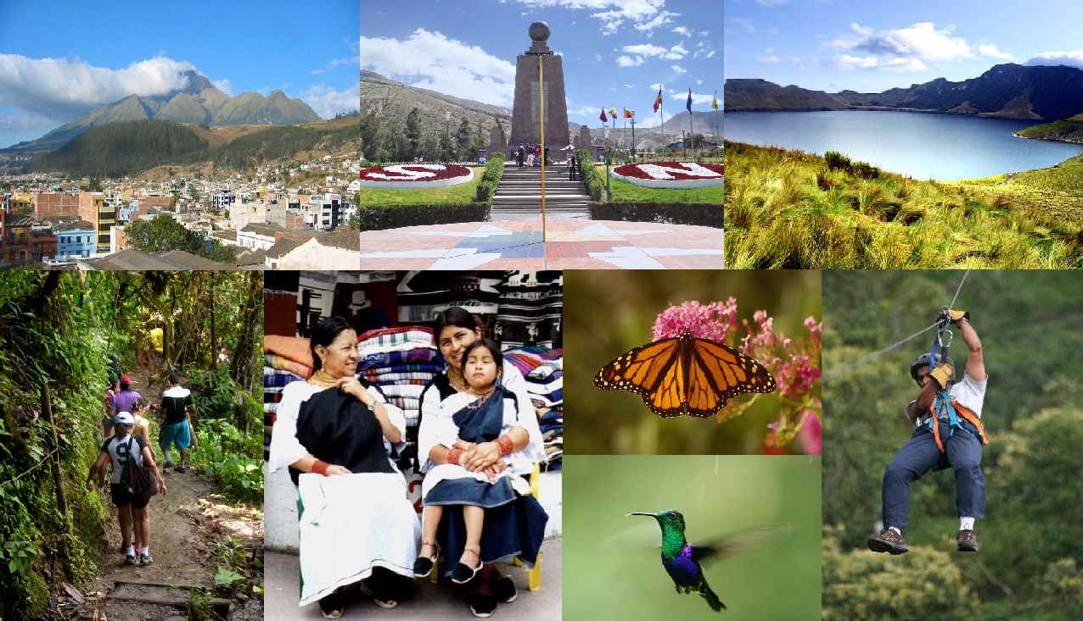
THANK YOU

