Slide 1
Climate of the Republic of Kazakhstan. The influence of global climate change on the region.
Climate change
Manakbayeva Sabina
Environmental Science MSc

Slide 2
Outline
General information
Climate of Eastern and Western Part of the country
Affect of climate change on Kazakhstan region
Predictions of climate change in the region
National Policy for adapting to Climate Change
References

Slide 3
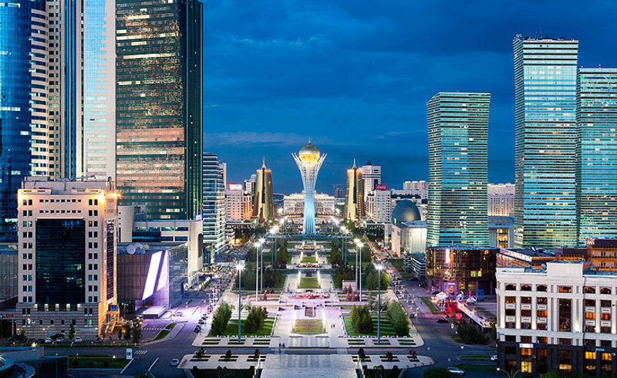
I. General information
S ~ 2,72 mln km2 (TOP 10 biggest country, 9th place);
Population ~ 17 mln ( 5.6 people on 1 square km);
Astana – one of the coldest capital in the world ( absolute min -51,5 C on 5 January 1893)

Slide 4
A landlocked country, located at the
center of the Eurasian continent.
The arid zone, represented by steppe (vast territory in the north of the
country), semidesert (arid steppes occupying central Kazakhstan), and desert landscapes (occupying
most of the country’s plain).

Slide 5
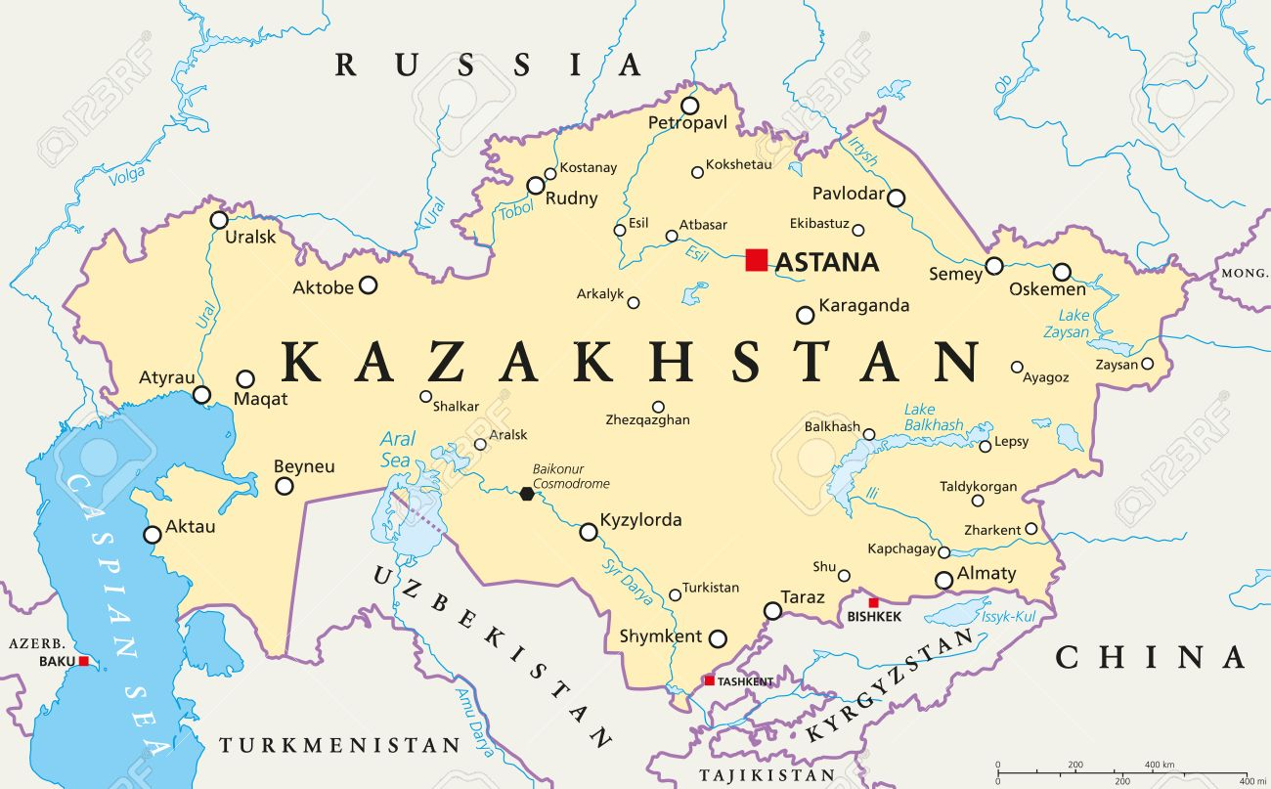
N
1700 km
S
W
E
3000 km

Slide 6
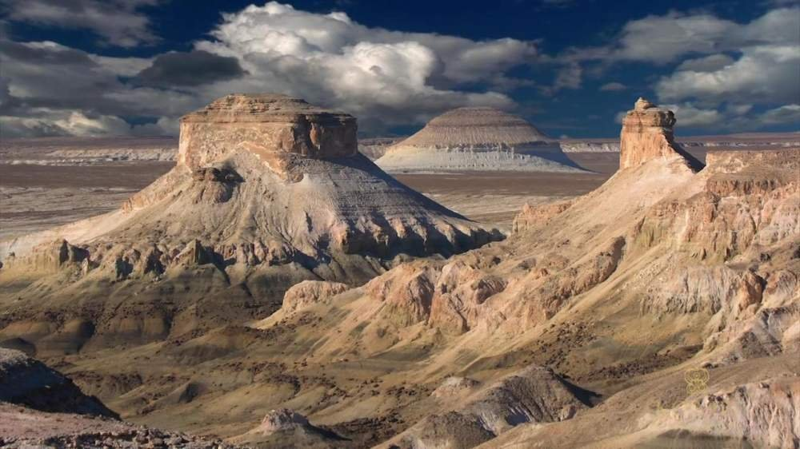
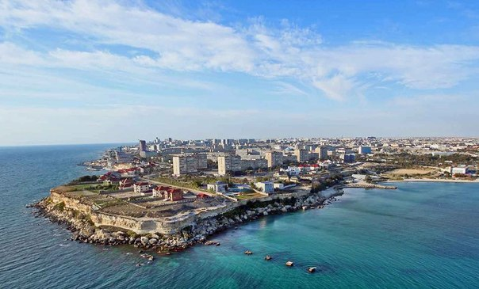
II. Climate of Western Kazakhstan Region (Batıs Qazaqstan oblısı)
Eastern Part of Europe (borders Russia and Ural Mountains; Ural river flows through this region)
Caspian Sea bounded by Kazakhstan to the northeast
*Ustyurt Plateau
*Aktau city, Caspian Sea

Slide 7
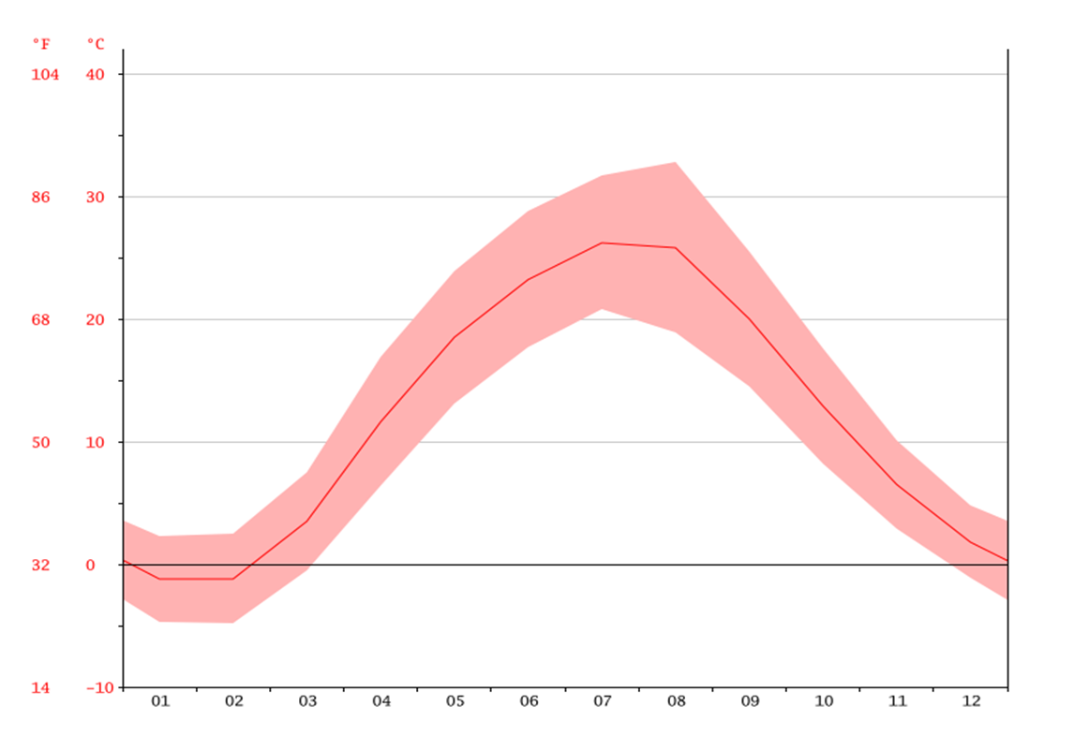
Aktau city
Average winter temperature : -2 C
Average summer temperature: + 22 С
Annual precipitation – 182 mm
Koppen classificaition : Dfa climate

Slide 8
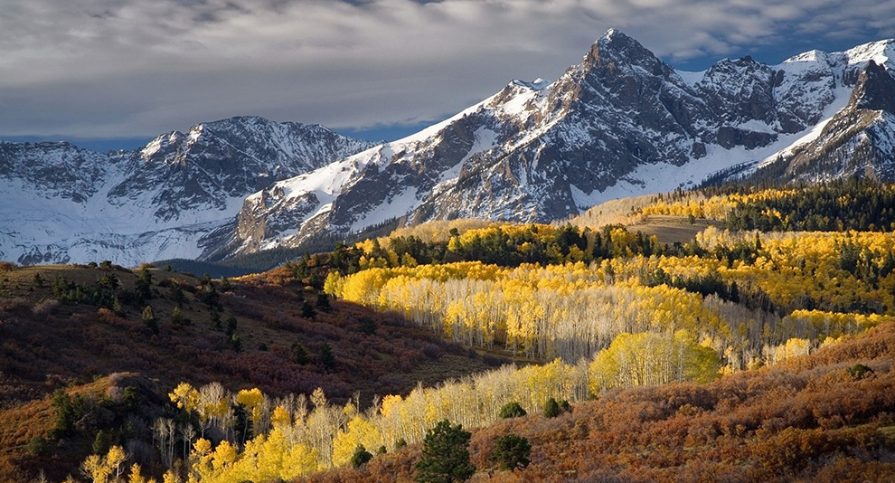
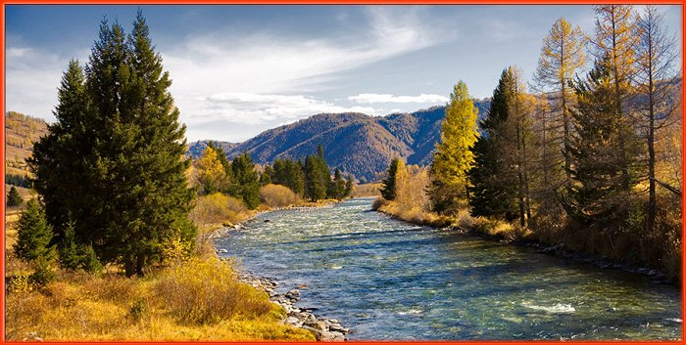
Climate of Eastern Kazakhstan Region (Shyghys Qazaqstan oblısı)
East Kazakhstan is one of the coldest regions in Kazakhstan
A very diverse range of geographic and climatic regions with the Altai Mountains, Russian Siberia and the eastern margins of the Kazakh steppes

Slide 9
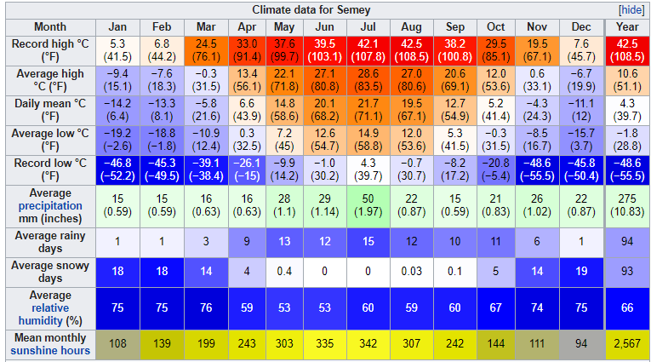
Semey city
Average winter temperature : -18 C ( Record low -46 )
Average summer temperature: + 27,5 С (Record high +42 C )
Annual precipitation – 275 mm
Koppen classif: Dfb

Slide 10
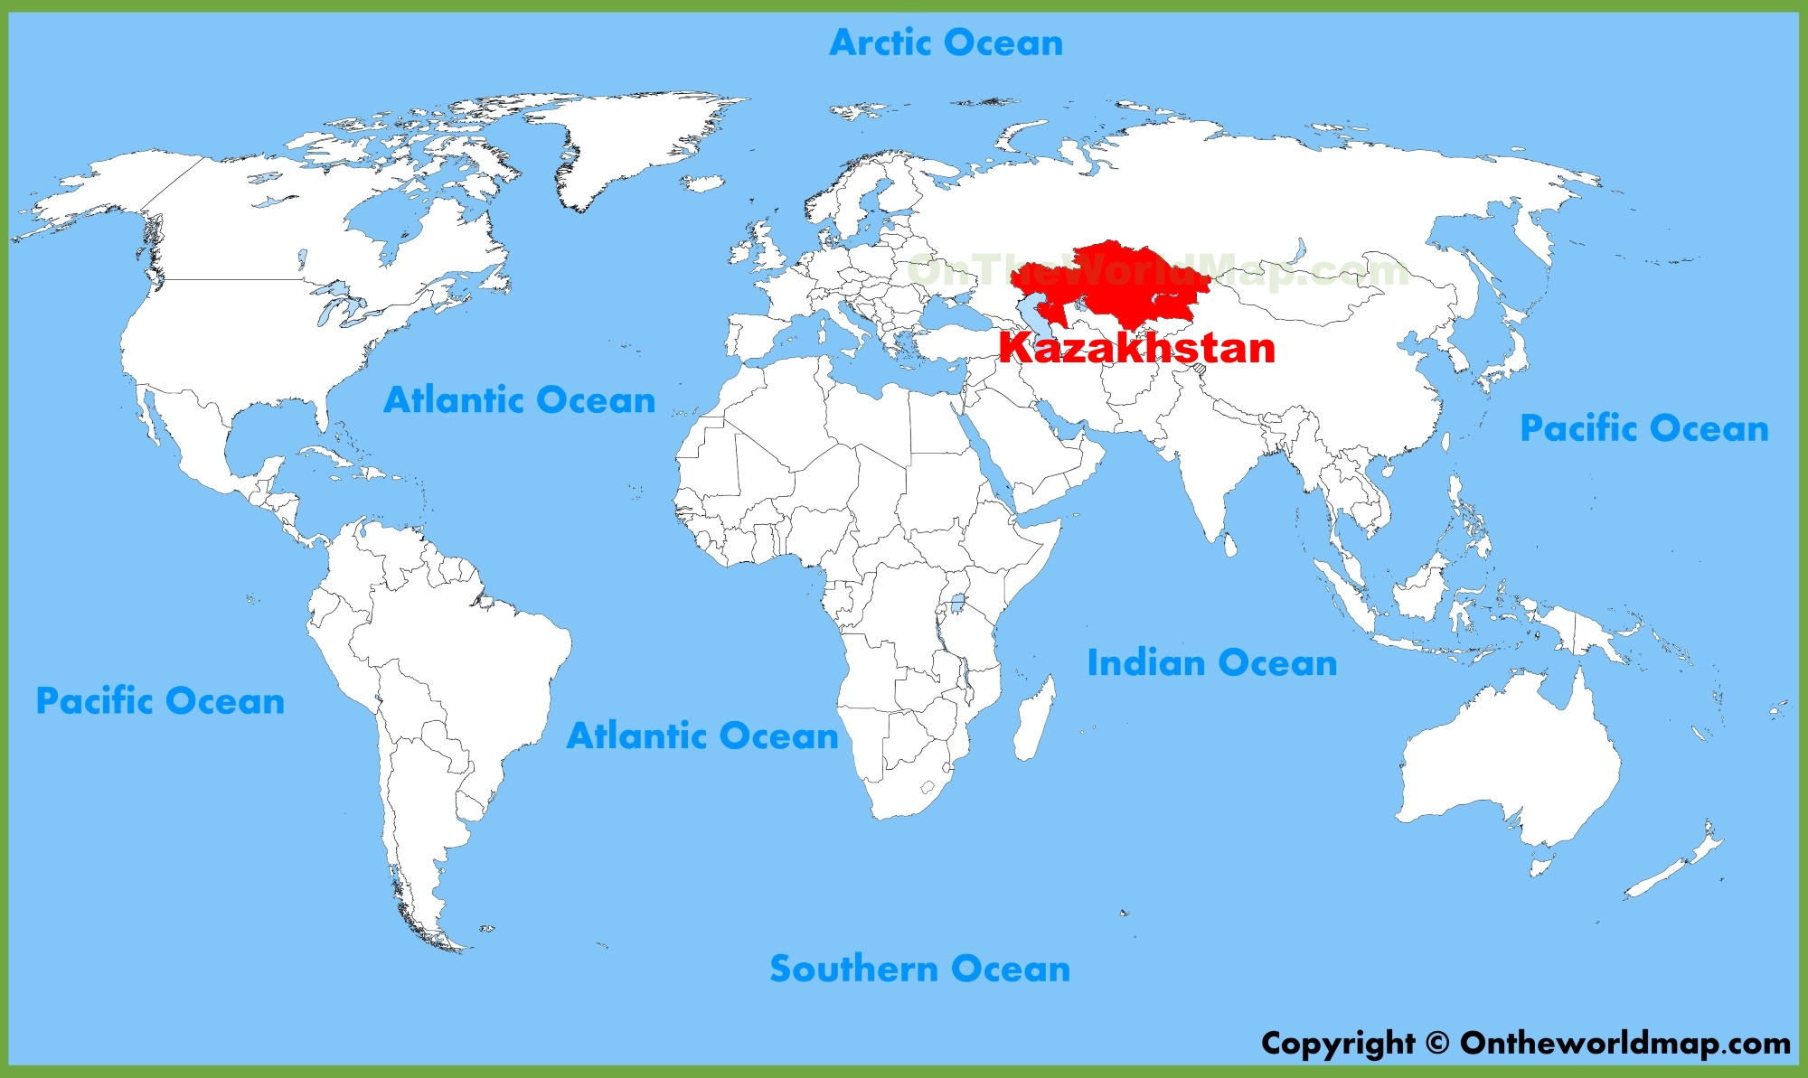
III. Affect of climate change on Kazakhstan region
The territory of Kazakhstan is located in the center of the Eurasian continent, and it is removed from the ocean by a considerable distance (2000 – 3000 km).
The territory is warming more dramatically
than the northern hemisphere and the globe on
average. There is a difference in the list of
the warmest years in the whole of the globe
and in Kazakhstan.

Slide 11
The ranked 10 warmest years for Kazakhstan
Rank | Year | Annual average temperature anomaly for Kazakhstan, C
1 | 2013 | 1,60
2 | 1983 | 1,76
3 | 2015 | 1,66
4 | 2002 | 1,53
5 | 2004 | 1,54
6 | 2007 | 1,48
7 | 1995 | 1,41
8 | 2008 | 1,38
9 | 1997 | 1,26
10 | 2006 | 1,19

Slide 12
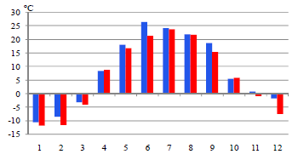
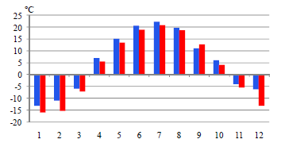
Average monthly air temperature in 2015 and climate normal averaged for the period 1961 – 1990 over the territory of Kazakhstan and its regions.
The air temperature in 2015 exceeded the norm almost the entire territory of Kazakhstan
and was below the norm in the West Kazakhstan.
West Kazakhstan
2015
East Kazakhstan
1961-1990

Slide 13
Predictions of climate change in Kazakhstan
Winter and summer temperatures have been increasing a little slower by 0.28 ºC and 0.19 ºC every 10 years respectively.
Temperature increase in Kazakhstan is projected to continue and median scenarios forecast a rise in the average mean annual temperature of 1.4°С by 2030, 2.7°С by 2050, and 4.6°С by 2085.
However, in most part of Kazakhstan, trends in extremes were insignificant, with the exception of some meteorological stations in different regions, where the daily maximum temperature increased by 0.20 – 0.60 ºС.
The annual precipitation amount decrease slightly by 0.2 mm every 10 years

Slide 14
V. National Policy for adapting to Climate Change
1. Kazakhstan 2050 Strategy
A focus on the energy sector and a recognition that the country must develop alternative energy sources (notably solar and wind power) with the goal that must account for at least half of the alternative and renewable energy sources country’s total energy consumption.
2. The Green Economy Concept for the Republic of Kazakhstan (2013-2020)
Developing hydrometeorological services, developing sustainable and high-efficiency agriculture, Improving Waste Management System and etc.
3. The “Green Bridge” Partnership Program on the implementation of the Astana Initiative for 2011–2020 aims to promote partnership between Europe, Asia, and the Pacific .

Slide 15
VI.References
Republican State Enterprise, “Kazhydromet”, ANNUAL BULLETIN OF CLIMATE CHANGE MONITORING IN KAZAKHSTAN, 2015 ( 2016,2017)
Second National Communication of the Republic of Kazakhstan to the UNFCCC, 2009.
https://www.worlddata.info/asia/kazakhstan/climate-east-kazakhstan.php
https://www.advantour.com/kazakhstan/western.htm
https://kazhydromet.kz/

Slide 16
Thanks for your attention!

