Slide 1
Climate in Brazil: present and perspective for the future
Aa2n1150e - Global and regional climate change
Patrícia Schnepper Gans

Slide 2
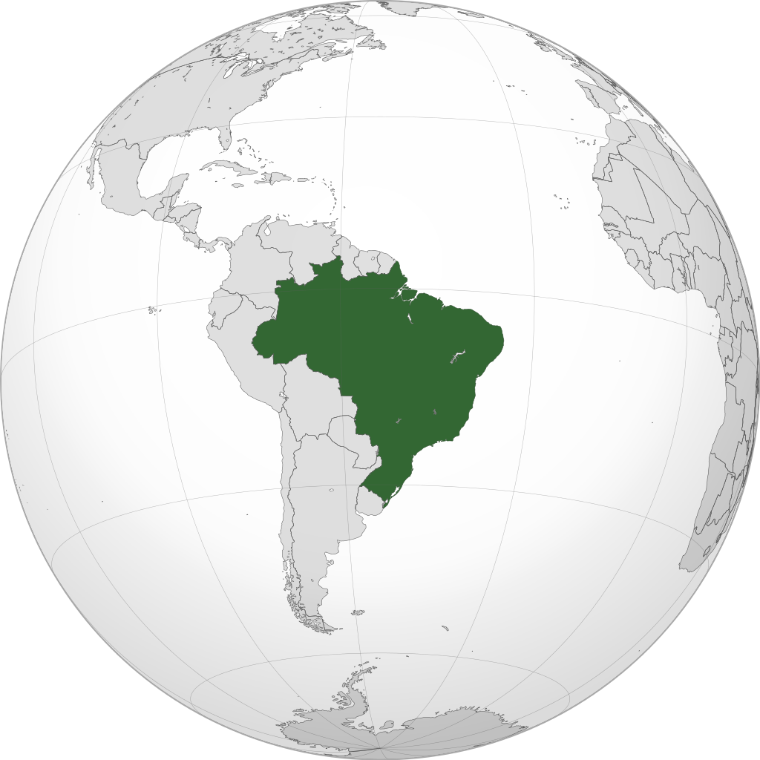
Climate in Brazil
Biomes : Atlantic Forest
Present Climate
Perspective for the future: temperature and precipitation
Perspective for the future: atlantic forest
Conclusion

Slide 3
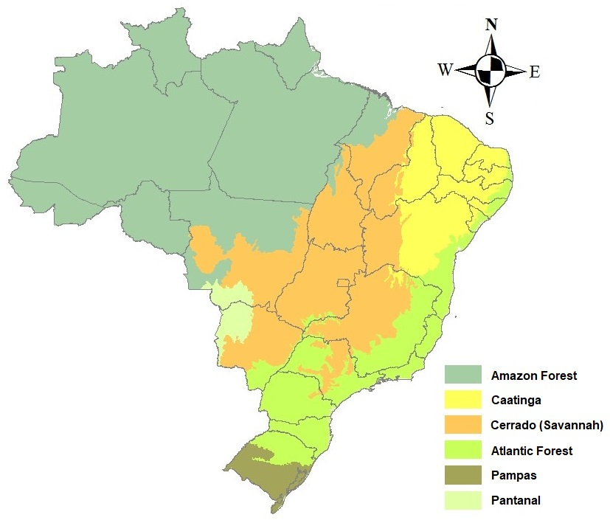
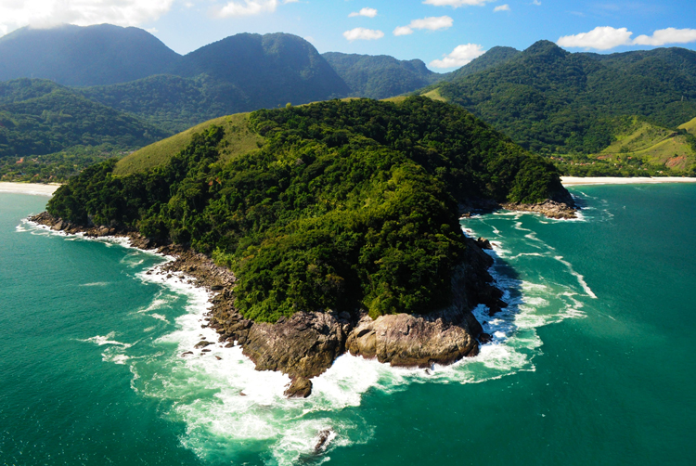
Biomes
Extends along the Atlantic coast of Brazil and inland as far as Paraguay and Argentina

Slide 4
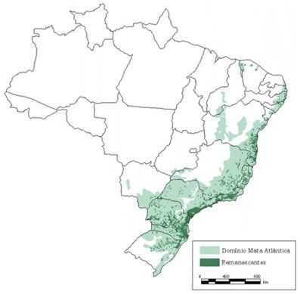
Atlantic Forest
Although it is just a small fraction of the size of the g Amazon rainforest, the Atlantic Forest still harbors of a range of biological diversity similar to that of the Amazon
Over 52% of its tree species, 40% of its vertebrates and 92% of the amphibians are endemic to this area
Today it accounts for 70% of Brazil’s population,
including cities like Rio de Janeiro and São Paulo
More than 85% of this forest has been cleared and
what remains is highly fragmented
Less than 2% of the whole biome is under protected
status

Slide 5
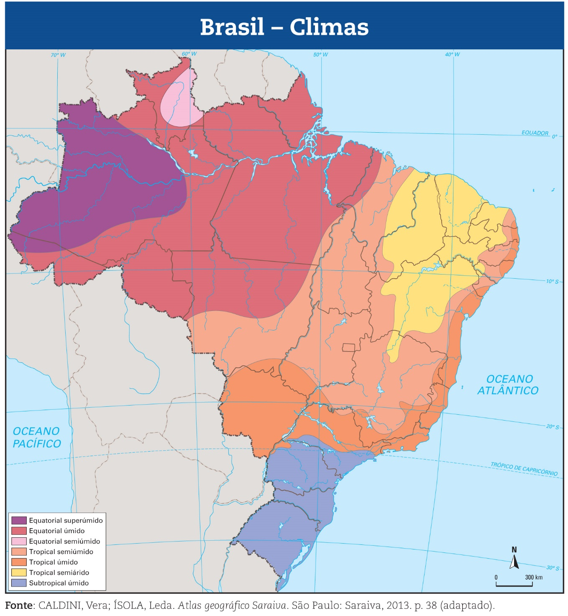
Present climate
The predominant climate Atlantic forest is the humid tropical with high temperatures and abundant rains without drought periods

Slide 6
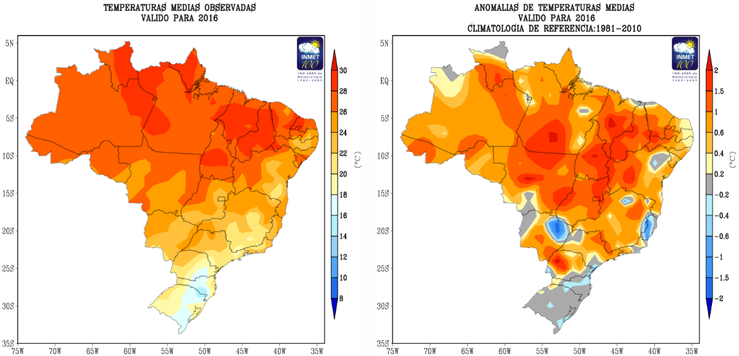
Average temperature in 2016
Temperature anomalies compared to the period 1961-2010
National Institute of Meteorology (www.inmet.gov.br/portal)

Slide 7
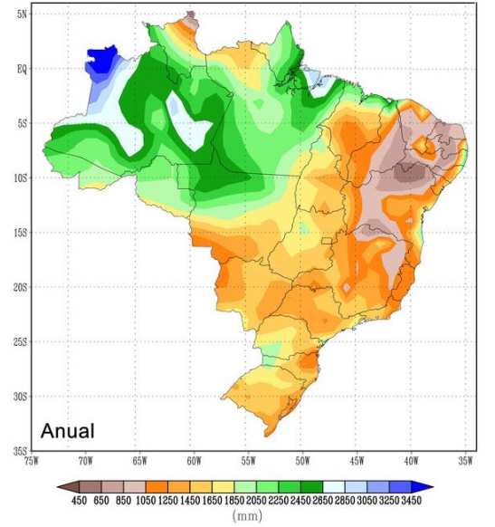
Map of average annual precipitation (mm) between 1961-1990
www.inmet.gov.br/portal

Slide 8
Perspective for the future
Climate change and possible changes in the biomes of South America (NOBRE et al., 2007)
Different models and scenarios
Period of 2071-2100
The analyzes show larger differences in precipitation and temperature anomalies between the different models than between the different scenarios for the same model
The expected warming for South America varies from 1° to 4° C

Slide 9
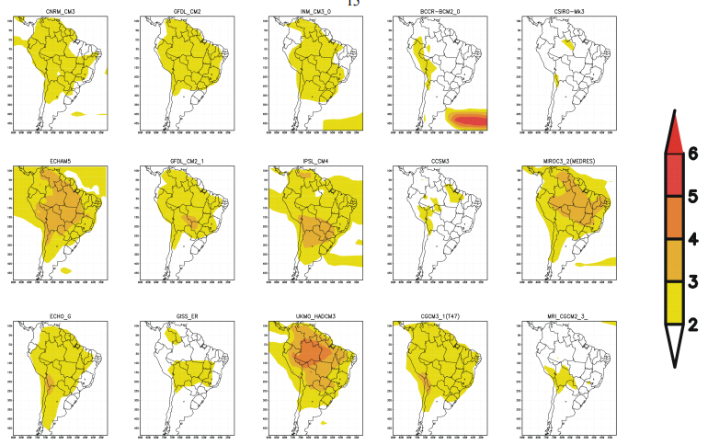
Temperature anomaly projections (°C) for South America for the period of 2071-2100 based on the period 1961-1990

Slide 10
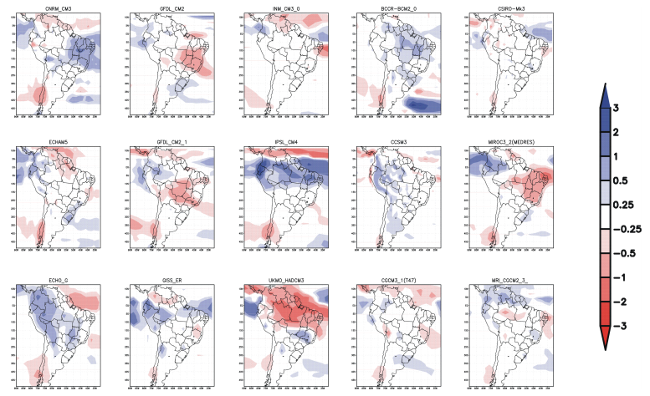
Precipitation anomaly projections (mm/day) for South America for the 2071-2100 based on the period 1961-1990

Slide 11
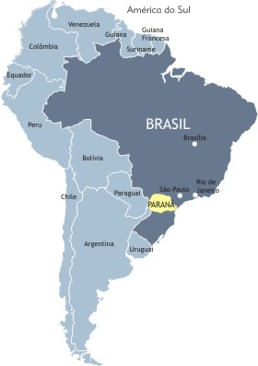
Perspective for the future
Vulnerability of biomes to climate change: the case of the Atlantic Forest in the state of Paraná (VIANA, 2015)
Prediction for 2050 and 2070
Models for various scenarios
Potential vegetation model Climate change model
Vulnerability of reminiscent vegetation to climate change

Slide 12
Percentage of relevance of each variable to obtain results
Annual average temperature 90%
Average temperature of the coldest quarter 90%
Average daily temperature range 70%
Isothermality 70%
Average temperature of the hottest quarter 70%
Precipitation Seasonality 70%
Precipitation of the driest month 50%
Texture 50%
Maximum temperature of the hottest month 40%
Minimum temperature of the coldest month 40%
Mean temperature of the driest quarter 40%
Rainiest month precipitation 40%
Precipitation of the coldest quarter 10%

Slide 13
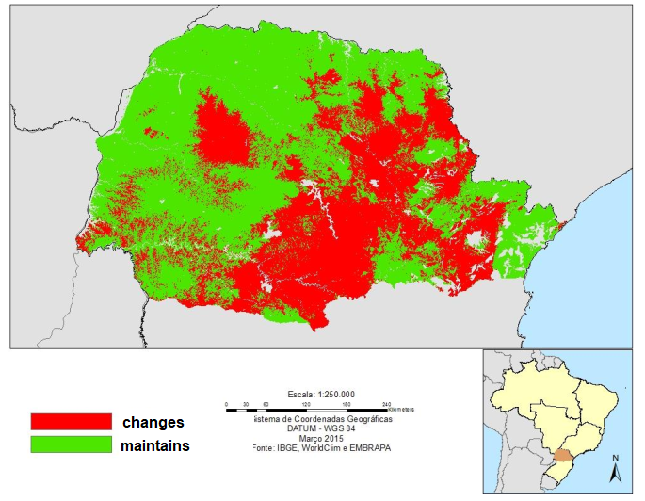
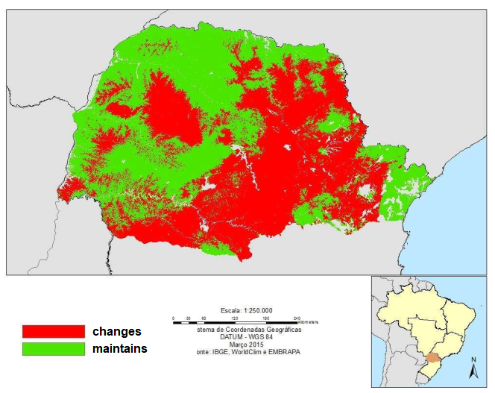
Prediction of vegetation change
2050 2070

Slide 14
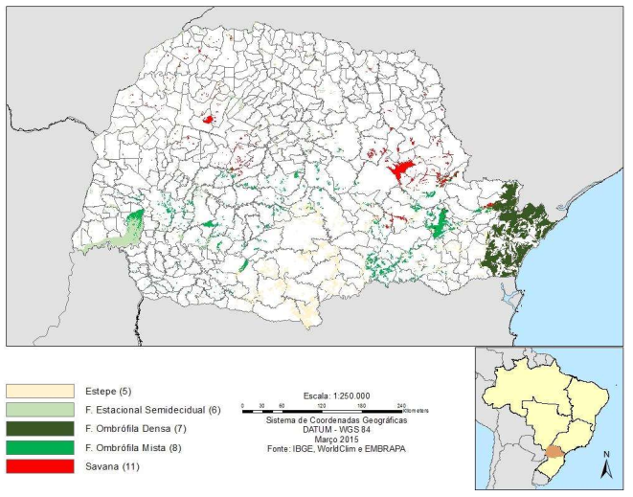
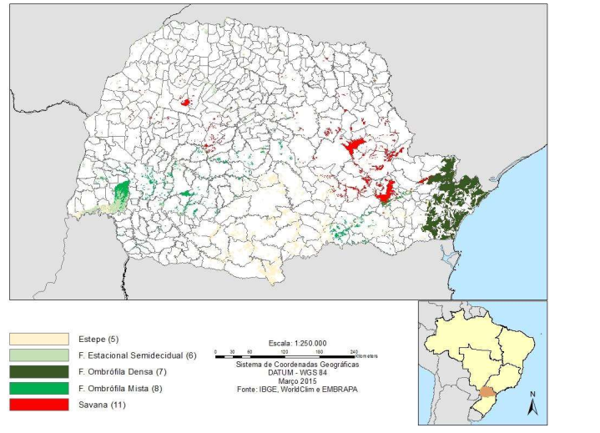
Prediction of vegetation classes
2050 2070

Slide 15
Conclusion
Climatic changes have an impact on natural ecosystems, which have impacts on biodiversity, agriculture, water resources, etc
The future of biome distribution in Brazil could be affected by combining impacts of climate change and land use change

