Slide 1
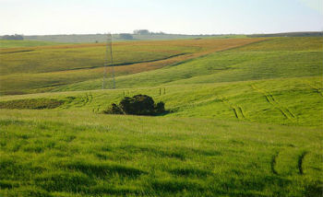
Climate and Climate change of Brazilian Pampas Region
Vinicius Deganutti de Barros

Slide 2
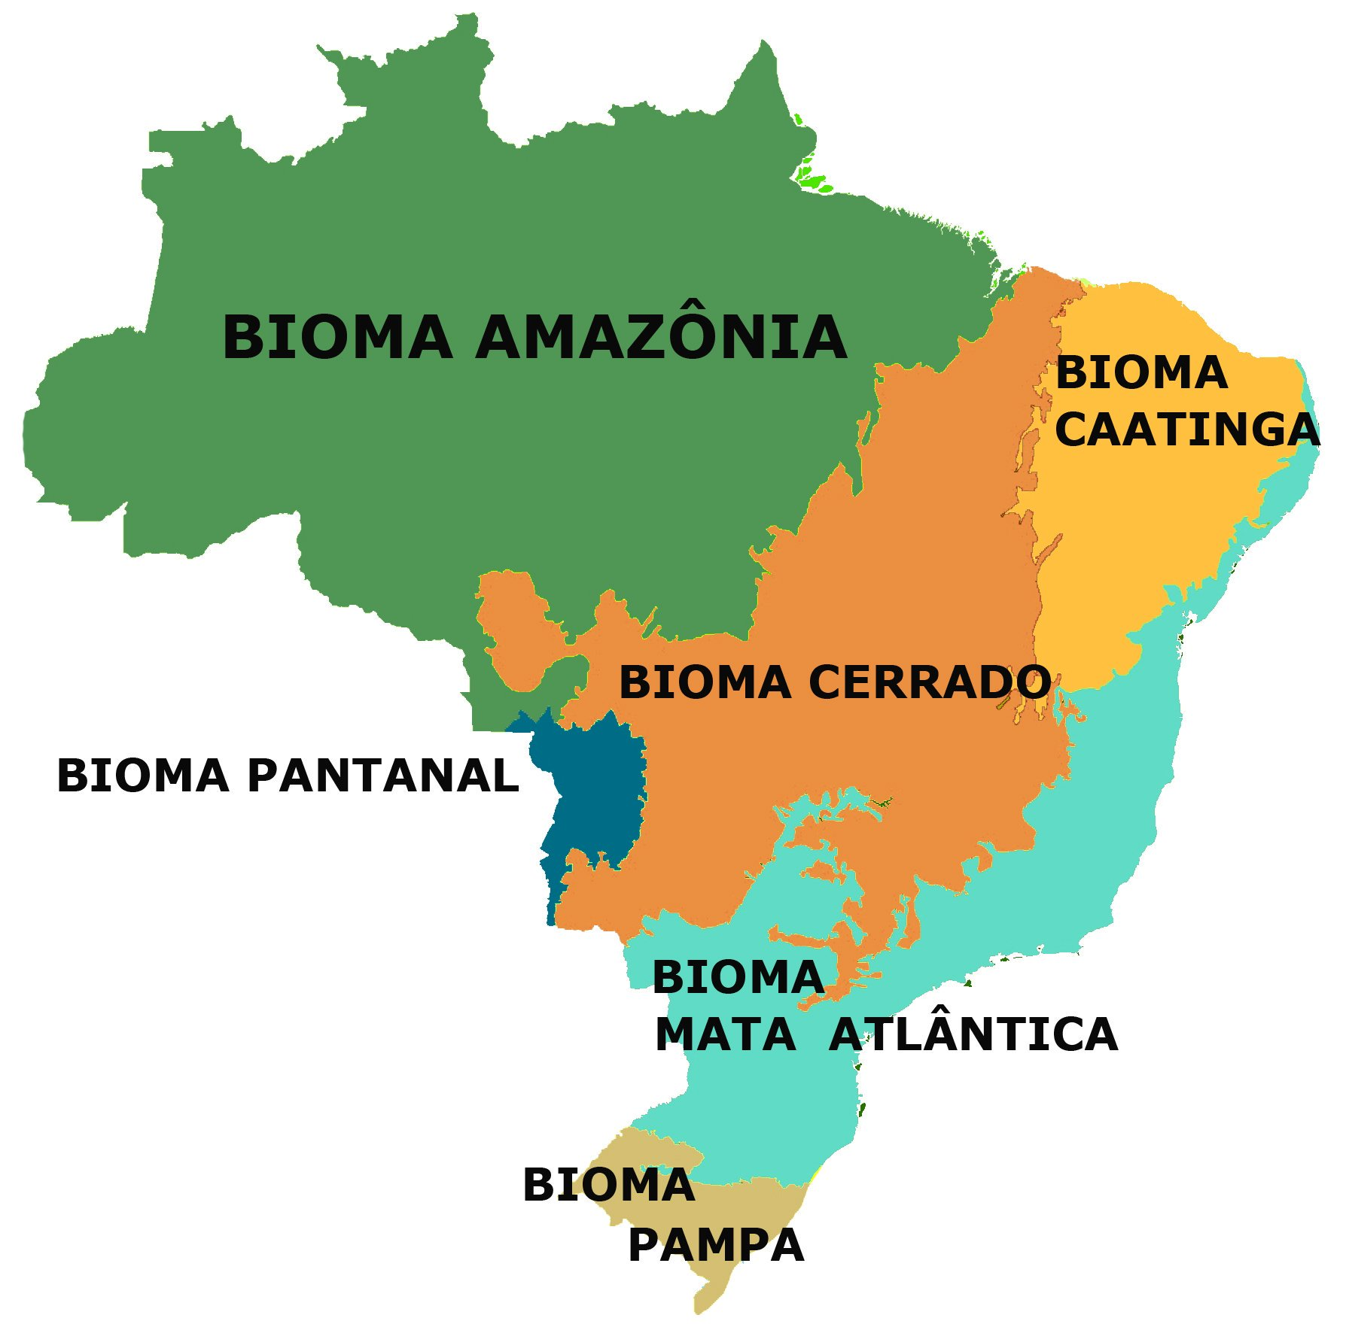
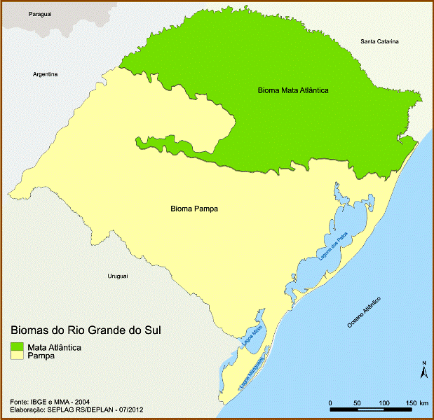
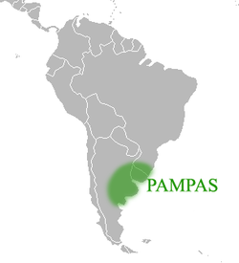
Introduction
Smallest biome in the country
Total area of 176496 Km²
Subtropical climate
Temperate climate
Four seasons well defined

Slide 3
Vegetation
Adapted from: Roesch, Luiz. The Brazilian Pampa: a Fragile Biome

Slide 4
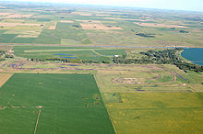
Vegetation
Mainly composed by short plants and grass.
Some tress and shrubs can appear near rivers.

Slide 5
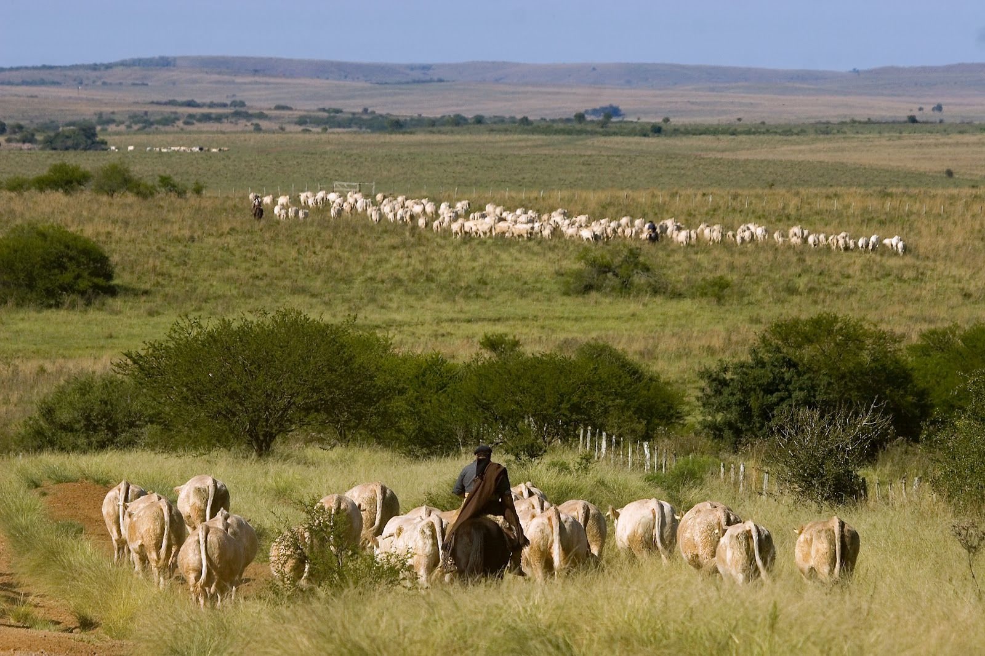
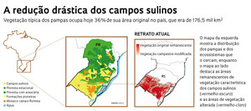
Mostly has been used for farming and livestock raising.
Estimate of 18 million animals

Slide 6
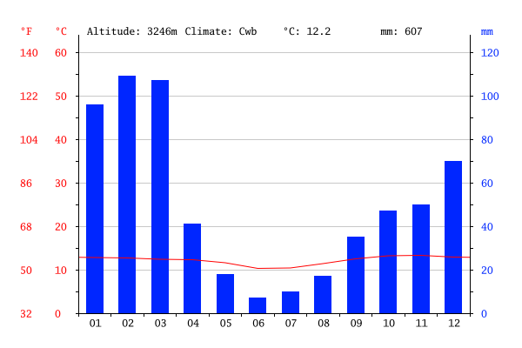
Climate
From: https://pt.climate-data.org/location/765026/

Slide 7
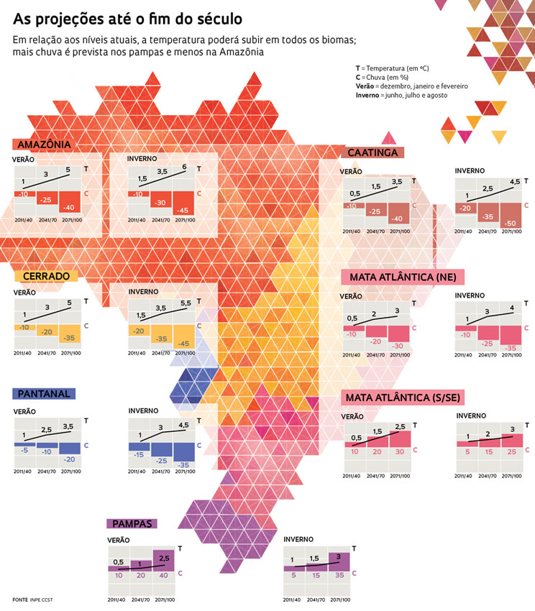
Climate

Slide 8
Climate
Deserfication of some areas (Uruguaiana)
Rise of rain intensities and rate
Presence of events like Hurricanes (Catarina in 2004)

Slide 9
Thank you!

Slide 10
References
EXTREMOS DO CLIMA, found on <http://revistapesquisa.fapesp.br/2013/08/13/extremos-do-clima/>
BIOMA PAMPA, found on <https://www.ibflorestas.org.br/bioma-pampa.html03-40142008000200006>
CLIMA PAMPA, found on<https://pt.climate-data.org/location/765026/>
Roesch, Luiz. The Brazilian Pampa: A Fragile Biome, Universidade Federal do Pampa, Campus São Gabriel. Found on <www.ddpi.com/journal/diversity
INTERVENÇÕES SUSTENTÁVEIS, found on< http://revistapesquisa.fapesp.br/2013/04/12/intervencoes-sustentaveis/>
CLIMATE SIMULATION AND CHANGE IN THE BRAZILIAN CLIMATE MODEL, found on< http://journals.ametsoc.org/doi/full/10.1175/JCLI-D-12-00580.1>

