Slide 1
Climate Change Impacts of Caspian Sea Basin
Global and Regional Climate Change
Ramal Dadashov – EEGZ48

Slide 2
Contents
Introduction
Basic consequences of Climate Change in Caspian Basin
Temperature and precipitation in the Caspian Sea basin
Caspian Sea level fluctuations
Regional land degradation
Caspian Sea ice extent
Vulnerable flooding
Result

Slide 3
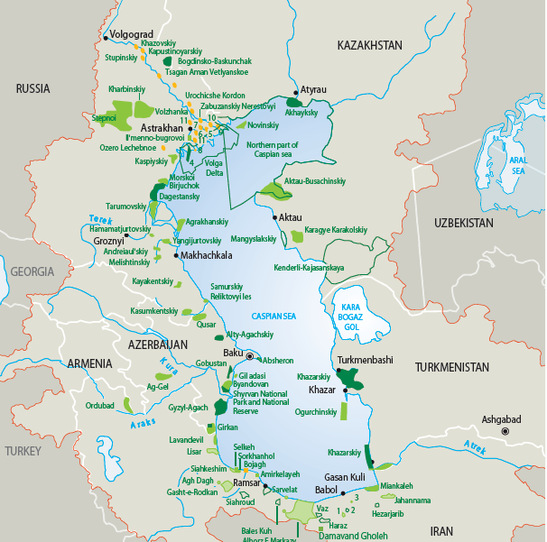
Introduuction
The Caspian Sea, surrounded by the five coastal the largest land-locked water body on Earth.
More than 130 rivers flow into the Caspian Sea
The primary tributary is the Volga River in the north
The Ural River, also in the north, and the Kura River in the west, are also significant tributaries
Salinity changes from north to south, from 1.0 to 13.5 parts per thousand (ppt)
There are more than 33 icelands

Slide 4
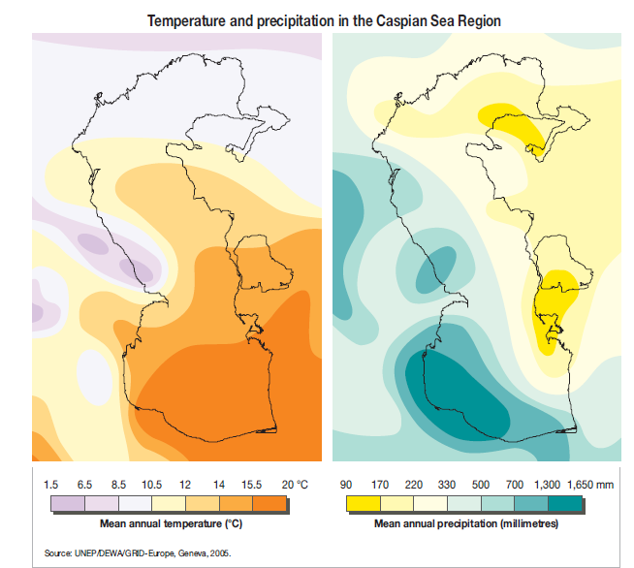

Slide 5
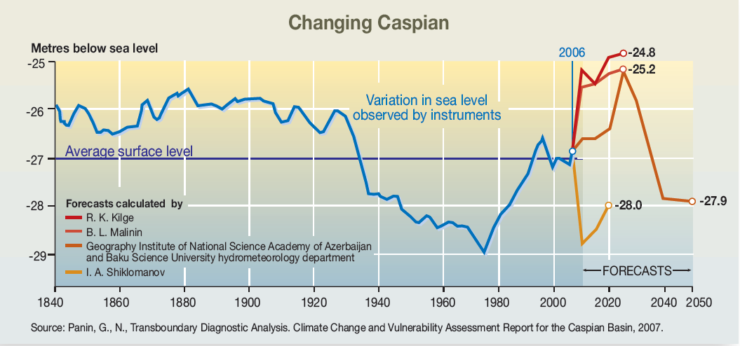
Caspian Sea level Fluctuations

Slide 6
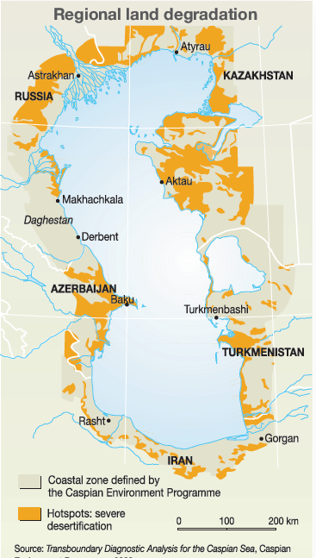
Kazakhstan and Turkmenistan -a lack of rainfall and extreme summer evaporation result in a high level of aridity
But deserts and desertification are not limited to the eastern part of the Caspian Sea coastal zone
Russia -mainly in Chernije Zemli (Black Lands) region in the Kalmykhian Republic — is wind erosion
Azerbaijan and İran –rainfall more than 600 and 1000 mm/year -deforestation and water erosion result in the degradation of vegetation
Turkmenistan remains high salinity of soils (CEP website)

Slide 7
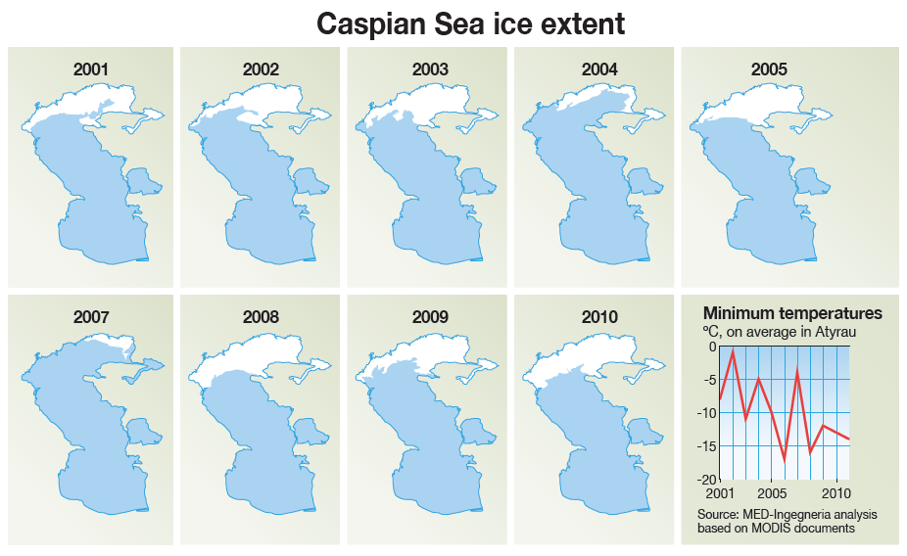

Slide 8
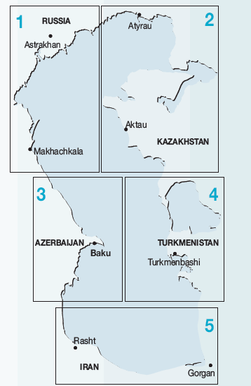
Vulnerable Flooding
resulting in considerable loss of lives and widespread economic damage
flooding incidents in the Caucasus and Elburz mountain valleys have dramatically increased
At the same time, Iran is among those which have been severely affected by droughts.

Slide 9
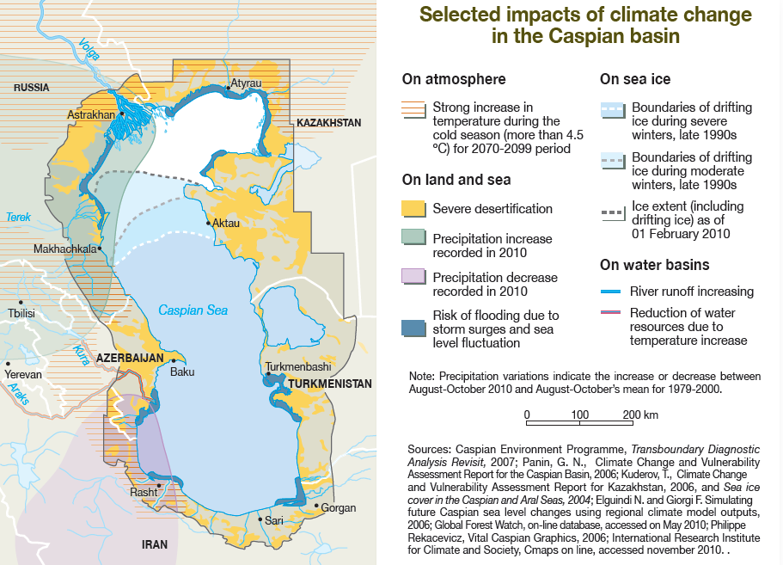

Slide 10
Result
If we summarize all information, conclusion is that; There are several impacts of Climate Change:
On Atmosphere- Expected increasing of temperature will be around 4.5 and 6 for end of this century.
On land and sea-severe desertification and habitat lost because of oil and gas industry
In the northern part of Caspian Sea basin has increasing precipitation, while, southern part of Caspian Sea basin has decreasing precipitation
There is flooding risk in the plenty of place where rivers meet with sea. Especially, in the Volga and Ural river basins.
On water basin: Reduction of water resources due to temperature increase, indirectly Climate Change impacts to biodiversity of Caspian Sea
Because of temperature fluctuations ice boundary change in the Northern part of Caspian sea.

Slide 11
References
Caspian Sea- State of the Environment 2010(Report by the interim Secretariat of the Framework Convention for the Protection of the Marine Environment of the Caspian Sea and the Project Coordination Management Unit of the “CaspEco” project)
Transboundary Diagnostic Analysis of Caspian Sea, Volume two
Vital Caspian Graphics , 2006 UNEP/GRID-Arendal
https://www.livescience.com/57999-caspian-sea-facts.html
https://en.wikipedia.org/wiki/Category:Islands_of_the_Caspian_Sea

Slide 12
Thanks For Attention

