Slide 1
Climate Change in Nigeria
Author: IKLAGA GABRIEL INALEGWU
Neptune Code: BQGDL3
Course: aa2n1150e Global and Regional Climate Change

Slide 2

NIGERIA

Slide 3
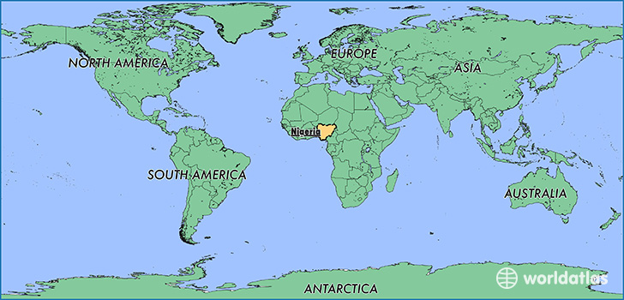
NIGERIA

Slide 4
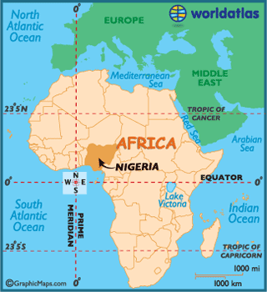
NIGERIA

Slide 5
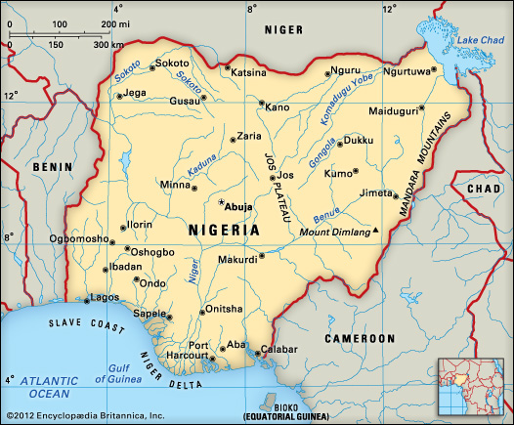
Basic Geography of Nigeria
Nigeria is a country in West Africa located between Latitude 4⁰N to 14⁰N above the equator and Longitude 2⁰E and 15⁰E of the Greenwich Meridian.
Nigeria shares land borders with the Republic of Benin I the West, Chad and Cameroon in the East and Niger in the North.
Its coast lies on the Gulf of Guinea in the south and it borders lake Chad to the northeast.
Noted geographical features in Nigeria include the Adamawa Highlands, Mambilla Plateau, Jos Plateau, Obudu Plateau, the Niger River, River Benue and the Niger Delta.

Slide 6
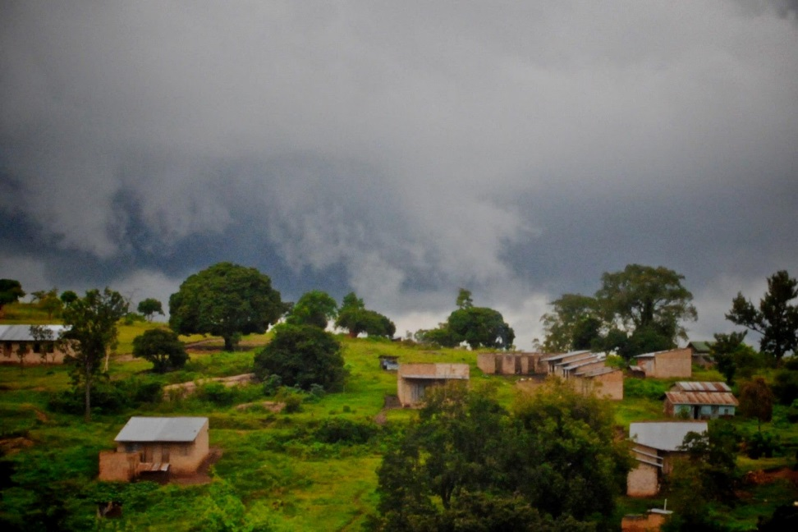
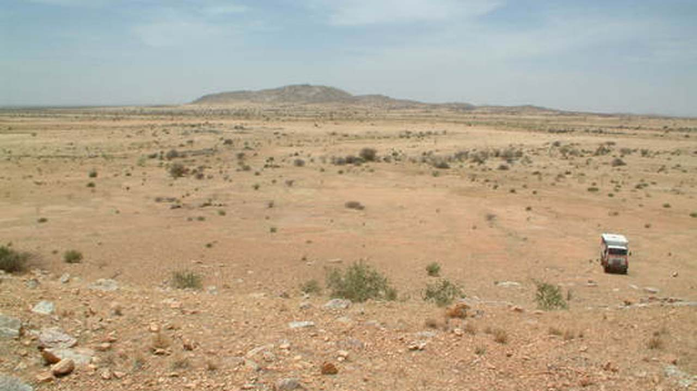
Climate of NIGERIA

Slide 7
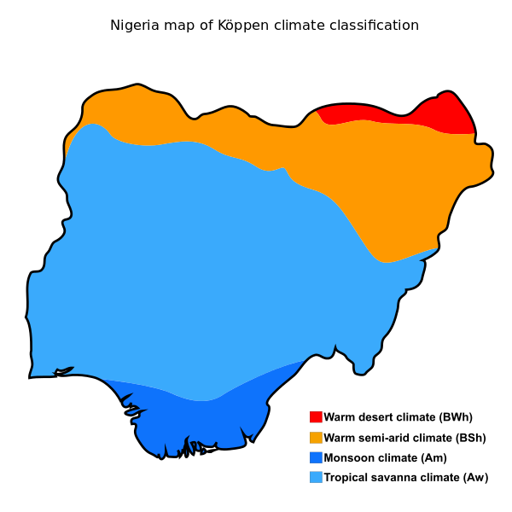
Climate of NIGERIA

Slide 8
Monsoon climate (Am)
found in the southern part of the country
influenced by the monsoons
originating from the South Atlantic Ocean which is brought into the country by the (maritime tropical) MT airmass, a warm moist sea to land seasonal wind
Its warmth and high humidity gives it a strong tendency to ascend and produce copious rainfall, which is a result of the condensation of water vapour in the rapidly rising air.
the southern part of Nigeria, records a maximum of 28 °C (82.4 °F) for its hottest month while its lowest temperature is 26 °C (78.8 °F) in its coldest month.

Slide 9
Monsoon climate (Am)
The southern part of Nigeria experiences heavy and abundant rainfall. These storms are usually convectional in nature due to the regions proximity, to the equatorial-belt.
The annual rainfall received in this region is very high, usually above the 2,000 mm (78.7 in) rainfall totals giving for tropical rainforest climates worldwide.
The southern region of Nigeria experiences a double rainfall maxima characterized by two high rainfall peaks, with a short dry season and a longer dry season falling between and after each peaks.

Slide 10
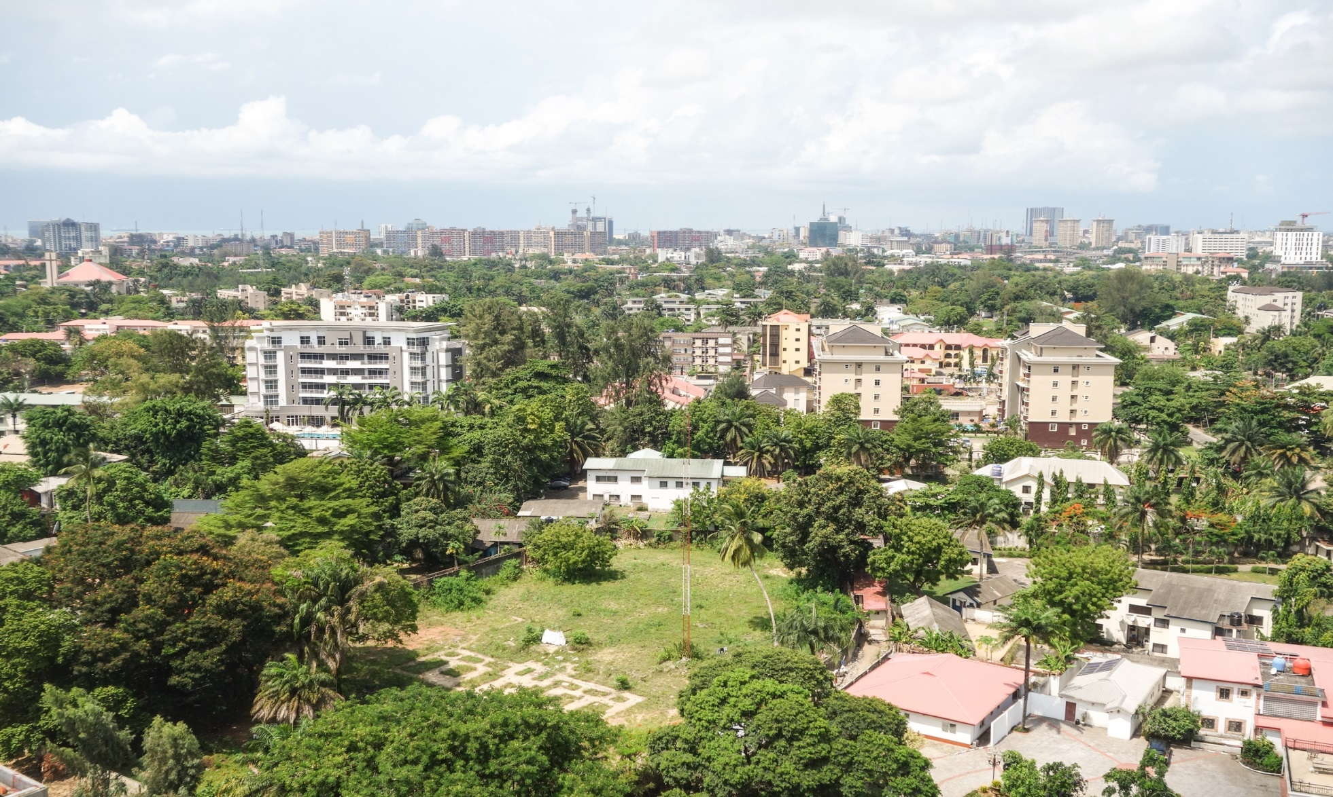
Monsoon climate (Am)

Slide 11
Tropical savanna climate (Aw)
is extensive in area and covers most of Western Nigeria to central Nigeria beginning from the Tropical rainforest climate boundary in southern Nigeria to the central part of Nigeria, where it exerts enormous influence on the region.
exhibits a well marked rainy season and a dry season with a single peak known as the summer maximum due to its distance from the equator. Temperatures are above 18 °C (64 °F) throughout the year. Averaging a temperature range of 18.45 °C (65.21 °F) to 36.9 °C (98.4 °F), and an annual rainfall of about 1,500 mm (59.1 in) with a single rainfall maxima in September.

Slide 12
Tropical savanna climate (Aw)
The single Dry season experienced in this climate, the tropical savanna climate in central Nigeria beginning from December to march, is hot and dry with the Harmattan wind, a continental tropical (CT) airmass laden with dust from the Sahara Desert prevailing throughout this period.

Slide 13
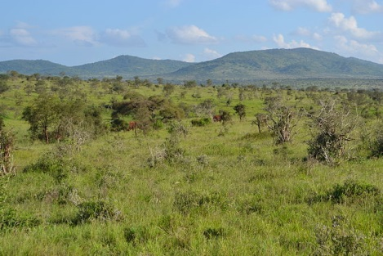
Tropical savanna climate (Aw)

Slide 14
The Sahel Climate {BSh}/{BWh}
is the predominant climate type in the northern part of Nigeria.
Annual rainfall totals are lower compared to the southern and central part of Nigeria.
The rainy season in the northern part of Nigeria last for only three to four months (June–September).
The rest of the year is hot and dry with temperatures climbing as high as 40 °C (104.0 °F).

Slide 15
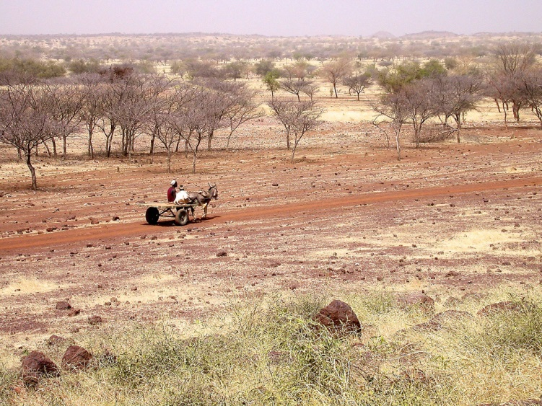
The Sahel Climate

Slide 16
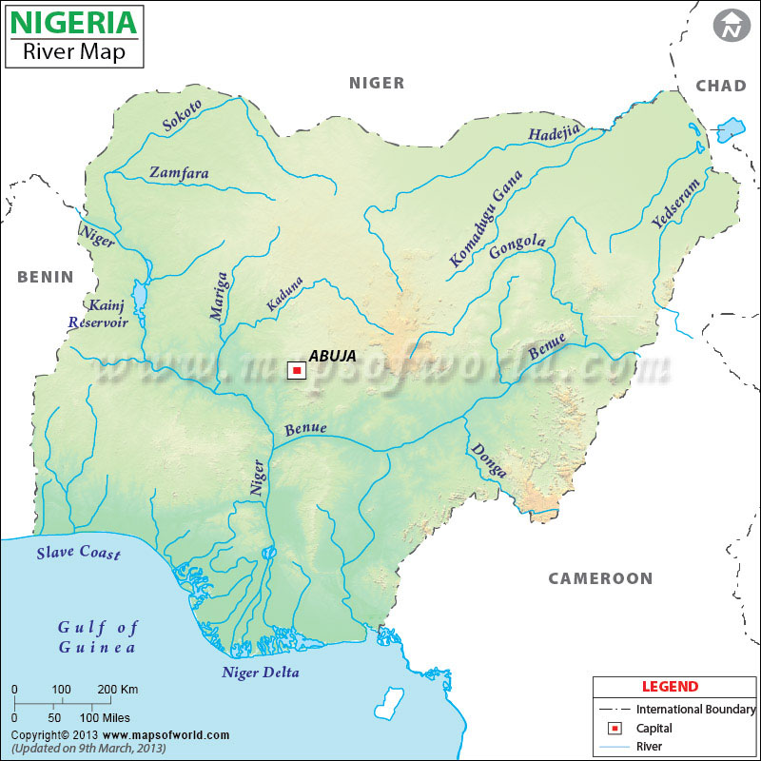
Drainage of Nigeria

Slide 17
Anthropogenic Activities in NIGERIA

Slide 18
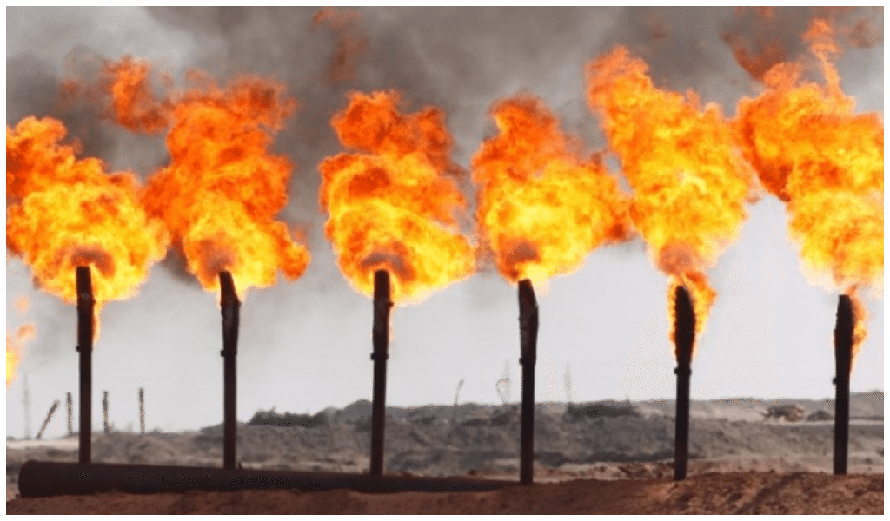
Gas Flaring

Slide 19
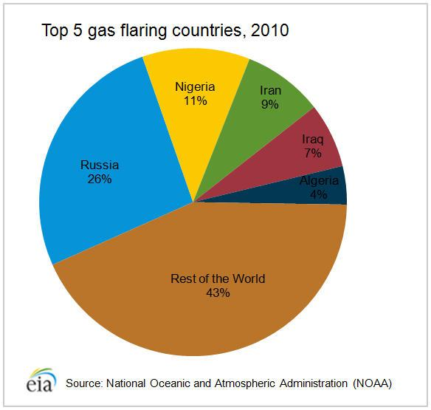
Gas Flaring

Slide 20
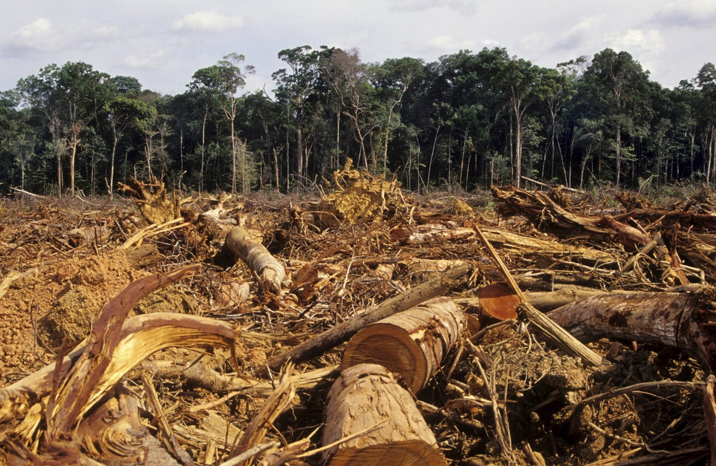
Deforestation

Slide 21
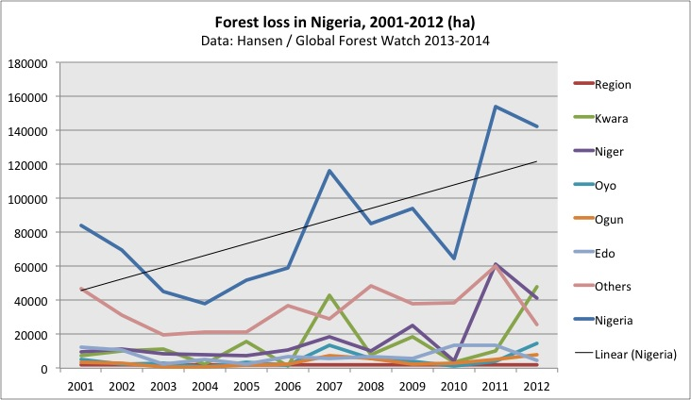
Deforestation

Slide 22
Impacts of Climate Change in NIGERIA

Slide 23
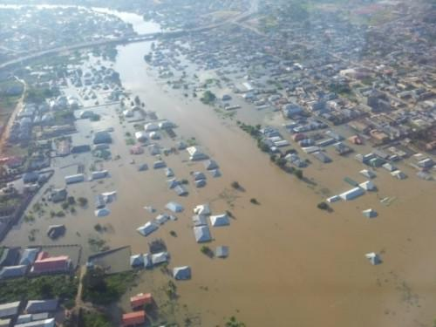
Flooding

Slide 24
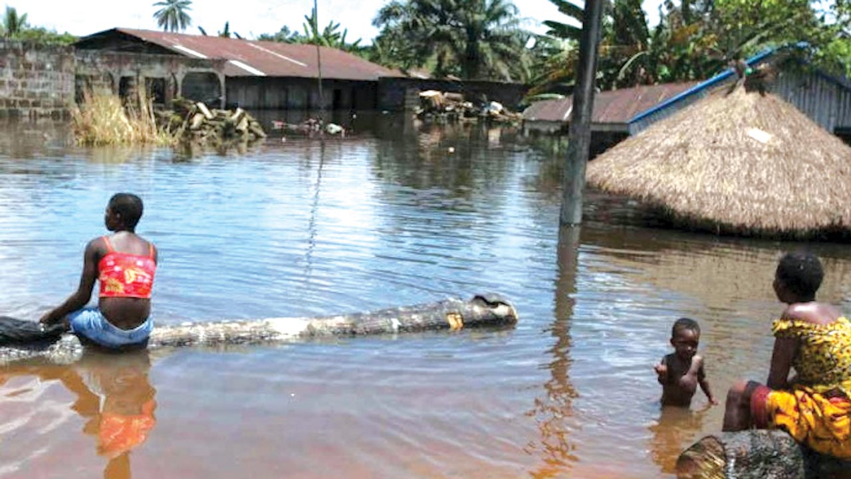
Flooding

Slide 25
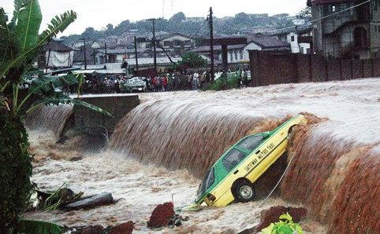
Flooding

Slide 26
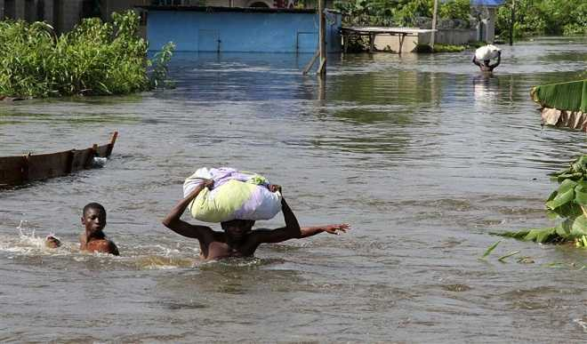
Flooding

Slide 27
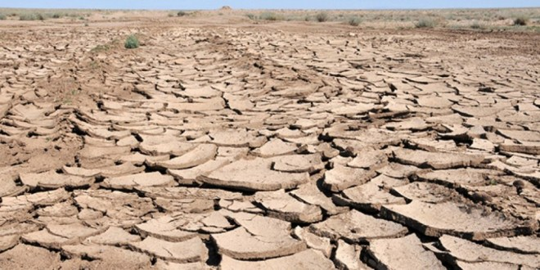
Desertification/Desert Encroachment

Slide 28
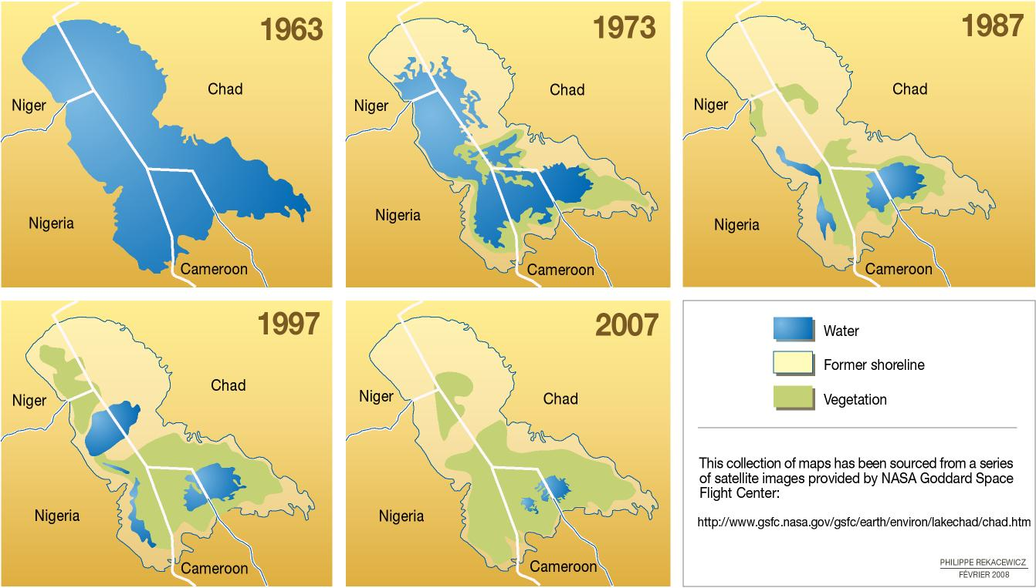
Shrinking Lake Chad

Slide 29

Communal Conflicts

Slide 30
Other Impacts of Climate Change in Nigeria
Rise In Climate related Sicknesses
Drought

Slide 31
Climate Projections in Nigeria
Decrease in Rainfall amount and duration
( 81mm drop in the last 105 years)
Increased average Temperature
( 1.1⁰C average rise in the last 105 years)
Agricultural Productivity (Droughts)
Increased events of Wind and rainstorms
Sea level rise leading to coastal inundation
(853 km coastline)

Slide 32
Bibliography
http://www.worldatlas.com/img/locator/country/nigeria-locator-map.jpg
https://media1.britannica.com/eb-media/94/62294-004-7F2FA9E2.jpg
http://www.worldatlas.com/img/areamap/7457de7b64ef4b7b0860059b4bfab7fe.gif
http://2.bp.blogspot.com/-TX5-mMlZpYE/TqvKzDg6SDI/AAAAAAAAADE/NnGDt4Lphm8/s1600/nick%2527s+rainstorm.jpg
https://guardian.ng/wp-content/uploads/2017/03/Chad-desert.jpg
https://en.wikipedia.org/wiki/Geography_of_Nigeria
https://s3.amazonaws.com/iexplore_web/images/assets/000/005/728/original/nigeria.jpg?1442934303
https://guardian.ng/wp-content/uploads/2016/07/Makurdi-flood.jpg
http://climatechange.gov.ng/
https://environmentalsynergy.wordpress.com/2011/04/18/the-effects-of-climate-change-in-nigeria/
https://www.usip.org/sites/default/files/Climate_Change_Nigeria.pdf
https://www.researchgate.net/profile/Zili_Yang/publication/4735785_A_Regional_Dynamic_General-Equilibrium_Model_of_Alternative_Climate-Change_Strategies/links/0deec53507d073e02a000000/A-Regional-Dynamic-General-Equilibrium-Model-of-Alternative-Climate-Change-Strategies.pdf
https://wedocs.unep.org/bitstream/handle/20.500.11822/18207/General_overview_of_climate_change_impacts_in.pdf?sequence=1&isAllowed=y

Slide 33

One Earth

