Slide 1
Climate Change: Colombia
Name: Harold Jurado
Course: 1st semester
Msc. Environmental Science

Slide 2
Location:
North: Caribbean Sea.
South: Brazil, Ecuador and Peru.
West: Pacific Ocean and Panamá.
East: Brazil and Venezuela

Slide 3
Regions:
Andean Region
Its in the west,Where the majorite Colombian population is located, Its conformed by 3 mountain ranges (Andes), Across all the country from south to the north, cold weather.
Caribean Region
In the north, It is characterized by warm weather, coast, beaches, agricultural and tourist area in the coastal area.
Pacific Region
In the west, acrossing all pacific coast covered by tropical forest and exuberant vegetation with warm and humid climates.
Orinoco Sabana
south east there are flat and undulating lands, it is rich in agriculture and livestock, there are also oil deposits, the climate is warm.
Amazon rainforest
in the southwest of the country, covered with immense rainforests, warm and temperate climate

Slide 4
Temperature:
Colombia is located torrid zone and does not have station. Therefore climate of Colombia is determined by geographical and atmospheric aspects such as rainfall, intensity, solar radiation, temperature, wind systems, altitude, continentality and atmospheric humidity.

Slide 5
Precipitation:

Slide 6
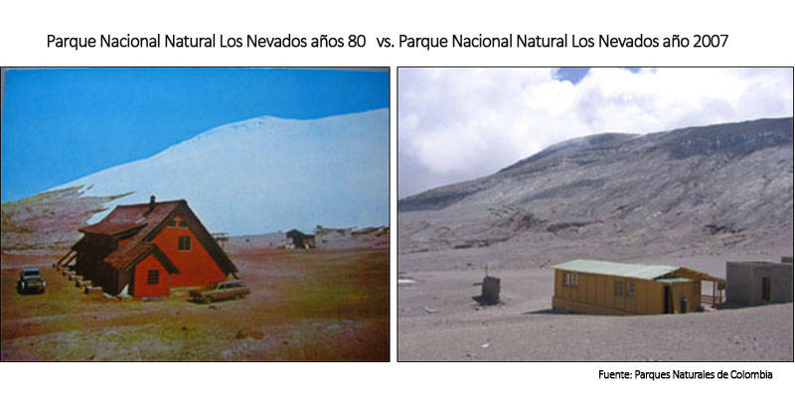
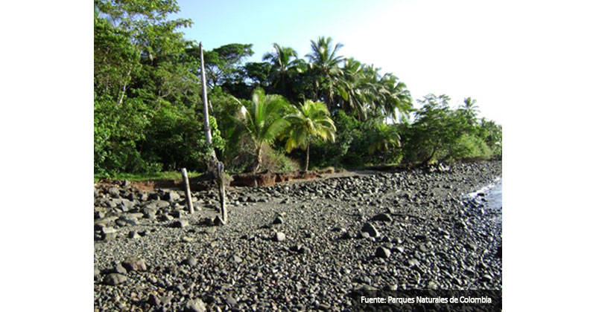
Impacts of climate change
The melting of glaciars
Coral bleaching
Loss of beaches and coastal erosion
Extreme events
endangered animals

Slide 7
Phenomenan “el niño” and “la niña”

Slide 8
Floods
Among the problems that occur with floods we have:
• loss of life, damage to homes, infrastructure and agricultural production areas.
• Stagnation of water due to drainage deficiency in the areas, with damage to the population due to health problems.
• Drift of unstable channels in avenues due to excessive load in the flow and erosion of margins in the main trough, which causes loss of bridges, roads, houses and productive areas.

Slide 9
what will happen in the future with the climate change?

Slide 10
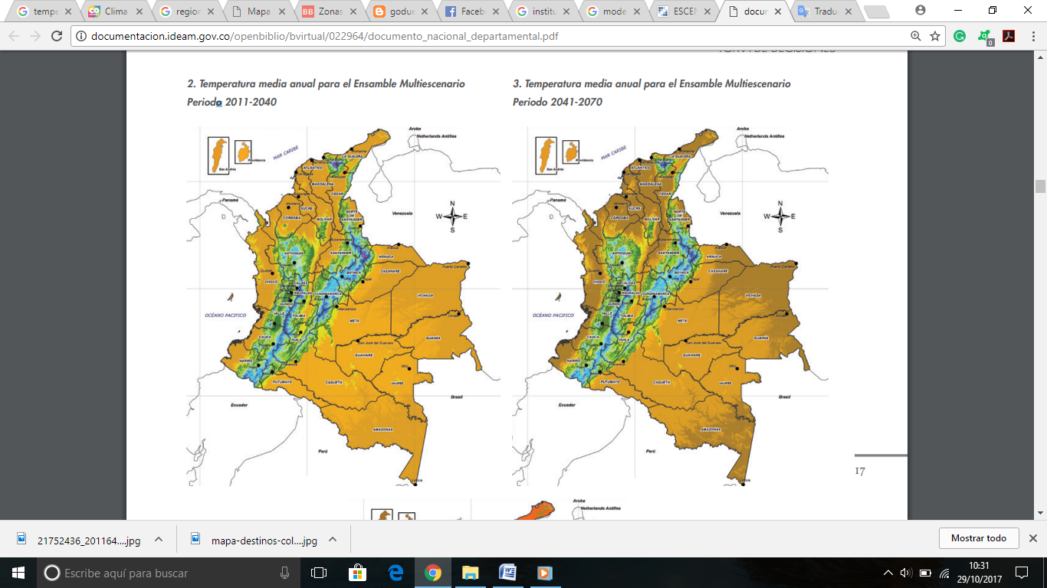
Climate model in colombia Average temperature 2011-2100

Slide 11
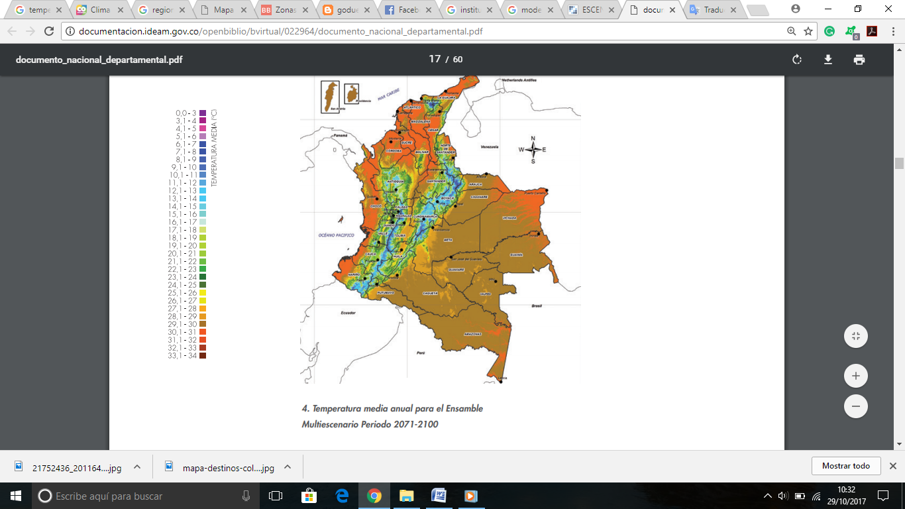
Average temperature 2011-2100

Slide 12
Difference from the average temperature 2011-2100

Slide 13
Difference from the average temperature 2011-2100

Slide 14
Precipitation average 2011-2100

Slide 15
Precipitation average 2011-2100

Slide 16
Conclusion
Colombia is a vulnearable country with the climate change.
Accelerate the transformation towards a low carbon economy, integrating climate as a main factor.

Slide 17
References
https://www.unihe.org/sites/default/files/colombia_project_paper.pdf
http://www.colombia.travel/es/informacion-practica/clima
http://www.ideam.gov.co/web/tiempo-y-clima
http://documentacion.ideam.gov.co/openbiblio/bvirtual/022964/documento_nacional_departamental.pdf

Slide 18
THANK YOU

