Slide 1
INDONESIA’S CLIMATE & FUTURE CLIMATE VISION
Tito Faradhimu Toni
Global & Regional Climate Change

Slide 2
OUTLINE
Geographical Information
Climate Condition
Climate Vision
Climate Change Impact
Conclusion

Slide 3
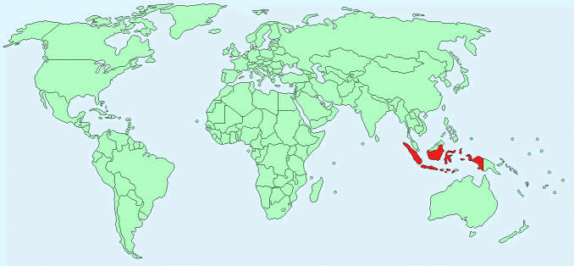
Geographical Information (I)
Southeastern part of Asia
Shares land borders with 3 countries
2 million square km of land (covered by forests)

Slide 4
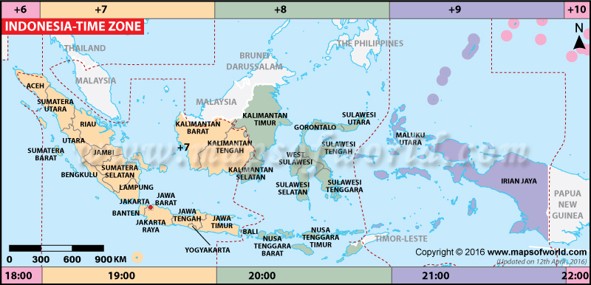
Geographical Information (II)
The Indonesian archipelago : 17,500 islands
5 main islands : Sumatra, Java, Borneo, Sulawesi, Papua
Land area : 1.811.569 km
Overall area : 1.904.569 km
Population : 255.461.700
2
2

Slide 5
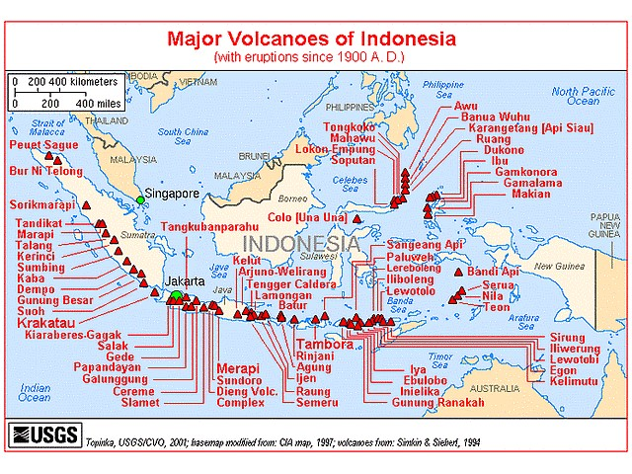
Geographical Information (III)
It lies on the Pacific Ring of Fire where the Indo-Australia Plate and the Pacific Plate are pushed under the Eurasian plate where they melt at about 100 km deep.
FACT : The 150 out of 400 volcanoes are active !

Slide 6
Climatic type | Precipitation Level (average in a month) | Temperature Level
Equatorial | > 60 mm
Monsoon | 60 mm < Am < 100 mm
Tropical Savanna | < 60 mm
18 °C <

Slide 7
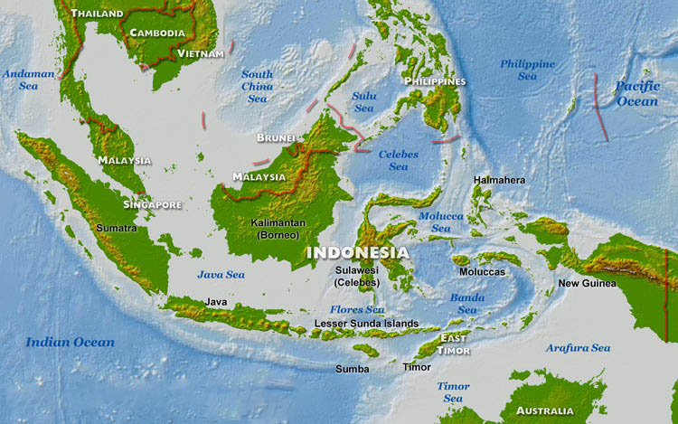
Indonesia Seasons : Wet and Dry
the dry season : April – October
the wet season : November - March
Rainfall in Indonesia is plentiful, particularly in west Sumatra, northwest Kalimantan, west Java, and western Papua. Kalimantan and Sumatra, experience only slight differences in rainfall and temperature between the seasons.
Parts of Sulawesi and some islands closer to Australia, such as Sumba and Timor, are drier. Nusa Tenggara, experience far more pronounced differences with droughts in the dry season and floods in the wet.
The area’s relative humidity ranges between 70 and 90%.

Slide 8
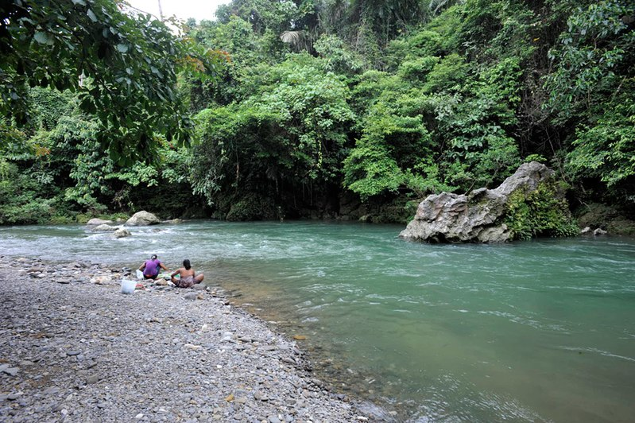
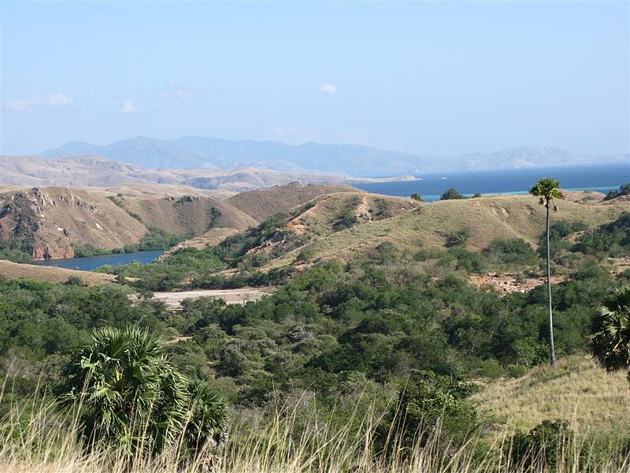
Indonesia hosts a wide array of diverse ecosystems from sea and coastal systems to peat, swamp and rainforests. Extremely high levels of biodiversity
Typical Indonesian rainforest, mostly found in Kalimantan and Sumatra (rainfall measuring more than 2,000 millimeters per year)
The islands closest to Australia, including Nusa Tenggara and the eastern tip of Java, tend to be dry
(less than 1,000 millimeters per year)

Slide 9
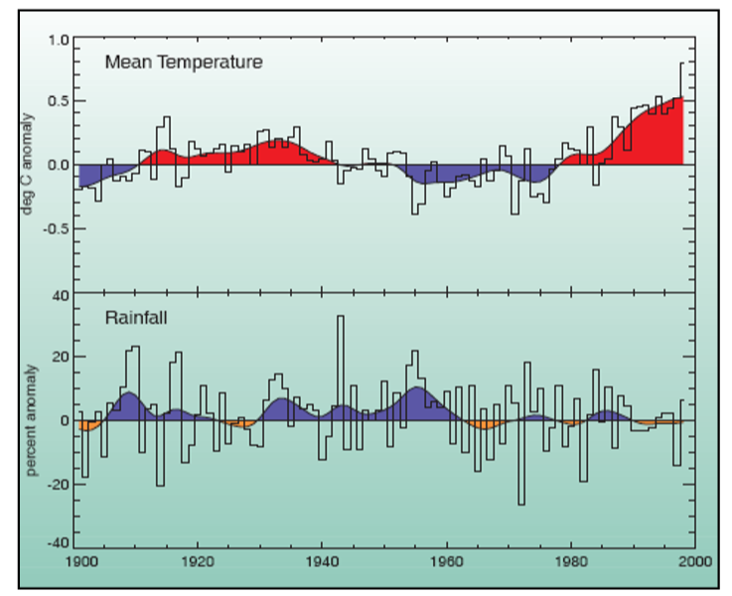
Changes in annual mean temperature (1901-1998); annual rainfall (1901-1998) across Indonesia
The mean annual temperature has increased by about 0.3°C.
Overall annual precipitation has decreased by 2 to 3%. Precipitation patterns have changed, there has been a decline in annual rainfall in the southern regions (Java, Sumatra & Nusa Tenggara) and an increase in precipitation in the northern regions (Kalimantan & North Sulawesi).
The seasonality of precipitation has changed. The wet season rainfall in the southern region of Indonesia has increased while the dry season rainfall in the northern region has decreased.
Precipitation in Indonesia is strongly influenced by El Niño events so that there will be more frequent and perhaps intense events in the future because of the warming global climate.

Slide 10
RCP Scenario of Temperature from 1984-2100

Slide 11
RCP Scenario of Precipitation from 1984-2100

Slide 12
Climate model vs Observational Data
Comparison between the average values of the present climate (1984-2004) based on the climate model and observed data during the same period. There are differences between model altitude data and actual altitude data, but no altitude corrections are made on these maps. Accordingly, there are some differences in temperature may be generated because of such differences in altitude data.

Slide 13
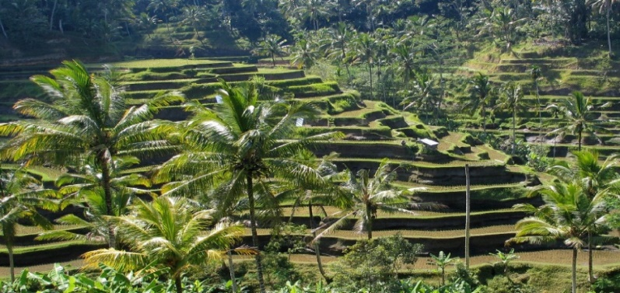
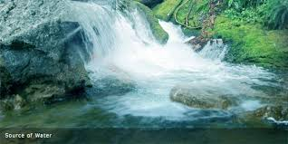
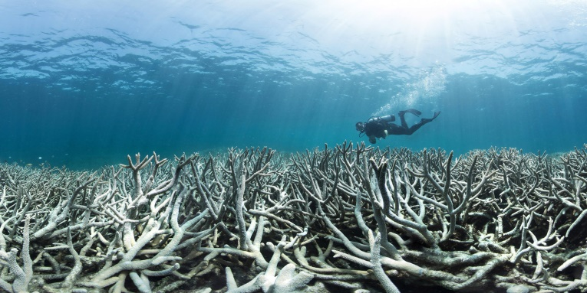
Climate Change Impacts
● Impact on agriculture:
Due to longer dry seasons caused by El Nino, significant damage is caused to farm products.
● Impact on water resources and availability:
It is predicted that the ratio of municipalities without sufficient water supplies will increase from the present 14% to 19% in 2025 and 31% in 2050.
● Impact on coastal areas and the ocean:
There are concerns about coral bleaching caused by El Nino and coastal erosion by sea level rise and high waves. Many islands will be drowned.
.

Slide 14
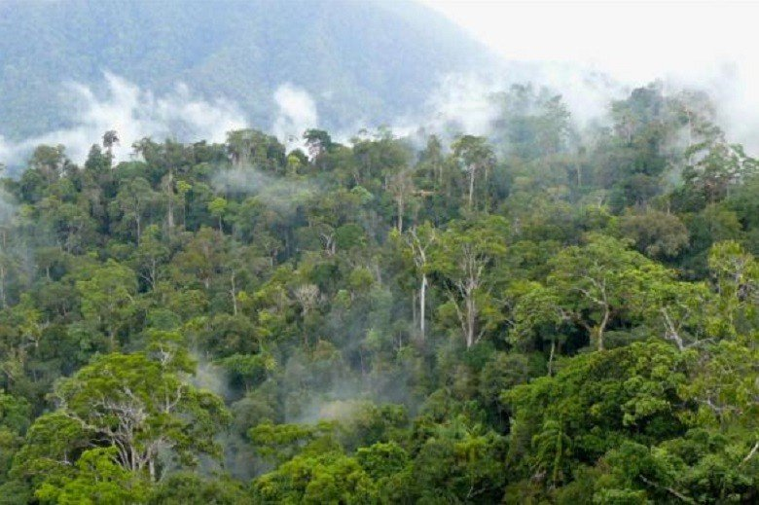
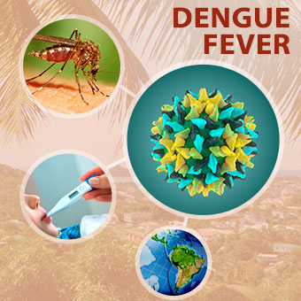
Climate Change Impacts
● Impact on Biodiversity and ecosystem service :
Changes in species distribution, reproduction timings, and phenology of plants.
● Impact on health:
There are concerns about the increase and spread of vector borne diseases such as dengue fever, malaria, and diarrhea.

Slide 15
Conclusion
The combination of high population density and high levels of biodiversity, makes Indonesia is one of the most vulnerable countries to the impacts of climate change.
Warmer climate and high precipitation are expected to be occured by the end of 21st century in Indonesia.
Annual rainfall and season changing, together with irregular drought and floods will occur more frequent in accordance with the global warming consequences.

Slide 16
References
Boer, R. and A. Faqih., 2004. Current and Future Rainfall Variability in Indonesia. In an Integrated Assessment of Climate Change Impacts, Adaptation and Vulnerability in Watershed Areas and Communities in Southeast Asia, Report from AIACC Project No. AS21 (Annex C, 95-126). International START Secretariat, Washington
Cruz, R.V., H. Harasawa, M. Lal, S. Wu, Y. Anokhin, B. Punsalmaa, Y. Honda, M. Jafari, C. Li and N. Huu Ninh., 2007. Asia. Climate Change 2007: Impacts, Adaptation and Vulnerability. Contribution of Working Group II to the Fourth Assessment Report of the Intergovernmental Panel on Climate Change. Cambridge University Press. 469-506. Cambridge. United Kingdom
Hulme, M and N. Sheard., 1999. Climate Change Scenarios for Indonesia. Climatic Research Unit, Norwich, United Kingdom
Ministry of The Environment of Japan., 2014. Climate Change in Southeast Asia : Outputs from GCM. Tokyo. Japan
WRI.World Resources 2000-2001: People and Ecosystems: The Fraying Web of Life; 2001.

Slide 17
THANK YOU

