Slide 1
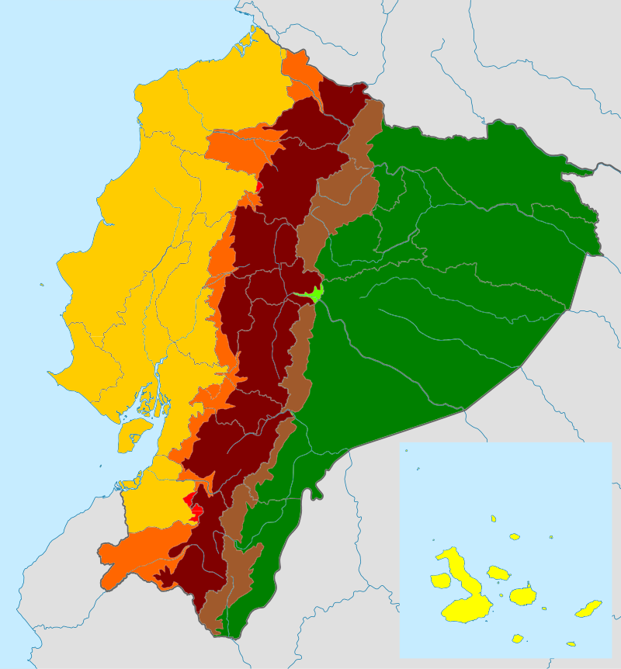
CLIMATE OF ECUADOR
JeanCarlo Andrade
aa2n1150e - Global and regional climate change

Slide 2
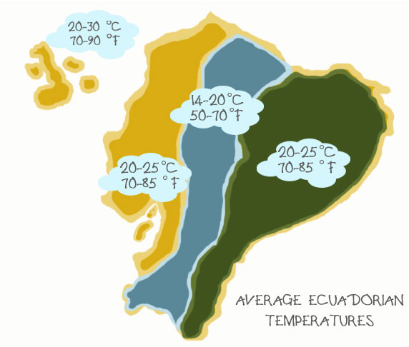
The most important is that all the areas have only two seasons.
Generally December through May is a rainy season, while the rest of the year is a dry season.
There are four main regions in Ecuador.
Coastal Lowlands
Insular Region
Highlands
Amazon Lowlands

Slide 3
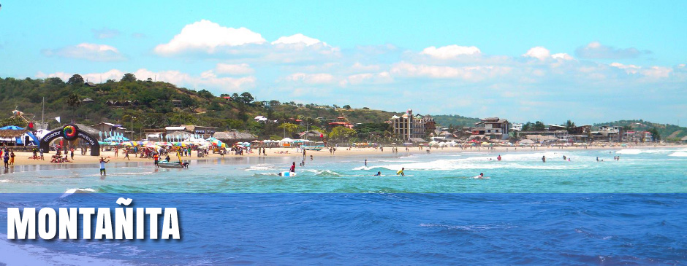
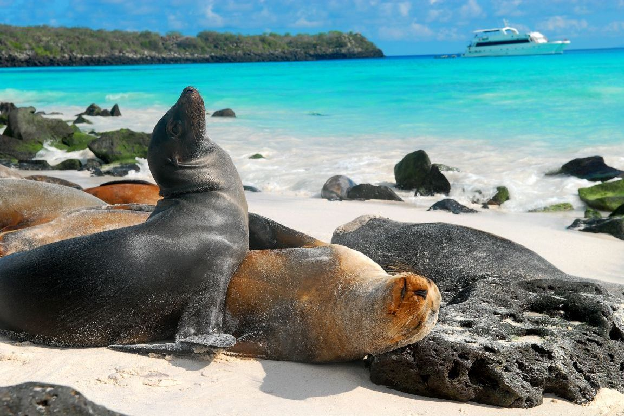
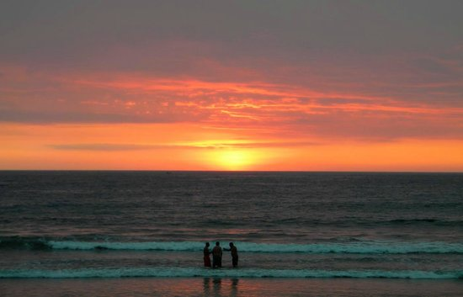
Coastal Lowlands & Insular Region
Spreads across the low-lying areas along the Pacific Ocean. Temperatures averaging 25° Celsius.
Along the coast, annual rainfall quickly drops from North to South.
There are two opposing marine currents that influence the climate of Ecuador. El Niño and Humboldt currents.
South is desert dry is because the Humboldt that carries a little moisture.
Notes:
Humboldt from Antarctica, result carry little moisture
El Niño coming from the north
When one of these currents becomes stronger and persists longer than normal, there are variations in precipitation
El Niño>Humboldt=rains/floods

Slide 4
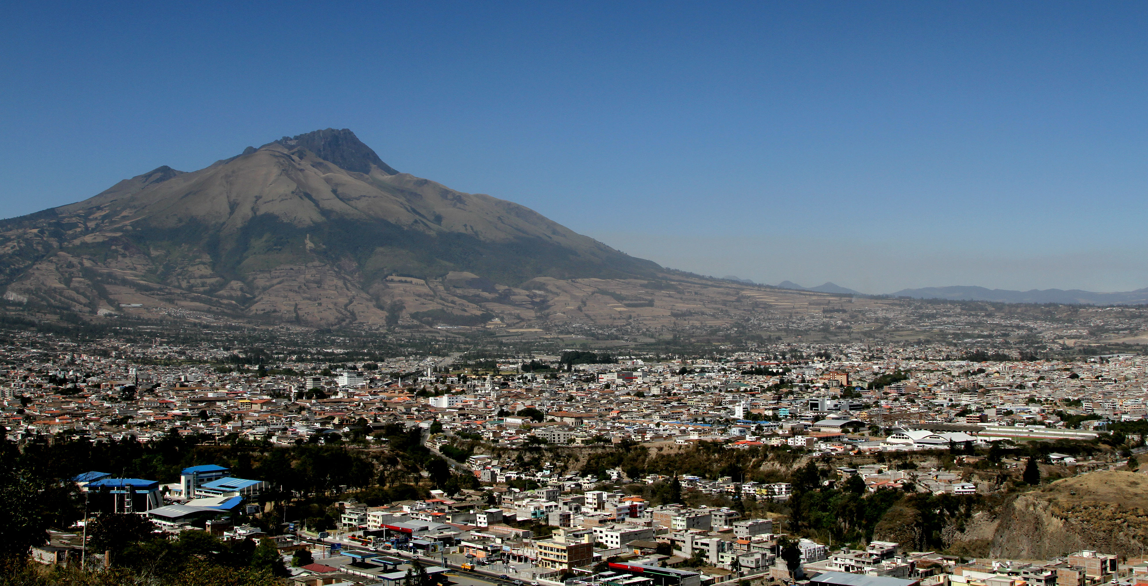
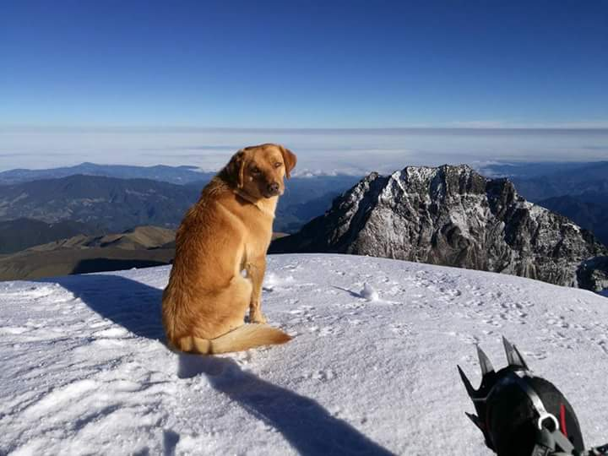
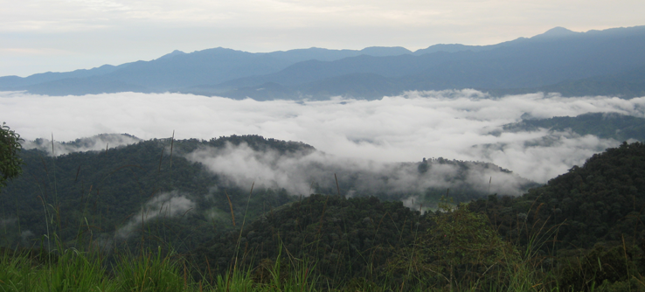
Andes valleys & Highlands
Weather with temperatures that may run up to about 16°C (average).
In the Central Andes valley, there are predominant spring-like weather conditions.
Temperatures vary with altitude. (2300 - 2800 m.a.s.l.)
The most moist weather conditions predominate on the external Andes flanks.
Above 3500 m.a.s.l., the climate becomes cold and several mountains in Ecuador are permanently snow-capped.
Notes:
Andes flanks: where the tropical winds are forced up; as they rise, rain is forced from the clouds to extremely high annual rainfalls

Slide 5
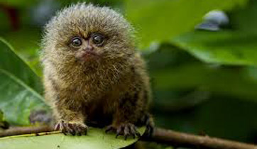
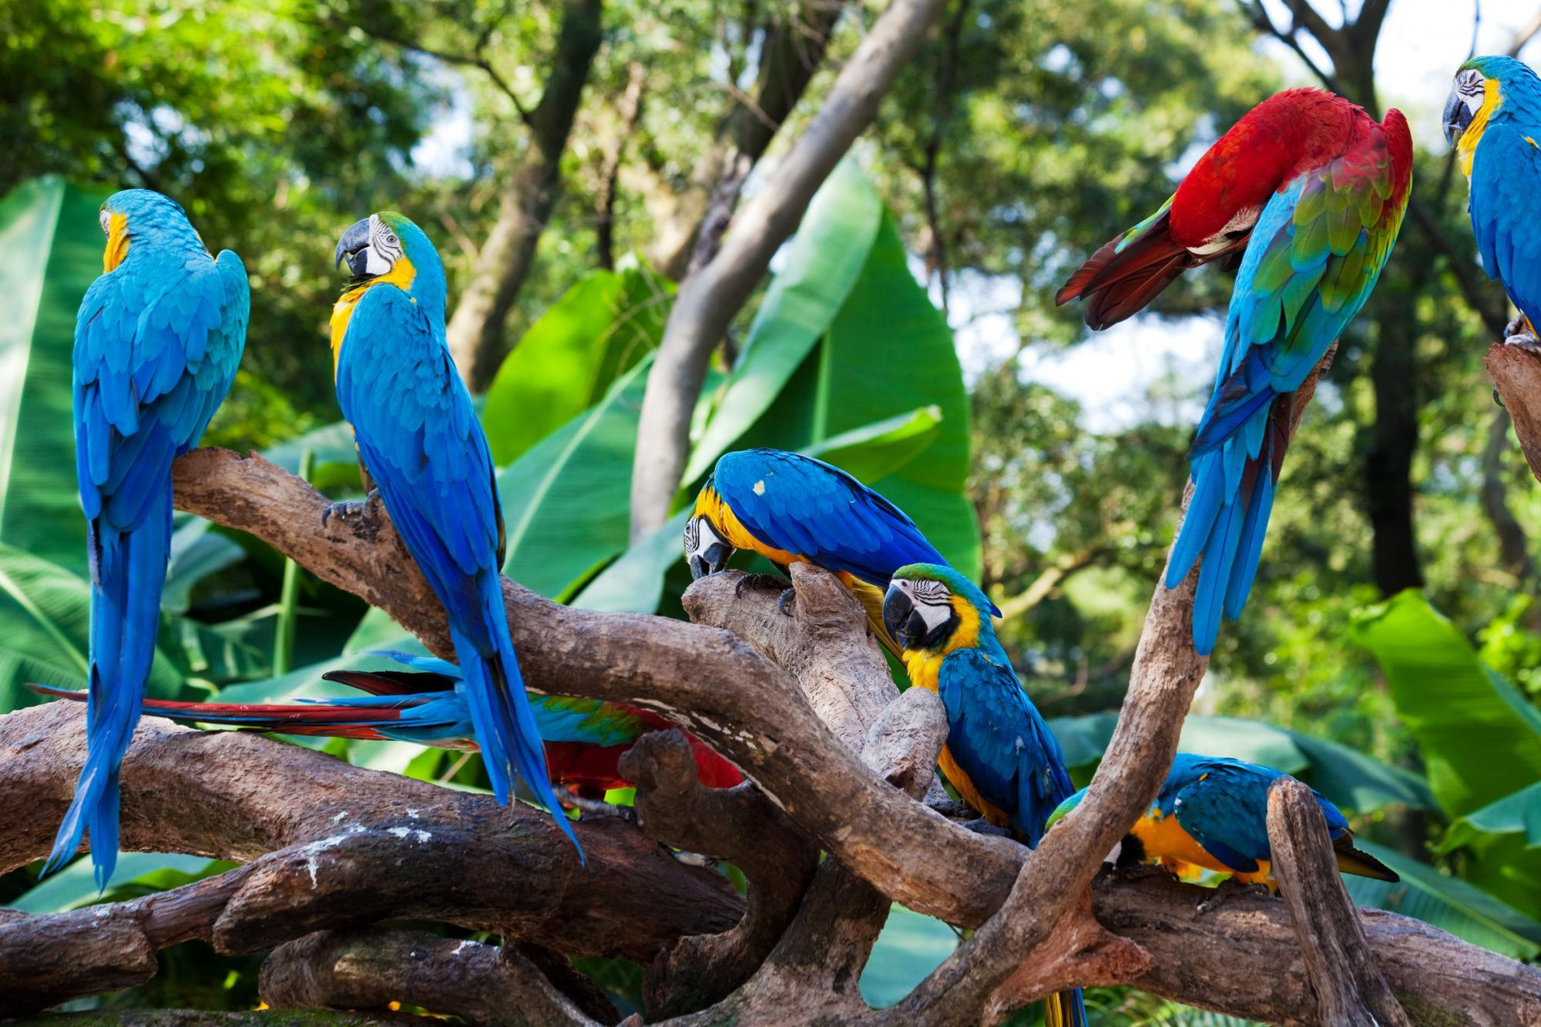
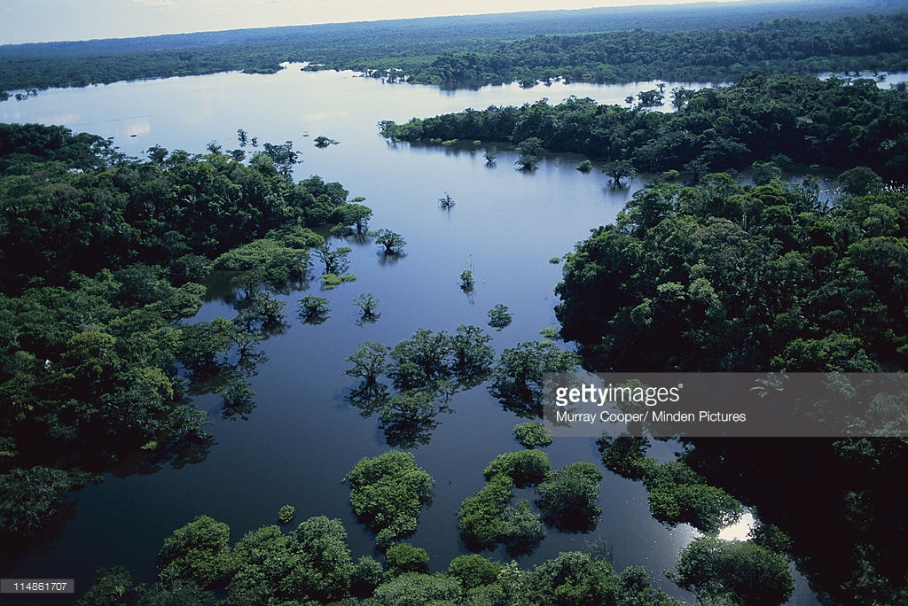
Amazon lowlands
Characterized by an average of about 3500 - 3200 mm of rainfall per year and an average temperature of 23° C.
Dry seasons have lower rainfall than the rest of the year, but even then, rain showers occur and it never becomes totally dry
Flooding
During such high rainfalls, which can last for up to several months, rivers rise above their river’s bed and large areas of forests become flooded.
Fishes enter the forest for feeding and spawning and are followed by the Amazon dolphins.
Notes:
Andes flanks: where the tropical winds are forced up; as they rise, rain is forced from the clouds to extremely high annual rainfalls

Slide 6
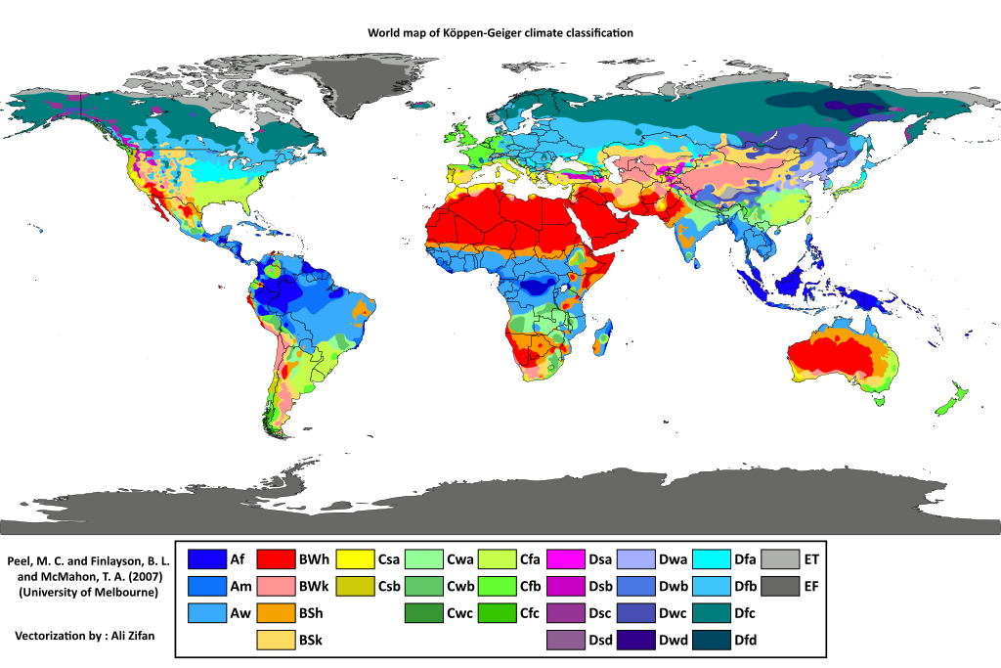

Slide 7
Köppen’s classification
Vegetation-based climate classification system developed by German botanist-climatologist Wladimir Köppen to define climatic boundaries in such a way as to correspond to those of the vegetation zones (biomes).
Köppen’s classification is based on a subdivision of terrestrial climates into five major types and one which includes the not easily categorized climates. This types are represented by the capital letters A, B, C, D, E and H.

Slide 8
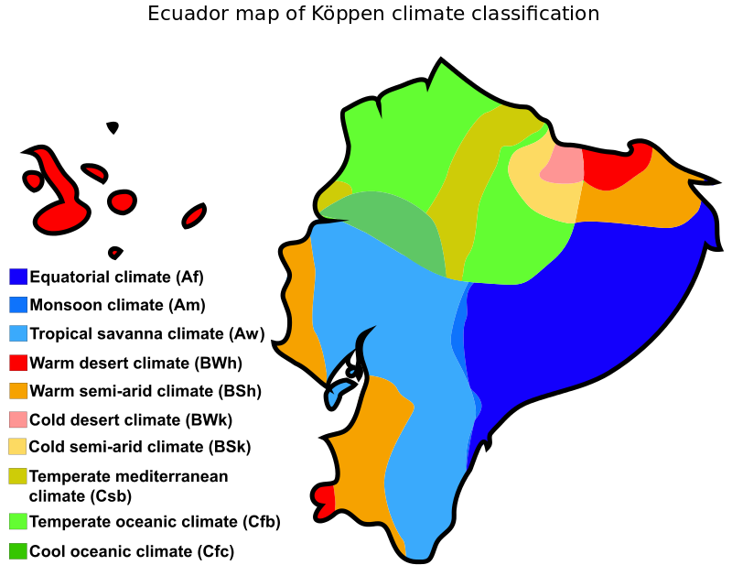
Köppen climate classification
Highlands climate

Slide 9
Conclusions
The climate of Ecuador varies by region, due to differences in elevation and also to the degree (latitude), in proximity to the equator.
The coastal lowlands of Ecuador are typically warm with temperatures in the region of 25 °C.
In the Central Andes valley, there are predominant spring-like weather conditions (16°C) that may vary because of altitude.
Amazon lowlands are characterized by high rainfalls per year and an average temperature of 23° C.
All areas have only two seasons. (Dry and wet).
Coastal areas are affected by ocean currents
Eleven different climates can be identified and four major types from Koppen’s classification: A (equatorial climate), B (tropical arid and semiarid), C (humid subtropical) and H (Highlands).

Slide 10
Bibliography
Arnfield, J. (2016, March 11). Köppen climate classification. Retrieved from ENCYCLOPEDIA BRITANNICA: https://www.britannica.com/science/Koppen-climate-classification
GoEcuador. (2016). Climate in Ecuador. Retrieved from GoEcuador Website: http://www.goecuador.com/ecuador-general-info/ecuador-climate.html
PARKS & TRIBES. (2015). Climate of Continental Ecuador. Retrieved from Cuyabeno National Park Website: https://www.parks-and-tribes.com/ecuador/climate-weather/climate-of-ecuador.htm
ScotDir. (2015). Climate of Ecuador. Retrieved from Society and Life WebSite: http://scotdir.com/home/society-and-lifestyle/climate-of-ecuador

