Slide 1
Global & Regional Climate Change
A presentation on Climate of India
Kishan Aherwar

Slide 2
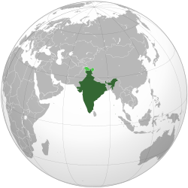
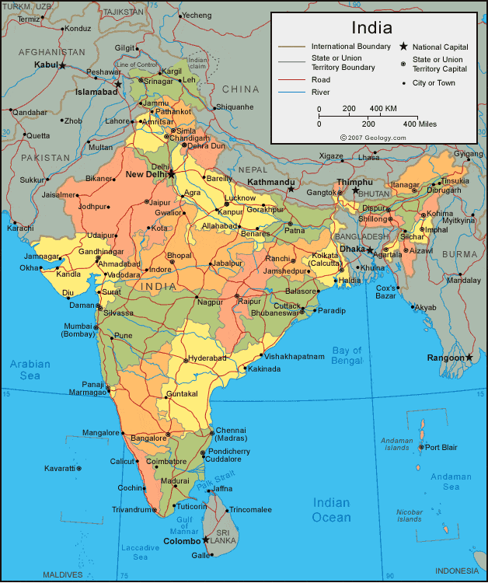
India In The world

Slide 3
Factors effecting climate of India
Latitude
Altitude
Direction of mountains
Distance from sea
Winds

Slide 4
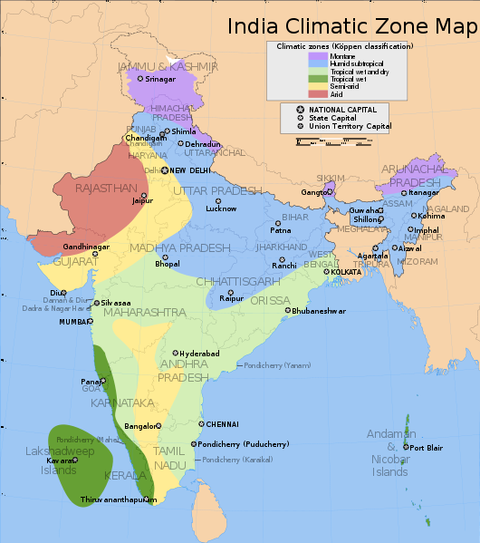
India-Climate zones
Köppen classification
Montane
Humid subtropical
Tropical wet & dry
Tropical wet
Semi arid
Arid

Slide 5
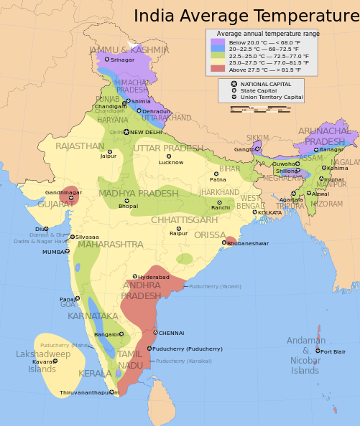
Annual Average temperature
Variations in temperature: While in the summer the mercury occasionally touches 55°C in the western Rajasthan, it drops down to as low as minus 45°C in winter around Leh

Slide 6
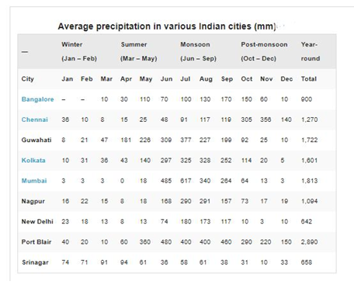
Precipitation

Slide 7
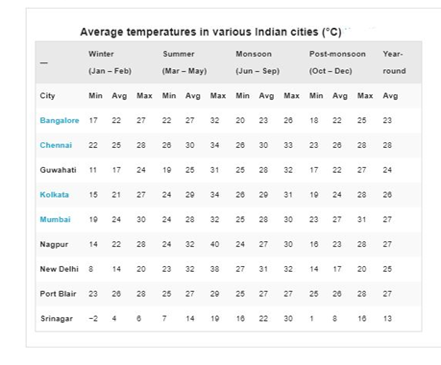
Temperature

Slide 8
Seasons In India-1
Winter, occurring between January and March. The year's coldest months are December and January, when temperatures average around 10–15 °C (50–59 °F) in the northwest; temperatures rise as one proceeds towards the equator, peaking around 20–25 °C (68–77 °F) in mainland India's southeast.
Summer or pre-monsoon season, lasting from March to June (April to July in northwestern India). In western and southern regions, the hottest month is April; for northern regions, May is the hottest month. Temperatures average around 32–40 °C (90–104 °F) in most of the interior

Slide 9
Seasons In India-2
Monsoon or rainy season, lasting from June to September. The season is dominated by the humid southwest summer monsoon, which slowly sweeps across the country beginning in late May or early June. Monsoon rains begin to recede from North India at the beginning of October.
Post-monsoon season, lasting from October to December. South India typically receives more precipitation. Monsoon rains begin to recede from North India at the beginning of October. In northwestern India, October and November are usually cloudless. Parts of the country experience the dry northeast monsoon

Slide 10
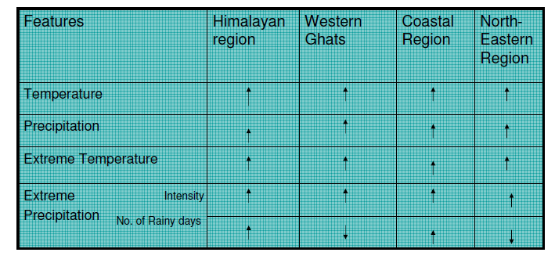
India And Climate Change
Projected Climate Change Parameters in 2030s
with respect to Previous Years.

Slide 11
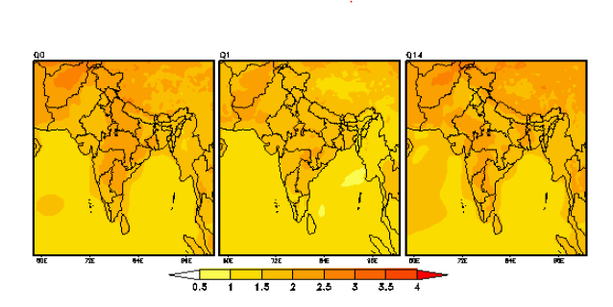
Emerging Results –Temperature Projections
A warming trend is projected for all the
regions till 2030s

Slide 12
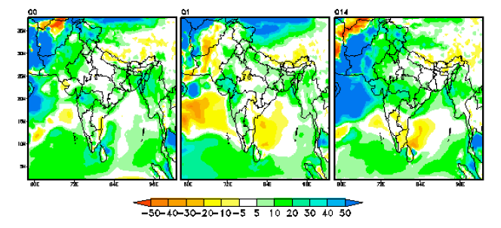
Emerging Results – Projections for Precipitation
The precipitation levels are projected to increase in all regions.
The number of rainy days are projected to decrease, However Intensity is set to Increase

Slide 13
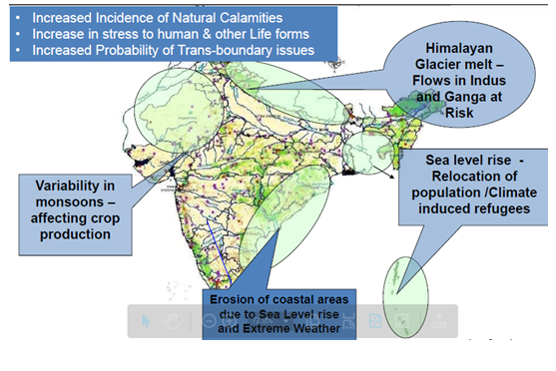
Risk To Ecosystem And People In India

Slide 14
References
Indian Network for Climate Change Assessment (INCCA)
wikipedia.org/wiki/Climate of_India
The energy research Institute (TERI)
Weatherbase

Slide 15
Thank You for Your Attention

