Slide 1
Global Climate Change Climate Change in Azerbaijan
Natavan Gurbanova
Environmental Science

Slide 2
Geographical Location
Azerbaijan shares land borders with Russia, Georgia, Armenia, Turkey and Iran which forms a total of 2,648 kms
Azerbaijan occupies the southeastern part of the Caucasus, descending to the Caspian Sea, between Iran and the Russia
40% of the country is covered by mountain ranges, of which the three major ones are Greater and Lesser Caucasus and the Talysh
The highest mountain is Bazardüzü Mountain which lies in Greater Caucasus range
The country is somewhere between Europe (North) and Asia(South), as the Caucasus mountains are the conventional border between the two continents

Slide 3
Azerbaijan on a map

Slide 4
Climate Formation
Climate types: arid subtropical, humid subtropical, temperate and cold
Sun Radiation
Cold arctic air masses of Scandinavian anticyclone, temperate of Siberian anticyclone, and Central Asian anticyclone
Hot air masses of tropical zones (subtropical anticyclone and southern cyclones), Central Asian anticyclones and local weather conditions

Slide 5
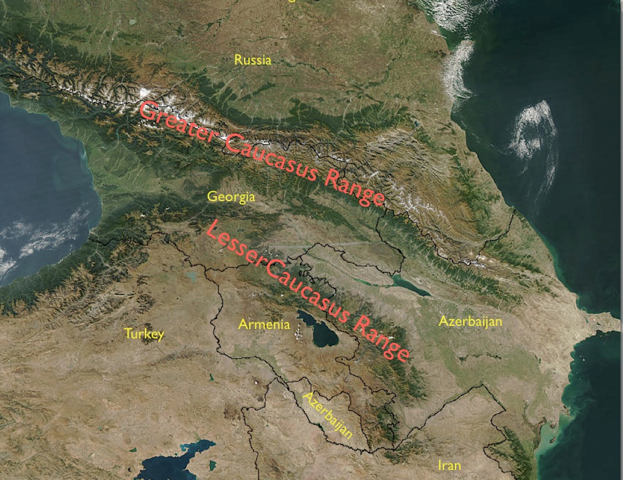
Climate Pattern
Humid subtropical climate type can be observed only in the south of Talysh mountains, it is typical for foothills and Lankaran lowland
Cold climate is observed in high mountain ranges, in the tops of Greater and Lesser Caucasus and alp and sub-alp meadows
Nine out of eleven existing climate zones
minimum temperature (–33 °C / –27.4 °F) (Julfa area)
maximum temperature (+46 °C / 114.8 °F) (Ordubad area)
maximum annual precipitation falls in Lankaran (1,600 to 1,800 mm)
minimum in Absheron (200 to 350 mm)

Slide 6
Average min and max Temperature/Average monthly Sunhours over the year

Slide 7
Average monthly Precipitation/Average monthly Rainy Days over the year

Slide 8
Average Humidity/Average Wind Speed over the year

Slide 9
Climate Change impacts
Forest decrease
Water Resources 15-20%
Increasing temperature
Shrinking glaciers 50% (last century)
Sea level rise, reduction and redistribution of river flows
Decreasing snowfall and an upward shift of the snowline
Flood
Droughts

Slide 10
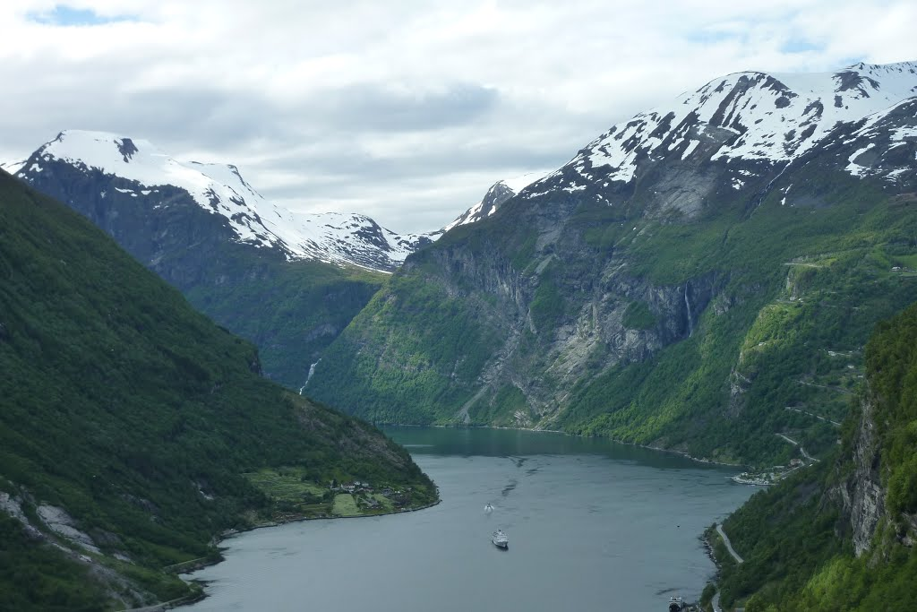
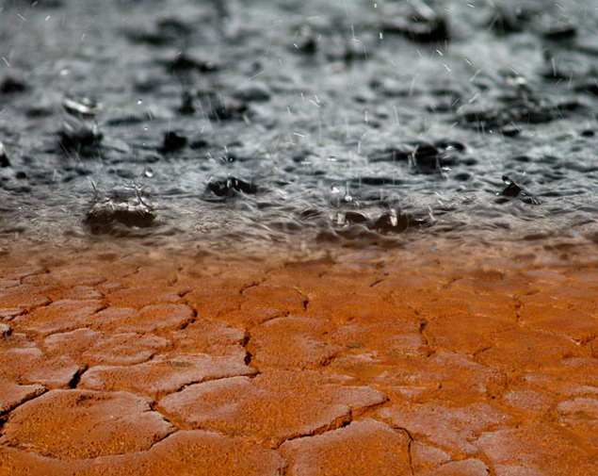
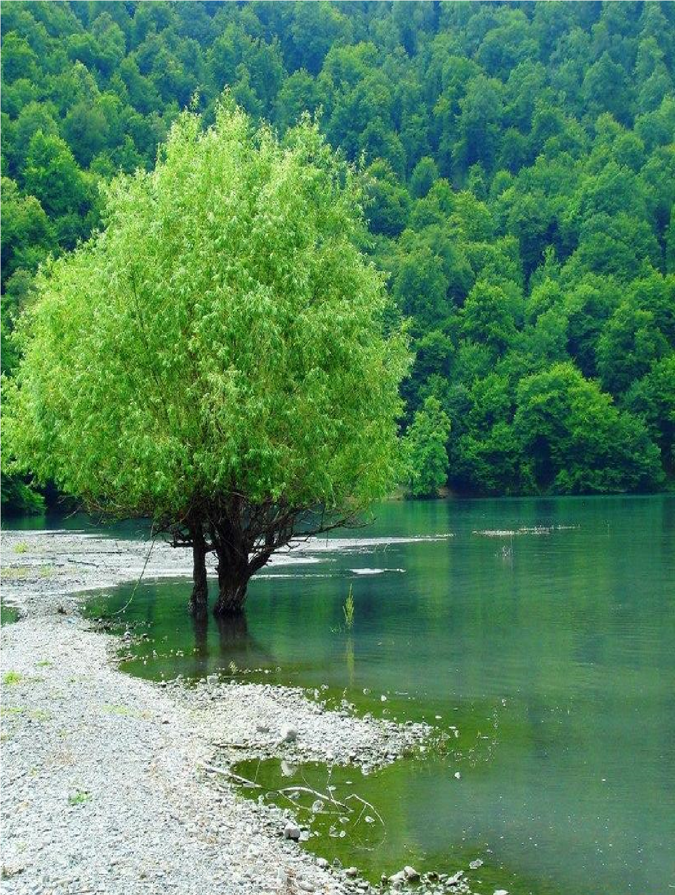

Slide 11
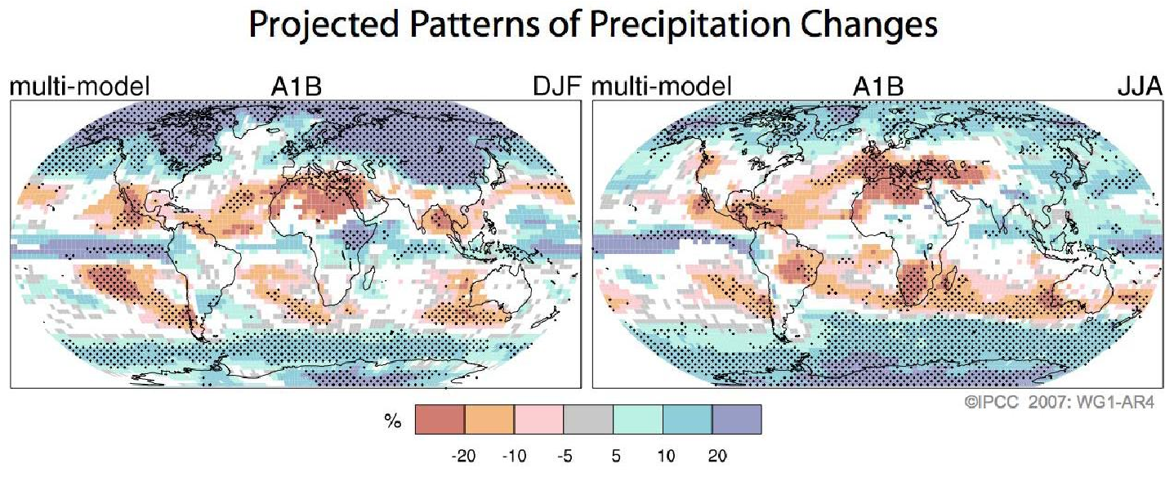
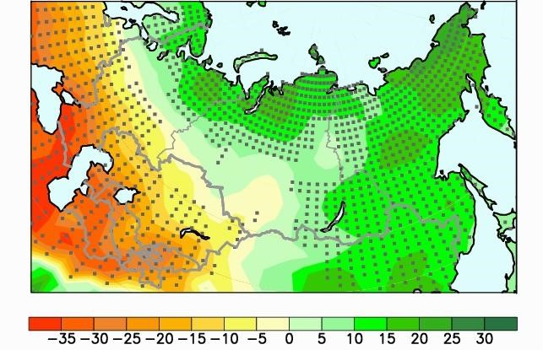
Future impacts of climate change
According to the UNIPCC forecast :
average temperature is expected to increase between 2 and 4ºC : 4.1-5.8 ºC by 2100
Precipitation will decline between 10 and 20%, Azerbaijan a decrease of up to 19% (with more rainfall in winter and less during summer)
Changes in precipitation may increase the current water deficit from 5 km³ to 11-13 km³ 10-15% increased salinisation in the Kura-Araz lowlands

Slide 12
Future impacts of climate change
The forests and alpine ecosystems will show a significant altitudinal shift upwards
Semi-desert and desert areas will expand, river flows decline, agriculture production and livestock breeding will suffer significantly
Extension of semi-desert and dry steppe areas will increase by 2.4 to 3.4 times 10-15%
Increased erosion 10-20% decrease of river flow
Reduced rainfall during spring and summer and increases in autumn and winter
until the end of the century Azerbaijan…

Slide 13
Thank you for your attention…

