Slide 1
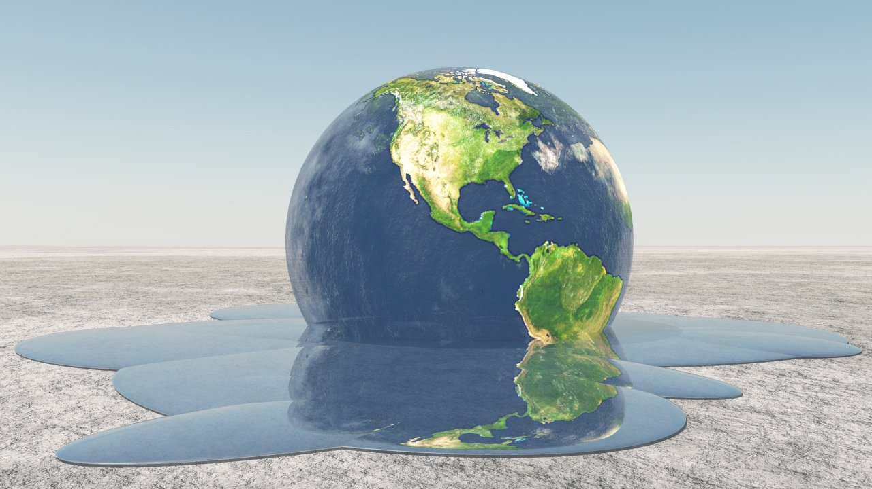
Climate Change in Syria
Prepared By: Salma Wardeh

Slide 2
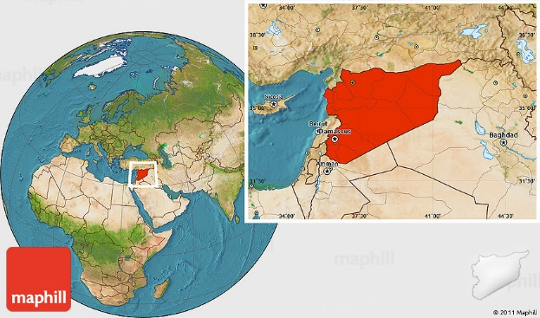
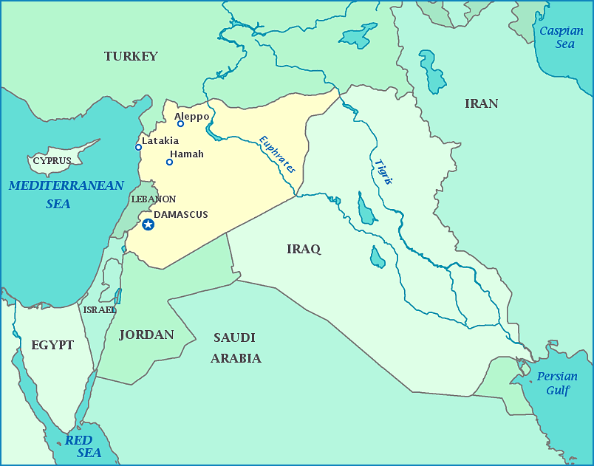
Location of Syria
Syria is located in Southwestern Asia, north of the Arabian Peninsula, at the eastern end of the Mediterranean Sea.
It is bordered by Turkey to the north, Lebanon to the west and southwest, Iraq to the east, and Jordan to the south.

Slide 3
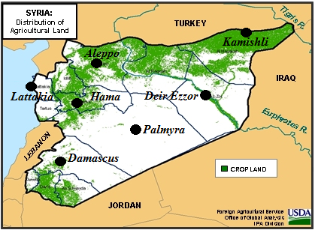
The Climate in Syria
Internal regions have continental and dry climate while coastal regions and the western mountains have moderate climate (extreme heat in summer (42 °c) and very cold in winter.
The winter is mild and the average of daily minimum temperature is 10 ° C while the summer is cool in places where the height more than (600 meters).

Slide 4
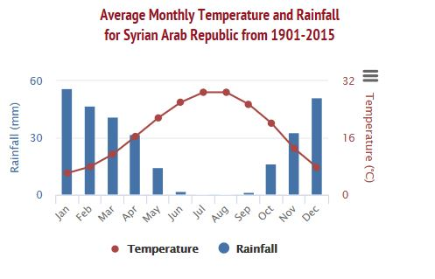
The average temperature in August is about 30 ° C, the average temperature in January is about 4.4° C.
There is a long dry season from May to September from the inland area towards the plains and the Syrian desert which the climate gradually becomes drier.

Slide 5
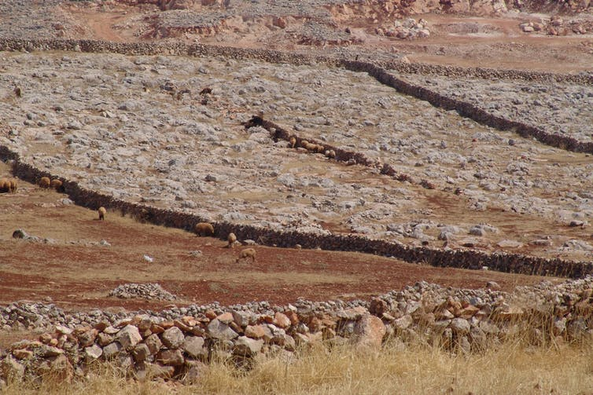
The state of climate change in Syria
The Main features of the ongoing state of climate change in Syria:
High temperature
Decrease in the precipitation rate with disturbance in the distribution and intensity.
Drought and water scarcity in many areas
Migration or internal and external exodus

Slide 6
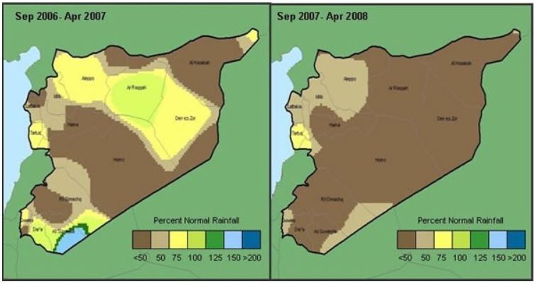
A catastrophic drought occurred during the agricultural seasons 1999-2000 and 2007-2008, which affected thousands of families and livestock breeders.
The continued drought led to the migration of 300,000 people in the northeastern region in 2009.
Most of the health and education indicators in the region declined, The frequency and severity of droughts have led to a decline in available water resources.

Slide 7
The Standard Precipitation Index (SPI) in Damascus Meteorological Station during specific time periods

Slide 8
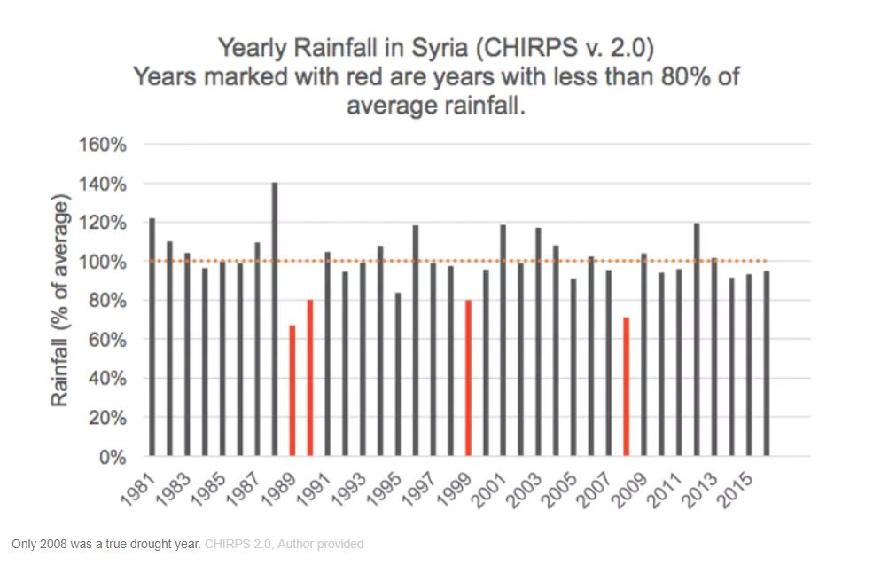
Most of the Syrian cities are currently suffering from a lack of water supplies, and Damascus, which is characterized by its abundant water, is today one of the thirstiest cities in the Middle East. The lack of water raised concerns about food production and increased the danger of desertification in the country.
This year, economists and water specialists warned of “Syria's thirst” during the coming period, due to the fact that the rainfall did not exceed 50% of the annual average in most Syrian regions and the level of water in the Syrian dams has declined. The annual water deficit is estimated at about 6 billion cubic meters.

Slide 9
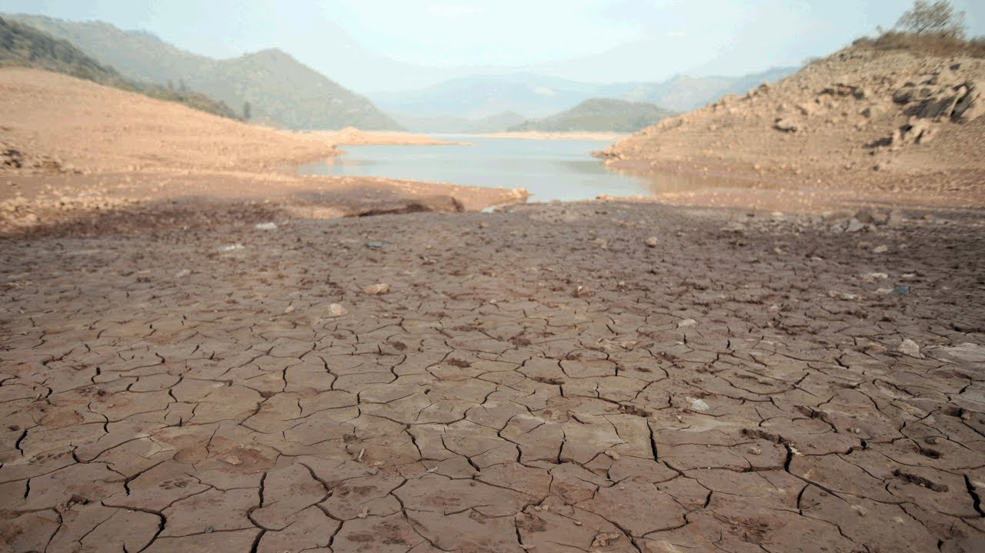
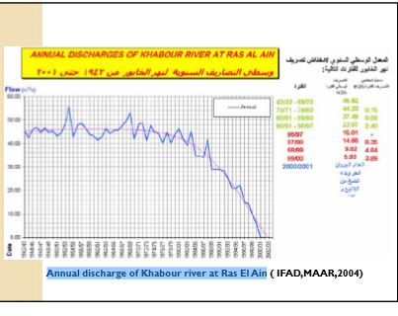
Climate Change Effects
Climate change is occurring in Syria by means of depleting water supply and advancing desertification, both of which are closely linked.
The effects of drought and desertification are further conflated considering that the population of Syria has increased by 50% in the past few years. Increased land use is needed to support this growing population, which contributes to erosion and makes much of the land unusable.
Desertification is directly correlated with the decrease in precipitation and over-grazing of land which have compounded the land desertification process. Desertification is also affecting regions such as the Khabur River in northeastern Syria. The Khabur River is on the opposite side of the country from Damascus, demonstrating the widespread effects of desertification.

Slide 10
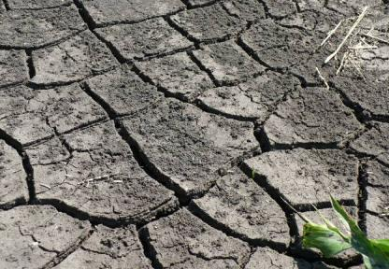
Climate change has affected agricultural systems through:
Drought conditions and limited water resources
Unsustainable agricultural cycles
Mismanagement and neglect of Syria’s natural resources
Main Causes:
Heavily dependence on water-intensive wheat and cotton farming, and encourage inefficient irrigation techniques.
Farmers have sought to increase supply by turning to the country’s groundwater resources, with Syria’s National Agricultural Policy Center reporting an increase in wells tapping aquifers from “just over 135,000 in 1999 to more than 213,000 in 2007.”

Slide 11
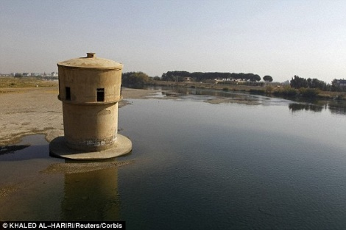
Recommendations
Water policy should focus on demand management rather on supply management.
This means more efforts are needed regarding the enforcement of water legislation, awareness, integration of land and water management through the implementation of integrated water resources management concept ( IWRM).
Changing crop types and introducing more efficient irrigation systems.
Euphrates river in Raqqa city, eastern Syria, is receded.

Slide 12
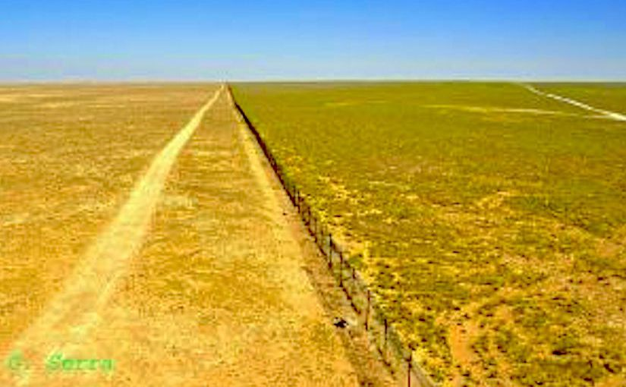
Recommendations
The poor usually are the most vulnerable to the effects of climate change and have the least means to adapt. Therefore, the top priority for adaptation in the water sector would be the reduction in the vulnerabilities of people (particularly the poor and disadvantaged) living mainly in rural areas( about 50% of the Syrian population ) and has as main activity the agriculture.

Slide 13
References
https://osu.pb.unizin.org/sciencebites/chapter/the-effects-of-climate-change-on-the-syrian-uprising/
https://climateandsecurity.org/2012/02/29/syria-climate-change-drought-and-social-unrest/
http://www.lebajica.com/sites/default/files/Impact%20of%20Climate%20Change%20in%20Syria_0.pdf
http://theconversation.com/is-syria-really-a-climate-war-we-examined-the-links-between-drought-migration-and-conflict-80110
http://www.sciencedirect.com/science/article/pii/S0962629816301822
http://sidaenvironmenthelpdesk.se/wordpress3/wp-content/uploads/2015/12/Climate-Change-in-Syria-Final-Draft-Background-Doc-Helpdesk-Env-and-CC.pdf

