Slide 1
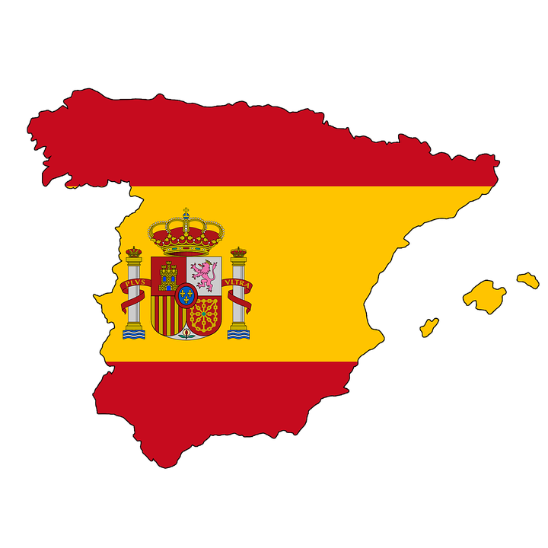
SPAIN
CLIMATE AND FUTURE CLIMATE CHANGE PERSPECTIVES
Santiago Ordoñez
Environmental Science MSc
Notes:
As we know, climate change is continuously increasing, and many countries are taking actions all around the globe.
Spain is in a thin line between acting, that includes many renewable energies projects, and conservation, to a passive state which doesn’t include emission cuts and other actions.

Slide 2
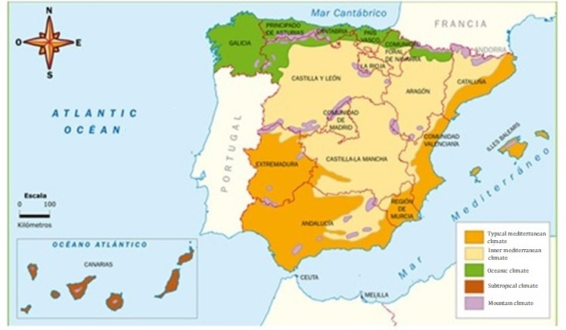
Spain has four seasons in most of its territory during all year. Variety of climates: * Atlantic * Mediterranean * Subtropical * Mountainous - Mediterranean zone: World’s “Hot Spot”.
GENERAL INFORMATION
Notes:
Wide variety of climates
Atlantic: N and NE, Pyrenees to Galicia
Mediterran: Mediterr. Coast, Balearic islands, interior, include typical, dry and cold climates
Subtropical: Canary islands
Mountainous: Pyrenees, Central and Iberic mountains
Mean Tº: Given by latitude, sea influence and altitude

Slide 3
Temperature, Rainfall
Temperature: Annual mean of 15.1 ºC
January 2016: Hottest month
Rain fluctuations from 1233 mm (Northern coast) to 300 mm (Points of Mediterranean coast)
Notes:
As Mediterranean is the common climate, is taken as reference.
Highest Tº in August
Highest Rainfall in November

Slide 4
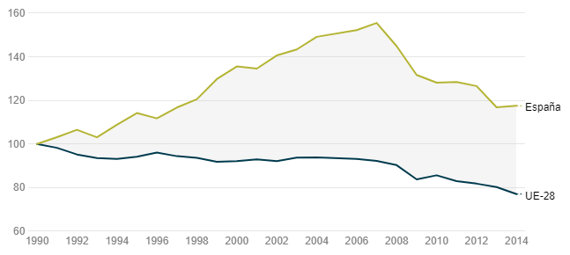
Climate Change: NOW
All European regions are vulnerable.
Spain: Coasts and flood plains -> Critical points
Greenhouse gases emissions (2016): Increasing in 14.5%, compared to 1990.
Equiv. CO2 tons. (1990) | Equiv. CO2 tons. (2007) | Equiv. CO2 tons. (2015) | Equiv. CO2 tons. (2016)
285.9 mill. | 440.03 mill. | 339.5 mill. | 328.7 mill.
2007 (155.51%)
117.54%
Spain
77.06%
EU
Source: European environment agency (EEA)
Notes:
- Critical points due to flooding danger!
Main trend from 1990-2016
UE has steadily reduced its emissions -> Policies and actions taken.

Slide 5
2016: Reduction compared to 2015. Why?
Carbon burning for electricity (30.6% less than 2015)
Extreme Temperatures
Tº ranges are varying continuously.
Extreme Rainfall episodes
December 16-22: 450 mm at one episode.
Summer: 45.4ºC (Cordoba), 44.6ºC (Sevilla) = September
Winter: -11.0ºC (Aragon), -7.3ºC (Valladolid) = December

Slide 6
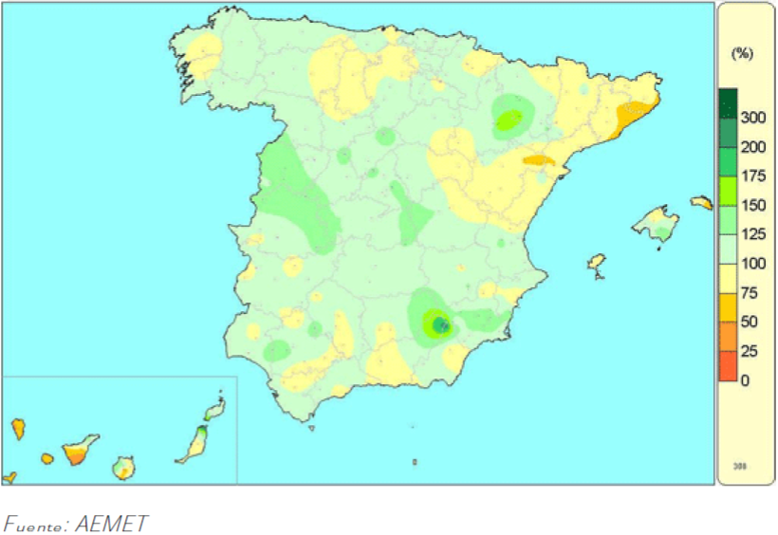
Extreme Rainfall episodes
Percentage of accumulated rainfall in Spain / Period: 1981-2010
Aragon
150-175%
Cataluna
50-75%
Castilla
175-200%
Andalucia
300%
Notes:
Most of the territory remains with the same range, or little increase (100-125%)

Slide 7
Climate Change: FUTURE PERSPECTIVE
Very high certainty | Temperature increase along XXI century
 | Summer Tº increase (mostly inner peninsula)
High certainty | Annual rainfall decrease, end of XXI century (5-25%)
 | Major extreme events out of normal time *
 | 20-40 mm less rainfall during summer and spring (end of XXI century)
 | Droughts moved to spring, lasting more by the XXI century half
Low certainty | Higher winter and autumn rainfalls in western and north-east peninsula.
Source: IPCC (2001)
Notes:
Effects remain mostly the same around the world, but get stronger in different places.
*Xtreme events: Heatwaves, coldwaves, torrential rain, freezings.

Slide 8
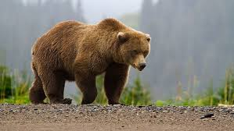
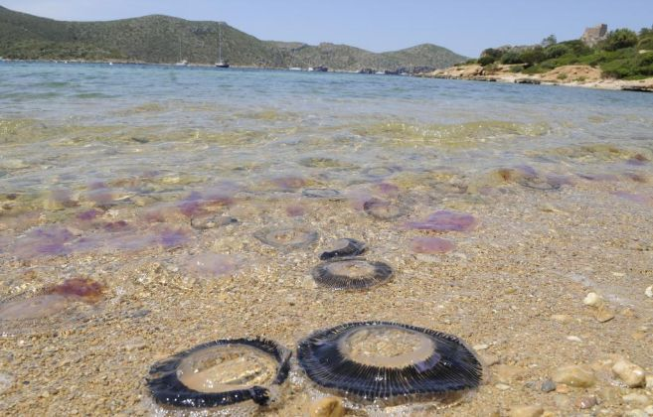
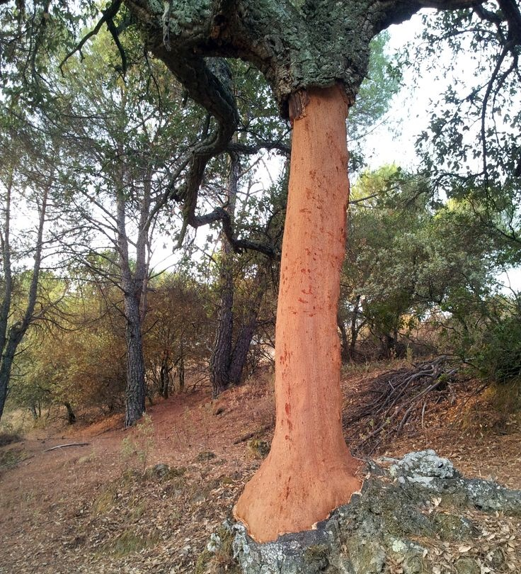
Climate Change: FUTURE PERSPECTIVE
Native species alterations:
Invasive species appearance:
Source: agencia.sinc.es
Source: http://www.elmundo.es
Source: agencia.sinc.es
Notes:
European grizzly bear: Dissapear by the end of the century
Cork oak (soil preserver tree): Lost in Cataluna by year 2100
---------------------------------------------------------------------
Medussas: Weren’t there before, appear and cause tourism and fishery problems

Slide 9
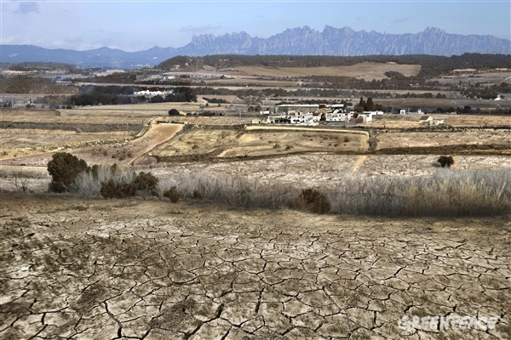
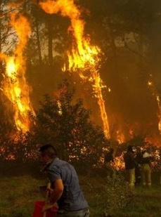
Fires:
Galicia: 305 fires simultaneously
2060: Greater risk (frequency and burned area)
Droughts:
Vineyards and crops: Highly affected
Source: Greenpeace, simulation (2014)
Source: Galicia’s Townhall (2015)

Slide 10
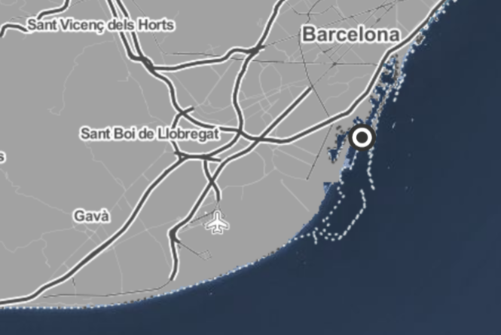
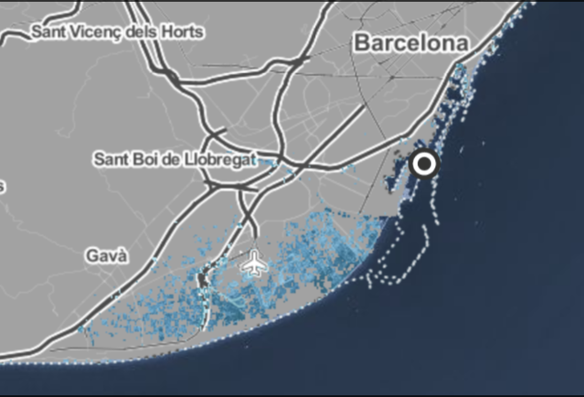
Rising sea levels
Current level 2.5 m. level rise
Fuente: www. climatecentral.org
Notes:
Just to put an example. Barcelona will not be the only affected city!

Slide 11
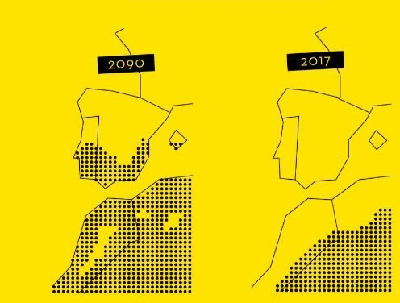
Desertification
Science Magazine:
A >2ºC = Sahara Desert extension.
Source: Science Magazine (2017)
Notes:
Andalucia, Extremadura, Murcia, Valencia; even affecting Algeria and Morocco

Slide 12
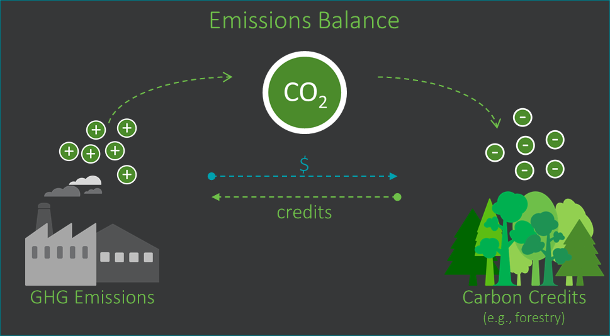
Conclusions
Reduce greenhouse gases emissions, better land use, minimize environmental impact.
Developed countries: Don’t rely on buying carbon credits, this delays actions!
Notes:
Environmental impact (waste, pollution, overpopulation, deforestation)
Carbon credit: Tradable certificate that represents the right to emit 1 tonne of CO2 or Equiv.CO2 tonnes of any greenhouse gas

Slide 13
References
Impacts of Europe’s changing climate. European Environment Agency Report, 2. Copenhague (2004).
Previous assessment of climate change impacts in Spain. Ministerio del Ambiente, Madrid (2005).
Climate of Spain, Víde Javier & Olcina Jorge, (2001).
http://www.aemet.es/es/serviciosclimaticos/datosclimatologicos/valoresclimatologicos?l=6155A&k=and
https://www.enviro-mark.com/news-and-events/newsletter/issue-40-newsletter/carbon-credits-added-value-for-your-brand-and-your-community
Climate change consecuences in Spain, Valladares J., (2006).
http://www.observatoriosostenibilidad.com/
https://ss2.climatecentral.org/index.html#13/41.3164/2.1278?show=satellite&projections=0-RCP85-SLR&level=5&unit=feet&pois=hide

