Slide 1
Climate of Kazakhstan
Ulpan Assen

Slide 2
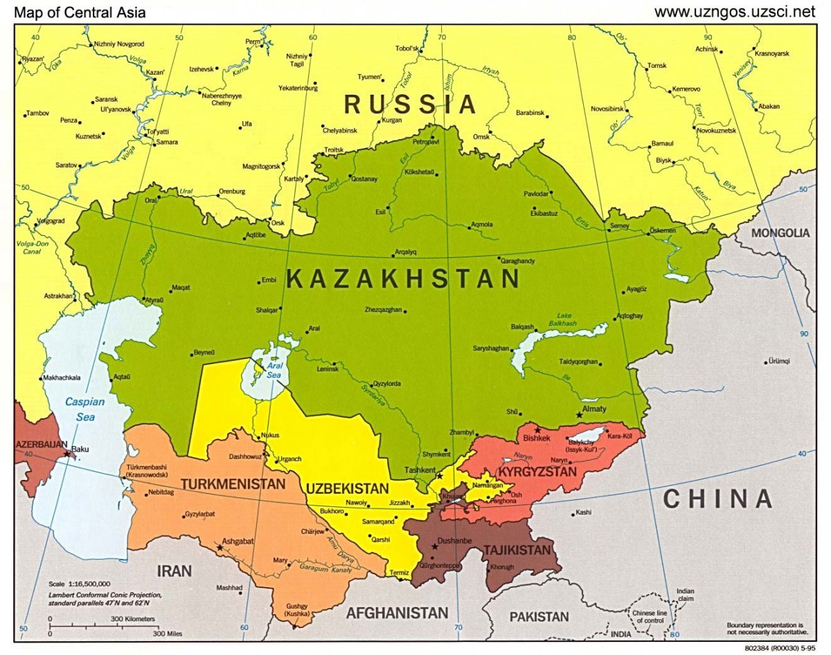
Geographical position of Kazakhstan
The Republic of Kazakhstan is located in the depths of the Eurasian continent (between 55 ° 26 'and 40 ° 56' N and between 45 ° 27 'and 87 ° 18' E). The territory of the republic extends from west to east by 3 thousand km and from north to south - by 1600 km. On the territory of the republic there are natural zones of the temperate zone - forest steppe, semi-desert and desert.

Slide 3
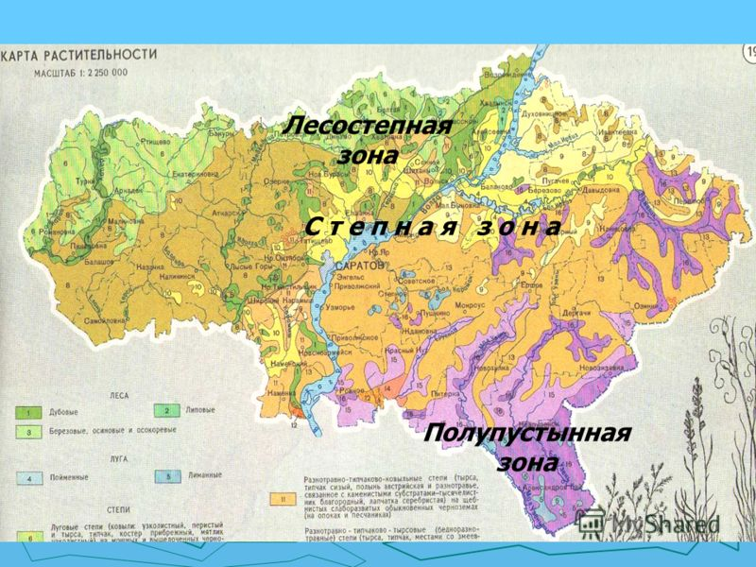
About 26% of the country's territory falls on the steppe, 44% - deserts, 12% - semi-deserts. Forests cover only 3.5% of the territory of Kazakhstan.

Slide 4
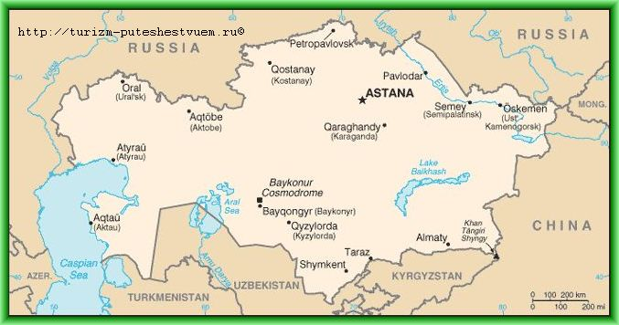
For the relief of Kazakhstan characterized by broad distribution of drainage basins (the Caspian Sea, The Aral Sea, Lake Balkhash), deep depressions and dry hollows.

Slide 5
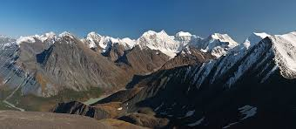
In the south-east of the republic there are mountains whose peaks reach a mark of 5-6 thousand meters above the sea level.
In the Tien-Shan mountain system, the highest point in Kazakhstan - Khan-Tengri peak.

Slide 6
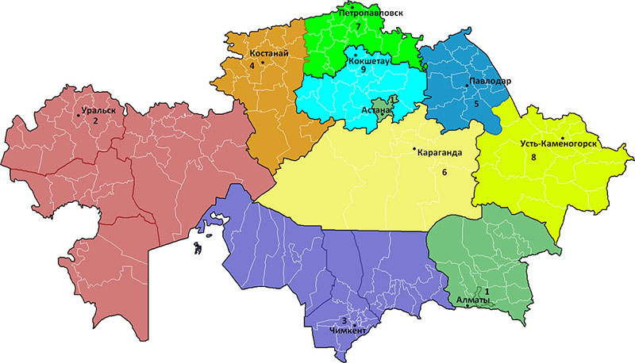
Climate of Kazakhstan sharply continental. In summer the temperature can reach + 45 ° C, and in winter - 45 ° С. In the north falls up to 3000 mm of precipitation, in the mountains – 1600 mm, in deserts less than 100 mm in year.

Slide 7
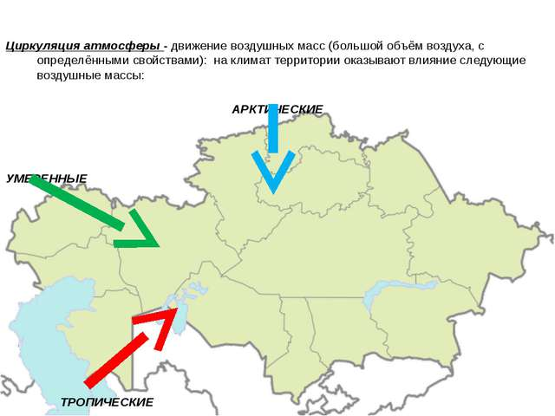
Air masses. The circulation of the atmosphere over the territory of the country is influenced by planetary circulation.

Slide 8
Solar radiation

Slide 9
Precipitation

Slide 10
maximum temperatures

Slide 11
Average temperature and precipitation

Slide 12
Temperature difference in North Kz (Astana) and South Kz (Almaty).

Slide 13
Climate of Astana is sharply continental with arid summer and cold snowy winter. The average annual temperature is 3,2 ° C. The average annual precipitation is 307 mm. Astana is the second coldest capital in the world (after Ulan Bator).

Slide 14
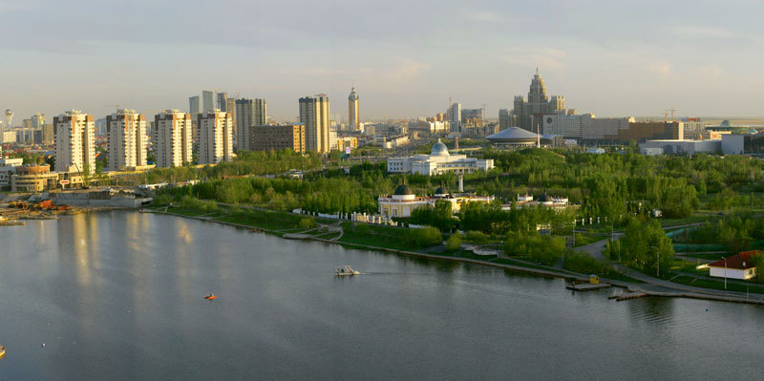
Green Belt around Astana and in Astana.

Slide 15
Due to the green belt around the capital:
There is a decrease in the average wind speed
The frequency of dust storms decreased three-times (from 15 to 5 cases per year)
The frequency of snowstorms decreased from 1.5 to 10 days
Fogs decreased from 35 to 21 cases
The annual rainfall in the region of Astana is gradually increasing
All these changes lead to the fact that Astana's climate becomes softer and more favorable for its residents

Slide 16
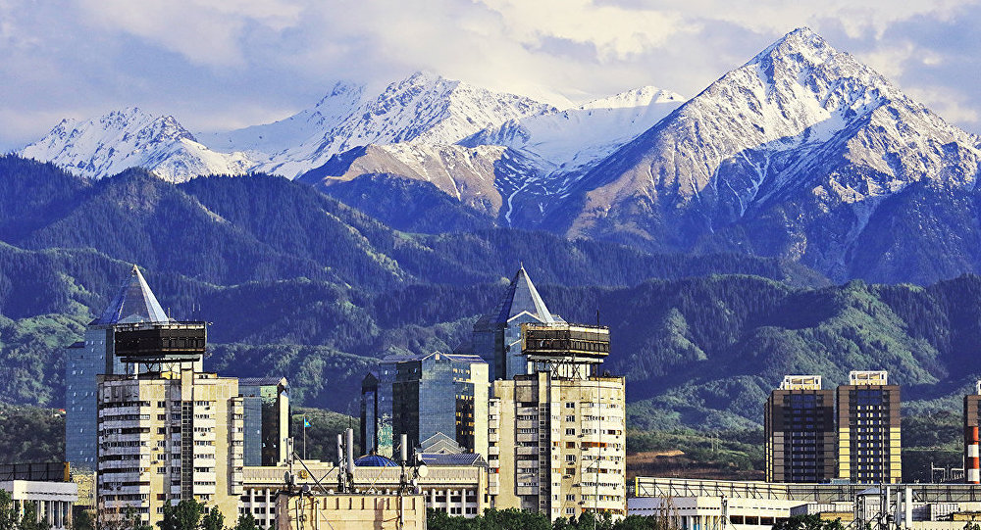
Almaty (Alma-Ata) is the largest and densely populated city. The climate of Almaty is continental and is characterized by the influence of mountain-valley circulation, which is especially evident in the northern part of the city.

Slide 17
According to experts, at present the climate of the city has acquired subtropical features: the summer is suffocating with heavy rains, thunderstorms and storm winds. Winter is warm with puddles and abundant wet snowfall.

Slide 18
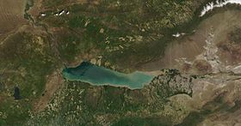
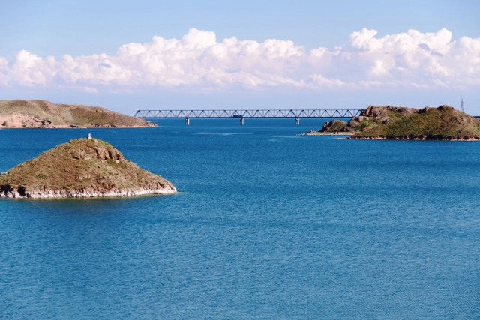
Main reasons why the climate in Almaty begins to acquire characteristic features of the subtropical.
1. Kapchai water reservoir. The reservoir was created to regulate the flow of the Ili River. In the (1965-1980) in the narrow, formed by the rocks Kapchagai gorge, built a dam and Kapchagai HPS. Its length is 180 km, width is 22 km.

Slide 19
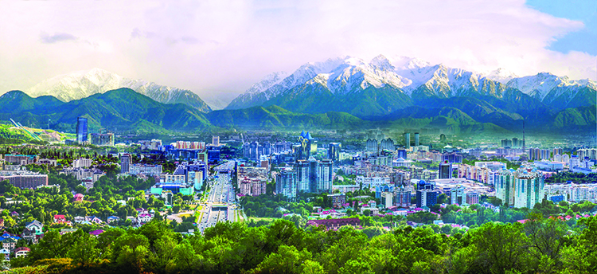
2. City relief and exhaust fumes (anthropogenic impact).
The Almaty is located in the foothill hollow and a small amount of wind makes it difficult to filter the air above the city.

Slide 20
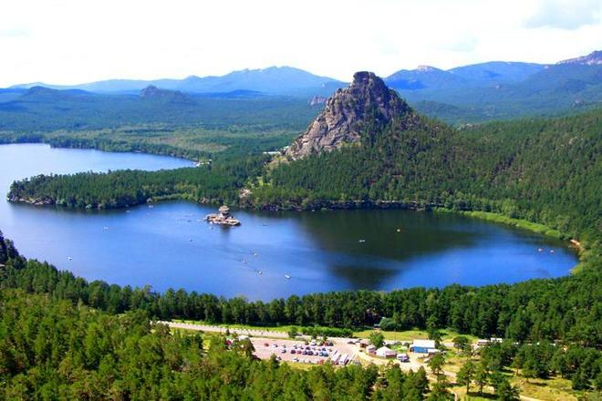
Conclusion
The conducted researches showed that the climate of Kazakhstan also significantly warmed up. From 1941 to 2010, the air temperature increased practically throughout Kazakhstan and throughout the seasons, with the exception of some local areas. At the same time, the average temperature for the year increased every 10 years by an average of 0.31 ° C.

