Slide 1
Global and Regional Climate Change–EEGZ8. The Climate Change Action of Azerbaijan. Abdullayev Məsud – Budapest 2017

Slide 2
Introduction. 1. Sustainable development; 2. General geography of Caucasus region and Azerbaijan; 3. Climate zones and precipitations, arid zones and glaciers 4.The most problematic points on the Climate Change of Azerbaijan; 5.How we can prevent carbon footprint (Inexhaustible energy). 6.Results; 7.References.

Slide 3
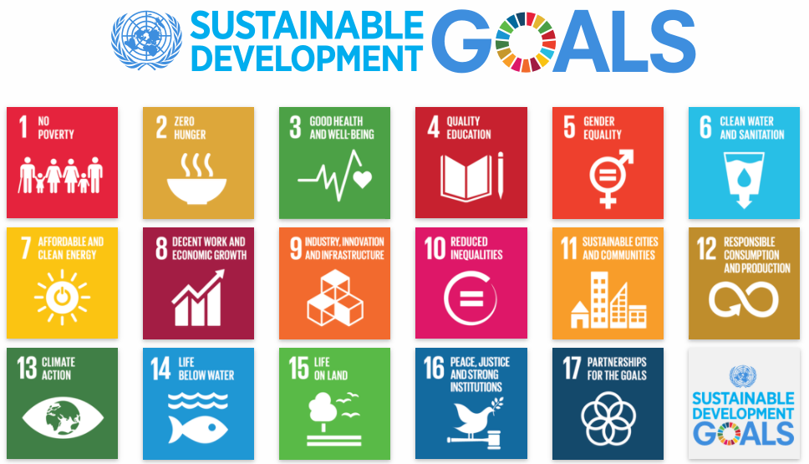

Slide 4
Sustainable development- That’s a kind of green bridge which is trying to get connect between economical development environment, human prosperity etc. Climate change – is an act which in the time of the progress annual temperature average is going to change and doesn’t repeat the previous phenomena. But we can’t prevent that process because as long as term climate change lasts, since when earth became earth (Such as Magnetic polar is moving), however our industrialization is going to accelerate that phenomena. Due to we have to consider other creatures and must think about our new generations.

Slide 5
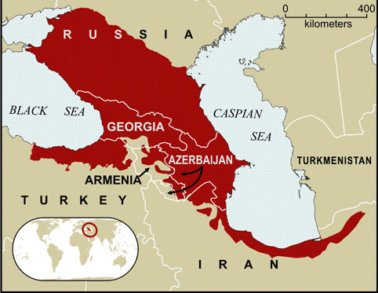

Slide 6
Within the last century the area of the Caucasian glaciers reduced by 36%, and the volume by 48%,despite the fact that 535 glaciers melted. The glaciers became 600 meters shorter on average. Within the last decades (since 1970 through 2000), glaciation conditions in the Caucasus continue to change against a background of the atmospheric precipitation increase by 10-15% and the air temperature increase by 1 degree C. During this period, the area of glaciers decreased by 12%, ice volume by 15%, and the number of glaciers grew up by 2.4%.
Glacier areas of Caucasus and Azerbaijan

Slide 8
Temperature ,climate types and precipitation.
Koeppen-Geiger classification:
The climate of Azerbaijan can be classified as Dfb climate;

Slide 10
Map of the Azerbaijan.

Slide 11
Climate formation in Azerbaijan is influenced by various air masses. Cold air masses, such as the Kara and Scandinavian arctic; Siberian anticyclones. Tropical hot air masses (subtropical anticyclone and southern cyclones), as well as Central Asian anticyclones and local weather conditions have influence.
Absolute minimum temperature (−33°C or −27.4°F) and the absolute maximum temperature (46°C or 114.8°F) were observed in Julfa and Ordubad.
The maximum annual precipitation falls in Lankaran (1,600 to 1,800 mm or 63 to 71 in) and the minimum in the Absheron Peninsula (200 to 350 mm or 7.9 to 13.8 in)

Slide 12
Carbon footprint of Azerbaijan.
Azerbaijan emitted approximately 48 million tCO2e of greenhouse gas (GHG) in 2012 (GoA, 2015), which is about 0.2% of the global GHG emissions. Azerbaijan is a non-Annex I Party to the United Nations Framework Convention on Climate Change .50% comes from fugitive gas in the oil and gas sector, and 24% is from the heat and electricity generation.

Slide 14
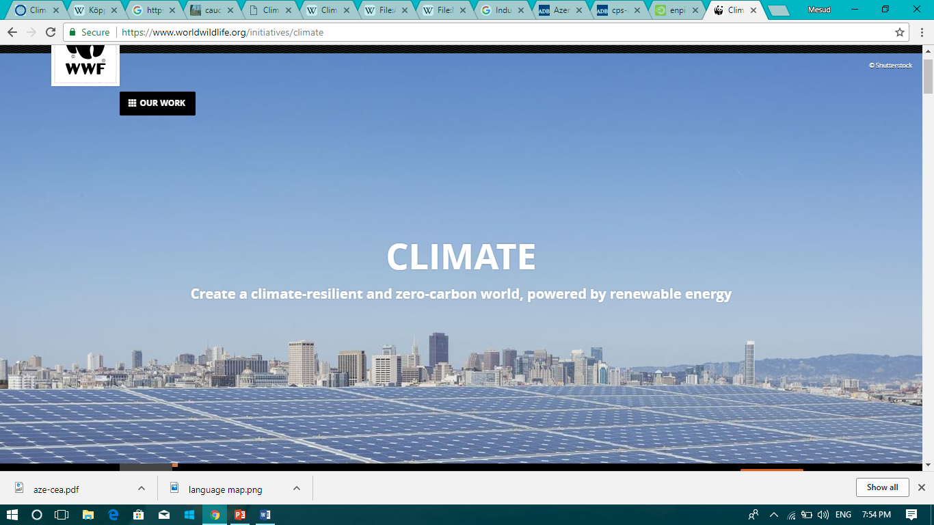
How we can Struggle against Climate change
According to Kiota protocol and other agreements on Climate Change all of independent countries have to do own responsibility.
To use Renewable and inexhaustible energy resources .
To get good knowledge about the environment.

Slide 15
TYPE OF POTENTIAL Of AZERBAIJAN | POWER (MVt)
Solar energy | >5000
Wind energy | >4500
Bioenergy | >1500
Geothermal | >800
LITTLE HYROPPOWER ENERGY STATIONS | >350

Slide 16
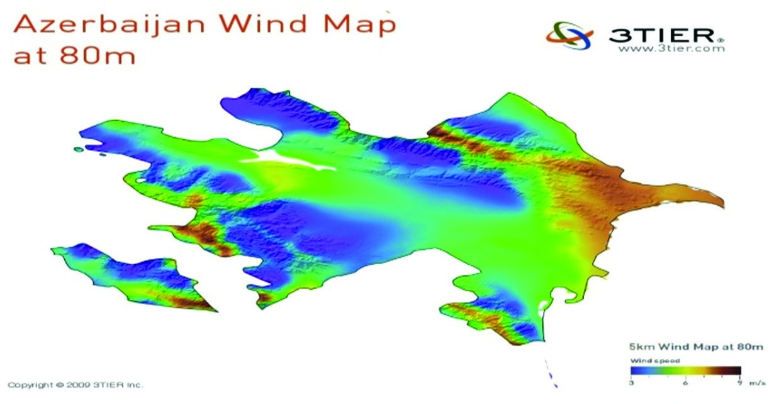

Slide 17
Results. 1.From 1880 to 2012, average global temperature increased by 0.85°C. Oceans have warmed, the amounts of snow and ice have diminished and glaciers are melting. 2.Given current concentrations and on-going emissions of greenhouse gases are increased, Due to The world’s oceans will warm and ice melt will continue. Average sea level rise is predicted as 24-30cm by 2065 and 40-63cm by 2100 in the meanwhile desertification will occur and the the Caspian sea level will decrease. Desertification is going to cover almost 2/3 area of Azerbaijan.

Slide 18
References. 1. climate.nasa.gov 2. eco.gov.az 3. wwf.panda.org 4. www.cepf.net 5. Georgian Biodiversity Country Study Report. 1996. (Manuscr.). Georgian Biodiversity Study Program. Tbilisi: UNEP, Georgian Ministry of Environment and Nature Resources Protection, NACRES. 6. weather-and-climate.com

