Slide 1
Climate change in Albania

Slide 2
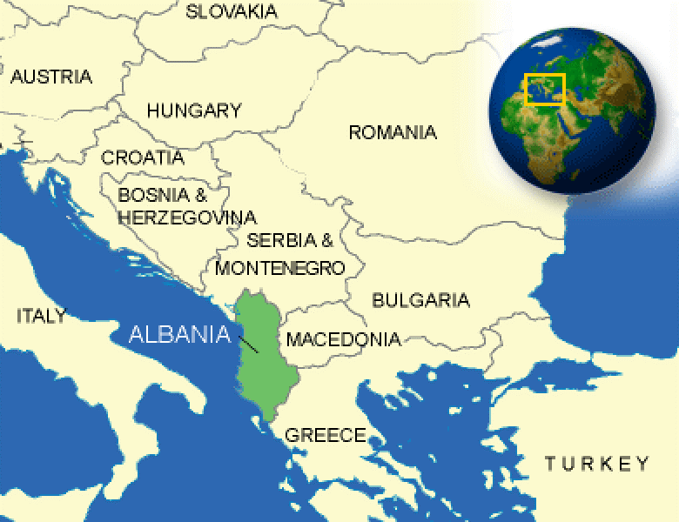
Location & characteristics
Southern Europe
Western part of the Balkan
Peninsula
The capital- Tirana
Total surface- 28 748 km²
Population: 2, 893,005 [1]
Source: http://www.countryreports.org/country/Albania/map.htm

Slide 3
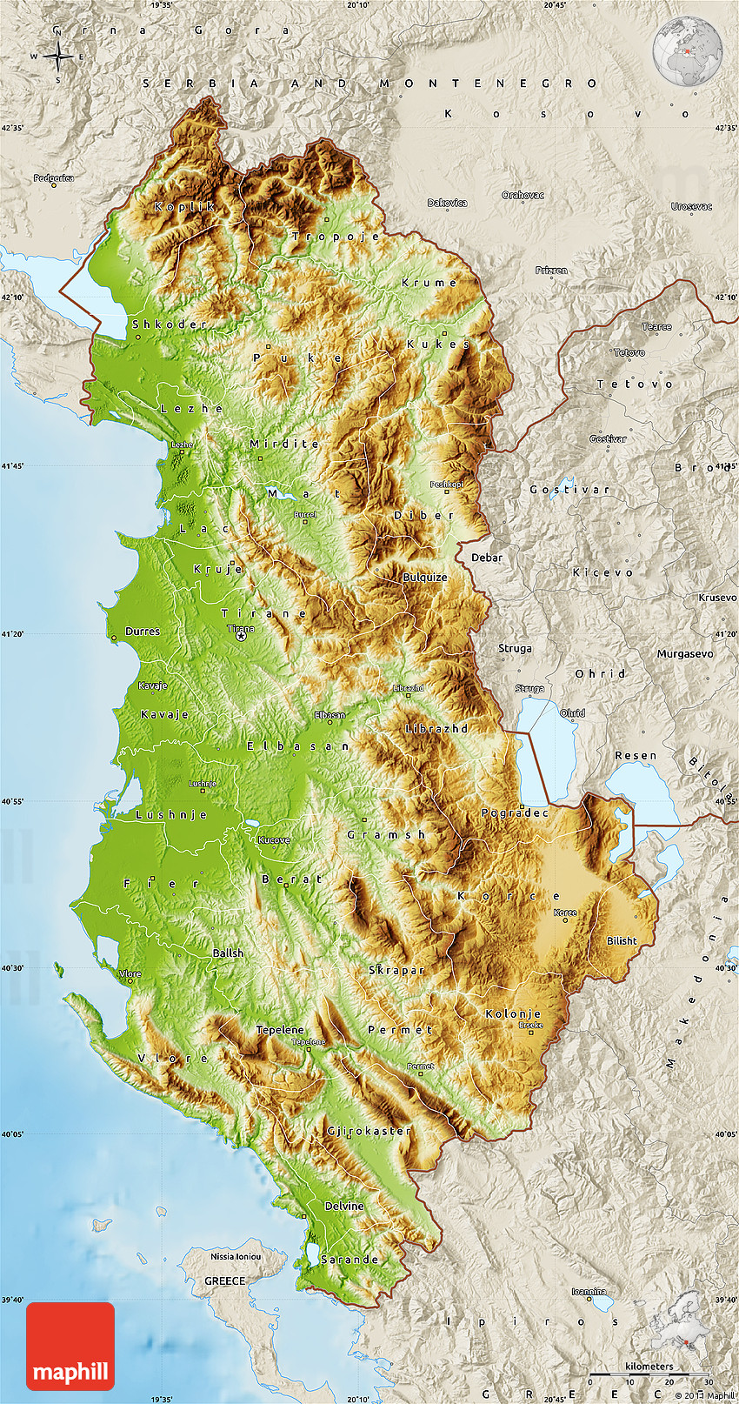
Albanian relief
20% of territory- coastal plains
Remaining- high rugged mountain ranges
Coastline- 476 km (Adriatic and Ionian sea)
Distinguished for biological biodiversity- due to
climatic, hydrological, geological, and topographical
conditions- 30% of flora and 42% of fauna of Europe[2] [3]

Slide 4
Albania‘s climate
Typically subtropical Mediterranean climate
Mild winters with abundant precipitation
Hot, dry summers
The annual mean air temperature varies
from 7°C over the highest zones up to 15°C
in the coastal zone.
South west: 16°C.
Lowland: 12-14 °C
The lowest recorded temperature was -25.8°C
and the highest 43.9°C (2).

Slide 5
The western part of the country, which is under the influence of warm maritime air from the Adriatic and Ionian seas, has more-moderate temperatures than the rest of Albania. The eastern part of the country, on the other hand, is mainly under the influence of continental air and is characterized by mild summers (owing to the high elevations) and cold winters.

Slide 6
Precipitation (abundant)
Total mean annual precipitation :1,485 mm/y
Southeast part of the country :600 mm
The highest precipitation : Albanian Alps: 2,800 - 3,000 mm/y
Mountainous southwest zone (abundant rainfall): 2,200 mm/y
Precipitation levels follow a clear annual pattern, with the maximum in winter and the minimum in summer (2)
Notes:
The highest precipitation total (70%) is recorded during the cold months (October - March). The richest month in precipitation over the whole territory is November, while the poorest are July and August. The number of rainy days (>1.0 mm) per year varies from 80-120 days/year (1).

Slide 7
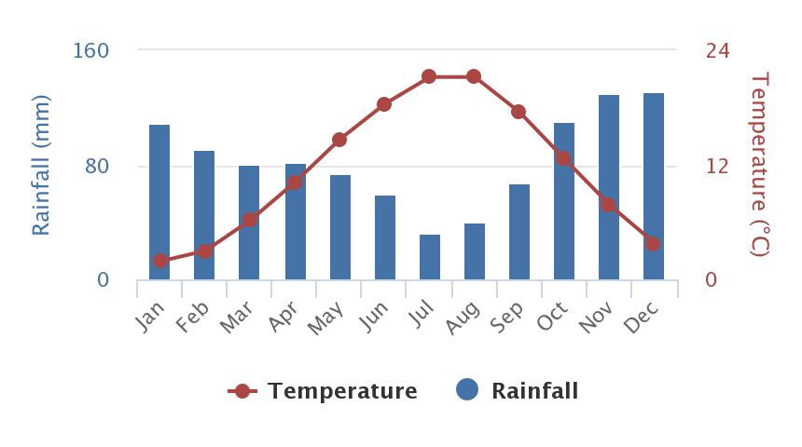
Climate Change Knowledge Portal. The World Bank Group

Slide 10
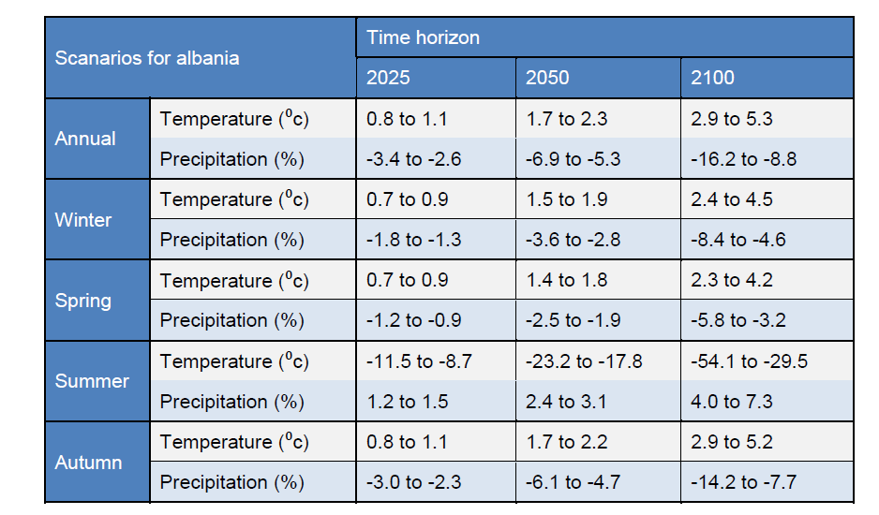
Source: http://drinkadria.fgg.uni-lj.si/externalapp/content/climate/FB11_CC_Albania_national.pdf

Slide 11
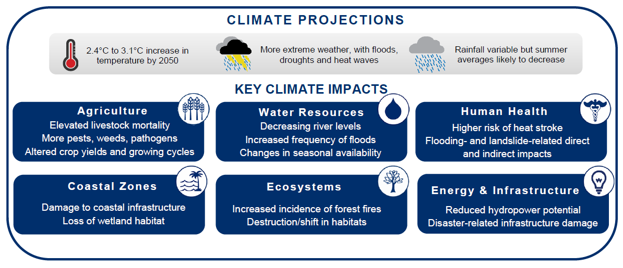
Climate change risk profile Albania: USAID 2016

Slide 12
Albania and climate change issue
Albania joined the United National Framework Convention on Climate Change (UNFCCC) in 1995
January 2005- Kyoto Protocol
First National Communication (2002) and Second National Communication (2009). The second communication focuses on the Drini River Cascade area. Preparation of a Third National Communication began in 2014.
The Ministry of Health’s Albanian Strategy for Health System Adaptation into Climate Change (2011) presents an action plan for 2011–2021.

Slide 13
According to the FNC Albania is a relatively low net emitter of greenhouse gases, with relatively low carbon dioxide (CO2) emissions per capita, mainly due to the fact that over 90 percent of electricity is generated by hydro-sources. The energy sector contributes more than 60 percent of total emissions. Relatively high CO2 emissions per GDP are explained mainly due to high energy intensity. Based on the predictions for future emissions, by 2020 total emissions will rise by more than five times over. Although Albania has made no commitments to reduce GHG emissions, the NAP aims curb their growth.

Slide 14
References
http://www.instat.gov.al/media/1285/population_of_albania_1_january_2017.pdf
http://dspace.epoka.edu.al/bitstream/handle/1/372/649-1923-1-PB.pdf?sequence=1
https://www.climatechangepost.com/albania/biodiversity/
http://drinkadria.fgg.uni-lj.si/externalapp/content/climate/FB11_CC_Albania_national.pdf
http://archive.rec.org/REC/Programs/ClimateChange/Docs/country-assessment-report-albania.pdf
http://sdwebx.worldbank.org/climateportal/index.cfm?page=downscaled_data_download&menu=historical
http://www.weatheronline.co.uk/weather/maps/city?3&WMO=13615&INFO=0&PAG=0&LEVEL=160
https://www.meteoblue.com/en/weather/forecast/modelclimate/tirana_albania_3183875
https://www.eea.europa.eu/soer/countries/al/climate-change-mitigation-state-and
http://sdwebx.worldbank.org/climateportal/index.cfm?page=country_future_climate&ThisRegion=Africa&ThisCcode=ALB

Slide 15

FALEMINDERIT
THANK YOU
KÖSZÖNÖM

