Slide 1
Cerrado, the Brazilian Savanna
Aa2n1150e - Global and regional climate change
-Matheus Carlo Costa

Slide 2
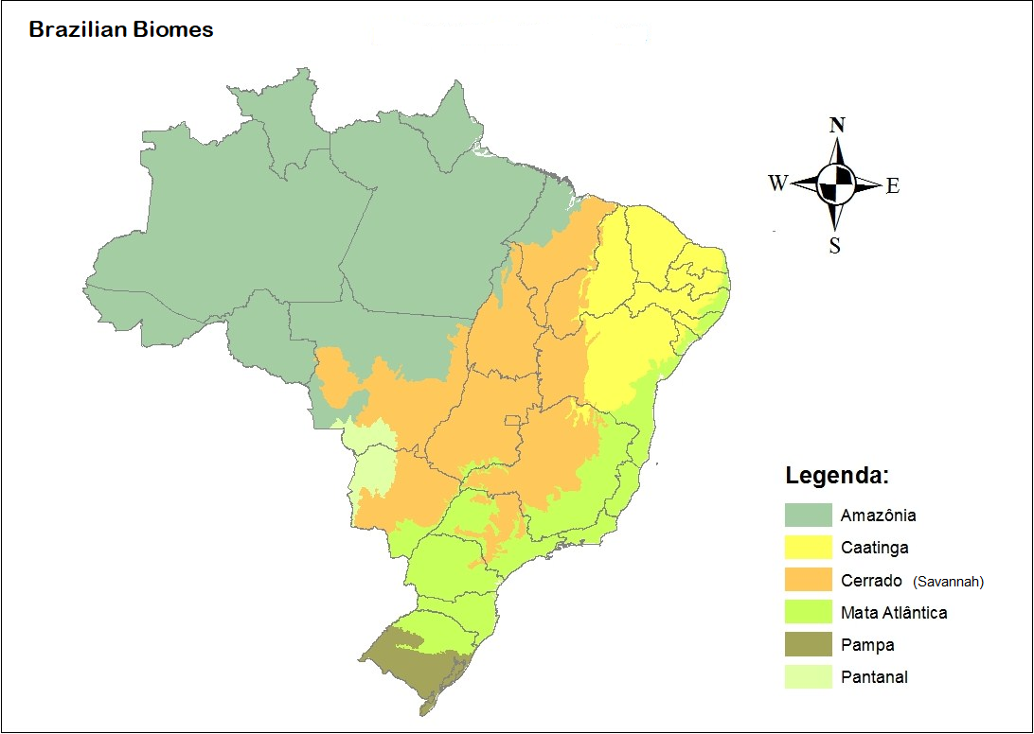
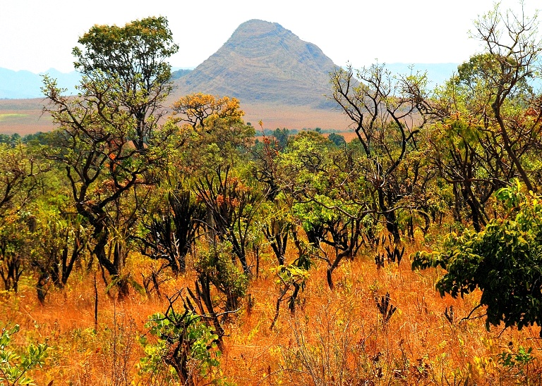
Figure 1 - Map of the brazilian biomes.
Biomes

Slide 3
Cerrado, Brazilian Savannah
Covering 2 million km², or 21% of the country's territory, the Cerrado is the second largest vegetation type in Brazil after the Amazon. (The area is equivalent to the size of England, France, Germany, Italy and Spain combined).
More than 1,600 species of mammals, birds and reptiles have been identified in the Cerrado.
Today approximately 29.8 million people lives in the savannah (16,2% of the brazilian population).
The capital of Brazil, Brasilia is located in the heart of the cerrado.

Slide 4
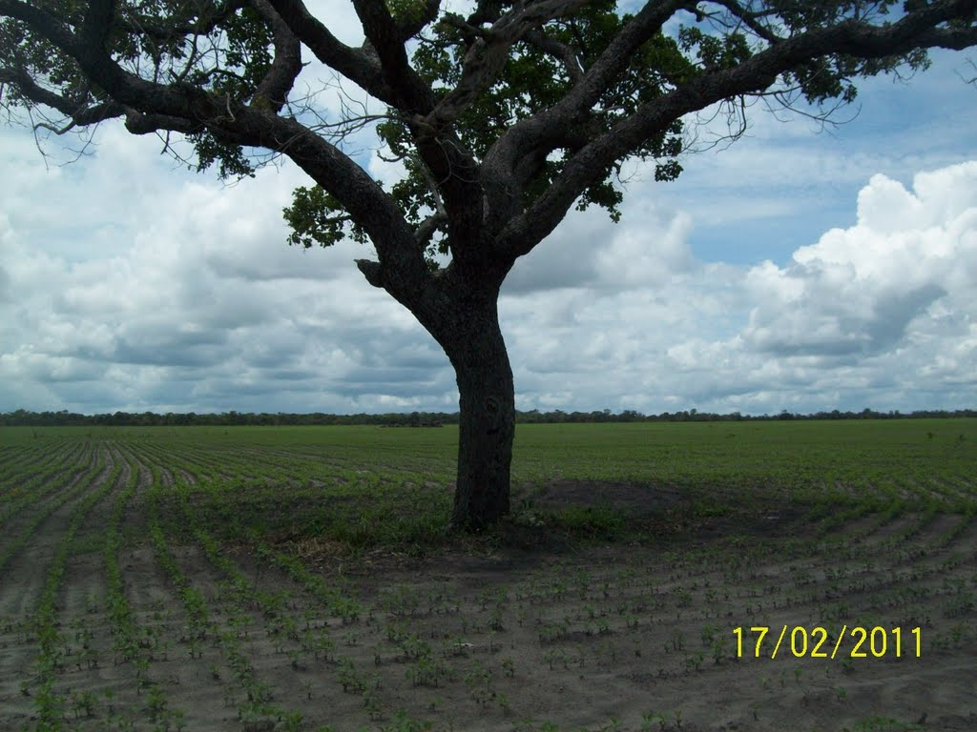
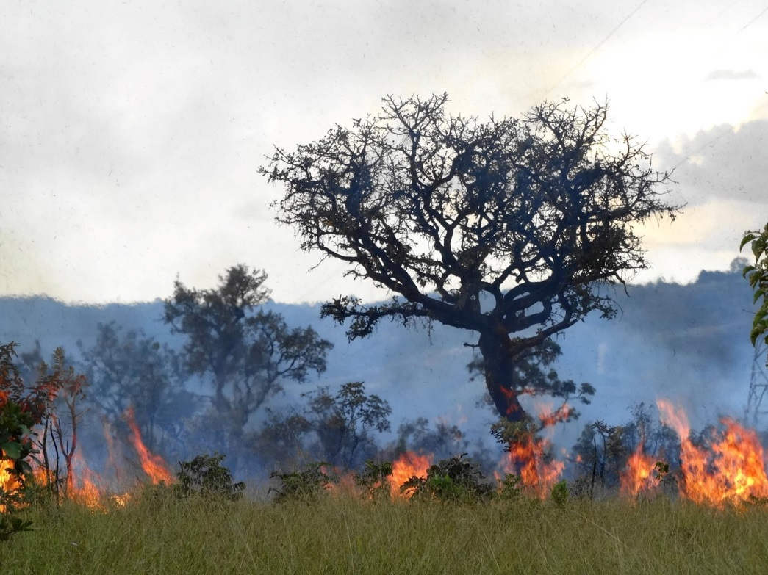
Only 20% of the Cerrado's original vegetation remains intact; less than 3% of the area is currently protected by law.
Figure 2 – Left: Single tree preserved in a soy plantation. Right: Fire in the cerrado.

Slide 5
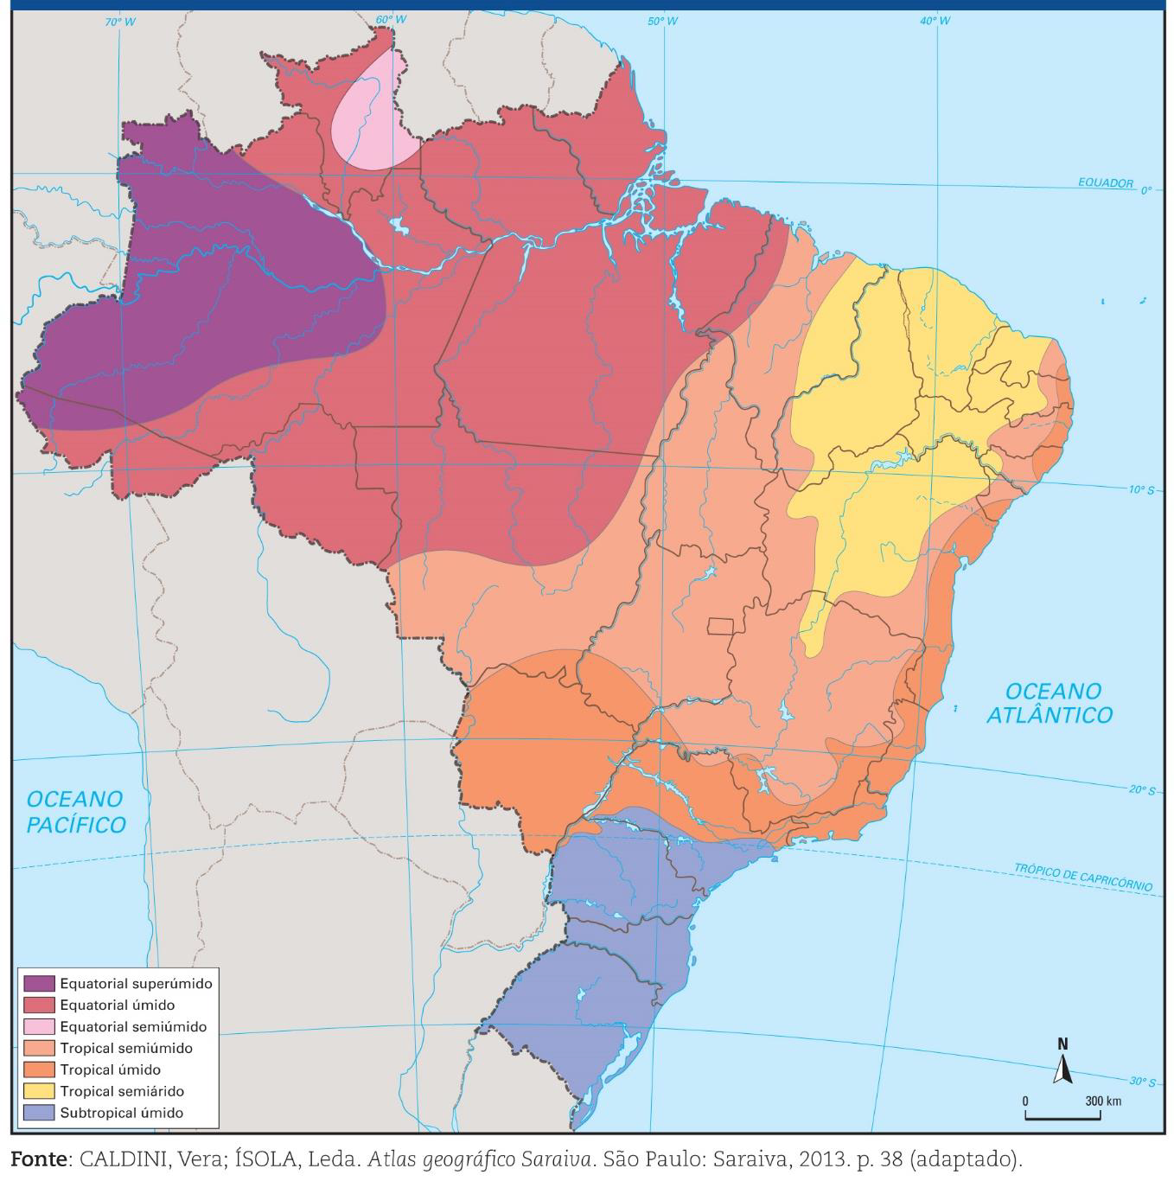
Climate
The climate in the midwest part where the cerrado is situated is humid tropical with seasonal rains.
Figure 4 – Brazil Climate.

Slide 6
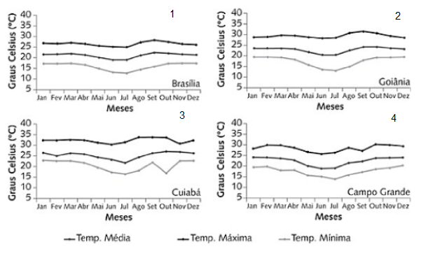
Figure 4 – Annual average maximum, mean and minimum temperature in four meteorological stations.
Figure 5 – Average maximum temperature a)Summer b) Spring
c) Winter d)Autumn period 1961-1990.

Slide 7
Figure 6 – Average minimum temperature a)Summer b) Spring
c) Winter d)Autumn period 1961-1990.

Slide 8
Figure 7 – Average temperature (left) and Temperature anomalies (right),
National Institute of Meteorology (www.inmet.gov.br/portal).

Slide 9
Figure 8 – Total cumulative (left) and anomalies (right) precipitations maps. National Institute of Meteorology (www.inmet.gov.br/portal).

Slide 10
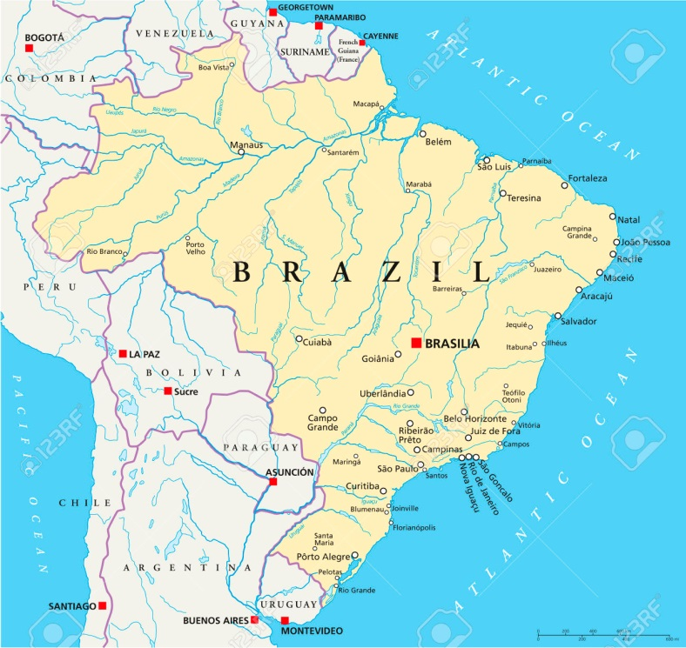
Brasília, the capital.
Brasília is the federal capital of Brazil, the city is located at the brazilian highlands in the country's center-western region.
Founded in 1960.
Elevation 1,172m.
Population 2,977,216 inhabitants.
Figure 9 – Brazil map, Brasília highlighted in red.

Slide 11
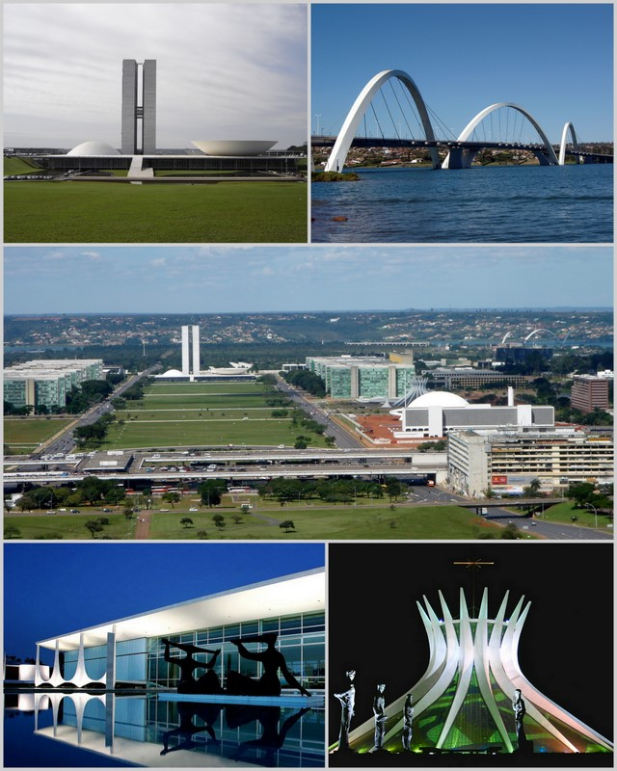
Figure 10 – Brasília maps, airplane shape is highlighted in yellow (Google maps)
Figure 11 – Touristic attractions.

Slide 12
Two distinct seasons: the rainy season, from October to April, and a dry season, from May to September.
The average temperature is 20.6 °C
September, at the end of the dry season, has the highest average maximum temperature, 28.3 °C

Slide 13
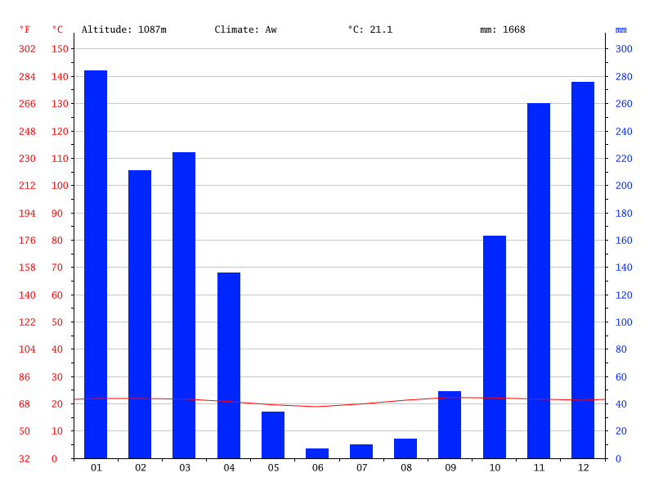

Slide 14
Perspective for the Future
Use of RCM (Regional Climate Models)
Reduction of rainfall in Amazonia as well as an small increase in rainfall in various regions of South America during 2071-2100.
in some models increases of up to 6-8 ºC warmer than the present by 2100, and with the degree of warming varying among models
The expected warming for South America varies from 1°to 4°C.

Slide 15
Figure 12. Projections of annual rainfall (mm/day) and air temperature for 2071-2100 relative to 1961-90, as produced by the ensemble of the 3 regional models: Eta CCS, RegCM3 and HadRM3P regional models

Slide 16
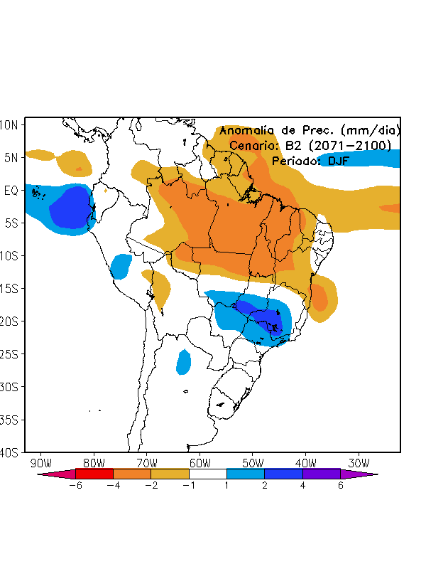
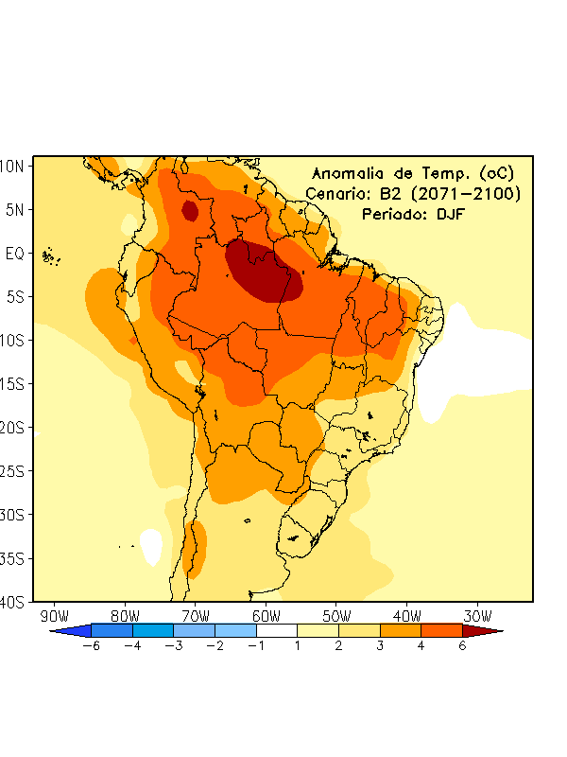
Figure 13 – Prediction of Precipitation (Left) and Temperature anomalies (right) for Summer 2071-2100. Global Model HadAM3P.

Slide 17
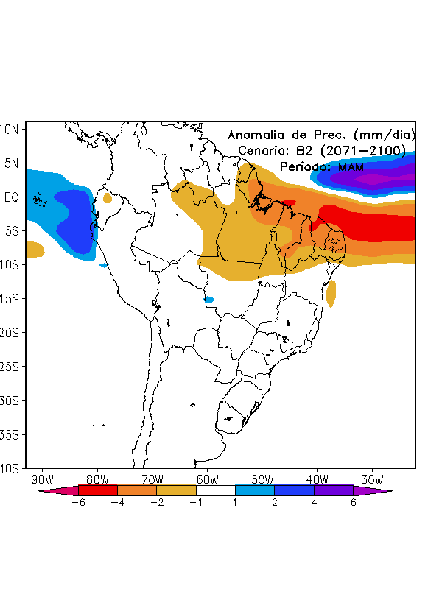
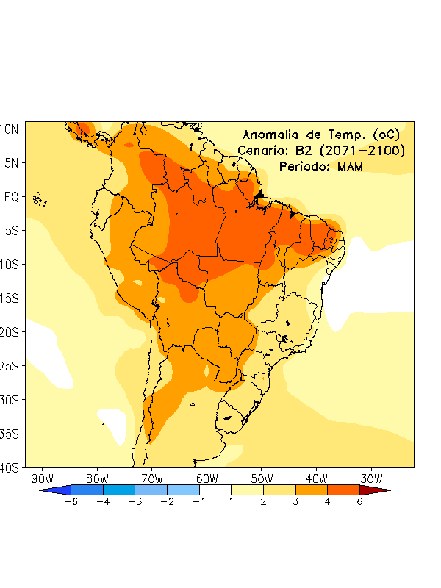
Figure 14 – Prediction of Precipitation (Left) and Temperature anomalies (right) for Autumn 2071-2100. Global Model HadAM3P

Slide 18
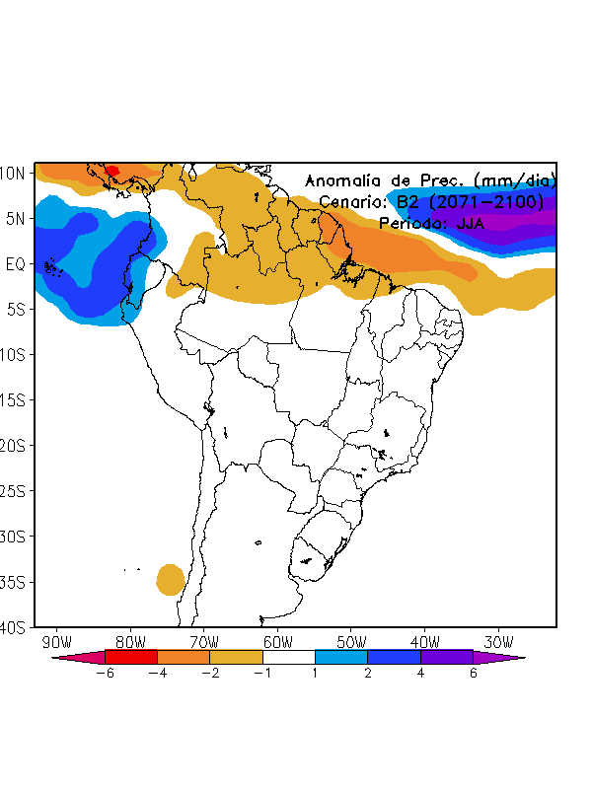
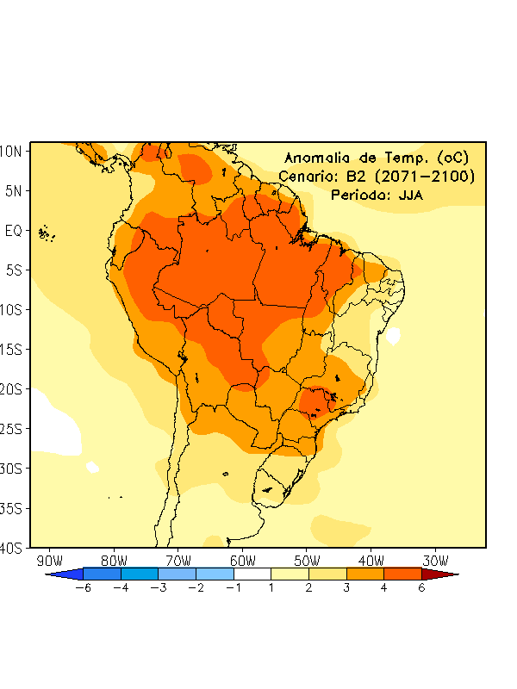
Figure 15 – Prediction of Precipitation (Left) and Temperature anomalies (right) for Winter 2071-2100. Global Model HadAM3P

Slide 19
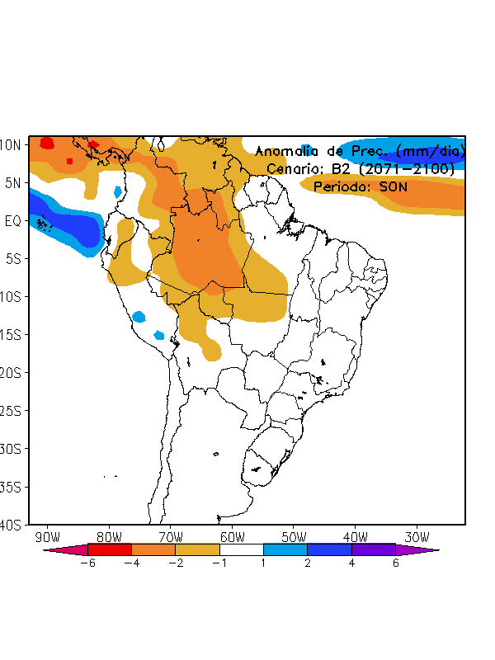
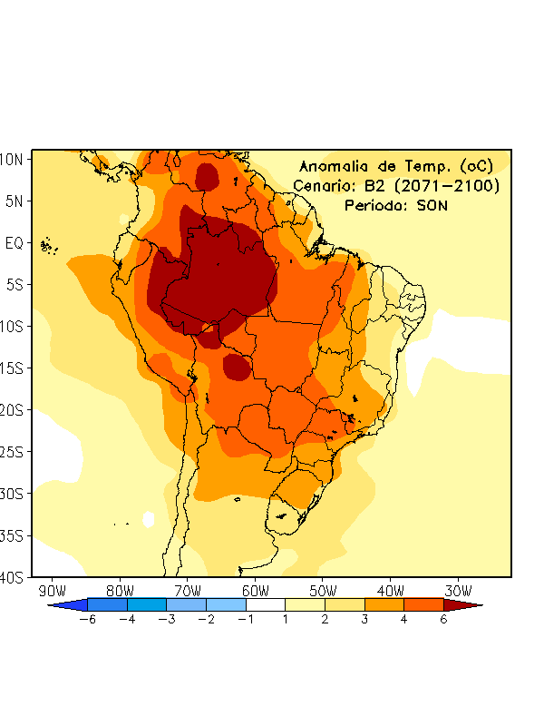
Figure 16 – Prediction of Precipitation (Left) and Temperature anomalies (right) for Spring 2071-2100. Global Model HadAM3P

Slide 20
Figure 17 - Prediction of temperature anomalies for december 2017-January 2018 by the National Institute of Meteorology.

Slide 21
Figure 18 – Probabilistic Prediction of precipitation for december 2017-January 2018 by the National Institute of Meteorology.

Slide 22
references
Marengo (2006) Regional Climate Change Scenarios for South America-The CREAS project. CPTEC/INPE.
Ambrezzi et al (2007). Cenários regionalizados de clima no Brasil e America do Sul para o século XXI: Projeções de clima futuro usando três modelos regionais. Relatório 3.
Marengo J.A. Ramírez V.(2014). Caracterização do clima no Século XX e Cenário de Mudanças de clima para o Brasil no Século XXI usando os modelos do IPCC-AR4.
NOBRE, C. A.; SALAZAR, L. F.; OYAMA, M.; CARDOSO, M.; SAMPAIO, G.; LAPOLA, D. Climate change and possible changes in the biomes of South America –Report nº 6. São Paulo, 2007.
http://wwf.panda.org/what_we_do/where_we_work/cerrado/
http://www.florestal.gov.br/snif/recursos-florestais/os-biomas-e-suas-florestas
NATIONAL INSTITUTE OF METEOROLOGY (www.inmet.gov.br/portal)
Gans P.S. (2017)Climate in Brazil:present and perspective for the future.

